Slide 1
ISLAM PAPER 8 REVISON

Slide 2
Environmental and medical issues
The Environment
Infertility Treatment
Transplant Surgery

Slide 3
Islam and the Created Environment
Islam teaches that the universe and everything in it was created by God as a place perfectly suited to human life.
The Qur’an states: ‘The sun and moon follow courses exactly computed; And the herbs and the trees – both alike bow in adoration… He has set up the balance in order that you may not break the balance.’ Surah 55:5-8
The universe was created by one God and as such the whole of creation has a unity, a common bond, within it.
Everything is created by God so humans must respect God’s creation and treat it with care.
There is a balance in creation so humans must work to maintain the ecological stability put in place by God since the creation.

Slide 4
Islam and the Created Environment
The Qur’an states: ‘Behold thy Lord said to the angels, ‘I will create a vice-regent on earth.’ And he taught Adam the nature of all things.’’ Surah 2:30
Islam teaches that God created Adam as his ‘Khalifah‘ (vice-gerent; someone who looks after things on your behalf) or steward of creation.
Islam teaches that God created humans as his stewards (Khalifahs) of the Earth. He showed people how to look after the Earth in the Qur’an.
Life is a test and God will judge Muslims on their faith and actions, including how well they looked after the world.
The Shari’ah (Muslim Law) and Ummah (Muslim Community) teaches a respect for all of God’s creation

Slide 5
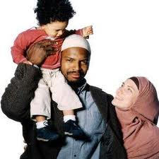
Islam and Infertility Treatment
Most Muslims will accept IVF & AIH for couples having fertility problems.
IVF & AIH is simply seen as the use of medical technology to bring about family life which is encouraged in Islamic life.
All other forms of embryo
technology are banned:
These methods deny the child’s right to know its natural parents. This is essential within Islamic religion and culture.
Any form of egg or sperm donation is regarded as adultery, a grievous sin within Islam.
Egg and sperm donation is also seen as being like adoption - which would not be appropriate in this circumstance.
The discarded embryos are not yet foetuses and their destruction can be justified because it is not taking life and the intention is to give childless couples children
The egg and sperm are both from the husband and wife so the baby will be the biological child of the parents.
Adoption has specific rules including: the child retains its biological parent’s name, full adoption is banned and adopted children are not considered ‘muhrim’.

Slide 6
Islam & Transplant Surgery
Most Muslims are against transplant surgery
Like Christians and Jews, Muslims believe in the Sanctity of Life, meaning, only God
has the right to
decide how and
when a person
should live or die.
However, Some
Muslims will
allow transplant using organs from a living donor.
In 1995 the Muslim Law Council of the United Kingdom, issued a fatwa (a legal ruling based on Islamic law made by senior Islamic figures). This stated that it was acceptable for living donations to be made and received in keeping with Islamic law.
Islamic religious lawyers agree that Islam aims to do good and not cause a burden.
Therefore, if a close relative was dying and a transplant would save them, then it should be done, just as pork may be eaten if a Muslim would otherwise starve to death.

Slide 7
Islam & Transplant Surgery
Shari’ah Law teaches that nothing should be removed from the body after death (even for a post-mortem) as Muslims believe they will need all their bodily organs if they are to be resurrected to face Allah on the last day.
The Qur’an states that god has created the body of a person so to take parts from one body and put them in another is to take on the role of God (shirk). This is considered as the greatest sin in Islam.

Slide 8
Crime and punishment
The importance of justice in Islam.
Islamic attitudes to punishment.
Islamic arguments surrounding Capital punishment.
Islamic attitudes to tobacco, alcohol and drugs.

Slide 9
Islam, Sin & Crime
Muslims believe there should be no difference between state law and religious law. The Islamic religious law is called Shari ’ah Law. In Islam committing a crime is a sin against God. Shari’ah Law governs the lives of Muslims around
the world and is the most widely used
religious legal system there is. It is traditionally upheld by the Imams
and the Ummah.
Muslims believe that God will judge all people justly on the Last Day. They also believe that it is their duty as vice-regents
(stewards) of creation to
ensure that people are
treated fairly and the
world is governed
in a just way.
The Qur’an describes God as just.
Justice is the basis for the ‘pillar of zakah’.
The Shari ’ah is based on justice and equality for all.
Allah wants people to treat each other fairly and establish justice.
There are many Hadith (sayings/teachings) of Muhammad about justice.

Slide 10
Islamic Attitudes to Punishment
Islamic punishments, as laid out in the Qur’an, can often seem very harsh. E.g. cutting off the hand of a thief or 100 lashes with a whip for someone caught in adultery. However, Muslim attitudes to punishment are based on deterrence and reform. Imprisonment is used in Muslim countries to protect society from anti-social criminals.
The greatest deterrent to a Muslim is that
God sees everything and He will judge
each person on the Last Day.
Strict punishments are only given as a last resort. Islamic courts will look into family circumstances. A person would not have a hand amputated if they stole to feed a starving baby.
The Qur’an lays down the punishment for certain crimes. ‘As for a thief, male or female, cut off their hand: a punishment by way of example, from God, for their crime.’ (Surah 5:41)

Slide 11
The Qur’an and Justice
The Qur’an teaches that judgement and punishment ultimately belongs to God.
However, God demands all people show justice and mercy to all other people.
Justice is an central part of God’s character. ‘My Lord hath commanded justice.’ Surah 7:29
Justice is for all. Everyone should put justice first, even before their family. ‘Stand up firmly for justice, as a witness to God, even as against yourselves or your parents or your kin, and whether it be against rich or poor.’ Surah 4:135
Muslims should act against injustice. However, for a victim to forgive a person’s injustice, is far better. ‘Act against those who oppress people and transgress (sin) against justice. They will have an agonizing punishment - though, if a person is patient and forgives, this is one of the greatest things.’
Surah 42:42-43
Allah is merciful to those who seek His forgiveness. ‘If anyone does evil or wrongs his own soul, but afterwards seeks God’s forgiveness, he will find Him most forgiving and merciful.’ Surah 4:110

Slide 12
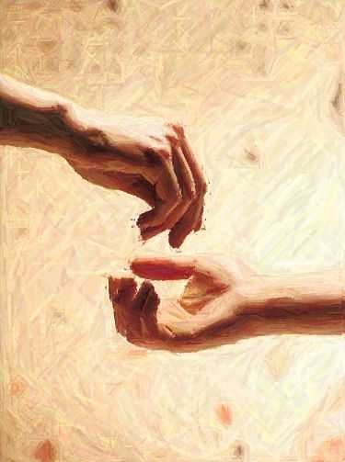
The Qur’an and Social Justice
Social justice is
very important in Islam. Muslim Aid and Islamic Relief are two aid agencies working to relieve poverty
and secure justice for the
poor and oppressed around
the world.
One of the ‘Five Pillars of Islam’,
is zakah, a compulsory payment to the poor. It is an annual payment made up of around 2½%
of any excess
wealth a person has
(i.e. cash, savings
and value of any
jewellery etc.). It
is not seen as
charity, which is
optional, or tax,
which is for the
state. It is based
on social welfare and the distribution of wealth.
Shari ‘ah law bans the charging or paying of interest on loans as this makes the less wealthy pay the wealthy and is unjust. As a result many Muslims feel they cannot take out traditional mortgages in Britain. Some UK banks now offer Muslim mortgages similar to rental agreements.

Slide 13
Islam on Capital Punishment
Shari ‘ah, allows for capital punishment for 3 offences:
Murder - the unlawful taking of another’s life.
Adultery - a married person sleeping with someone
they are not married to.
Apostasy - where a Muslim denies Islam and works
against it (this amounts to treason within Islam).
Some Muslims are against capital punishment, they say that Shari’ah Law in the Qur’an only suggests capital punishment and does not make it compulsory.
These Muslims would point to scriptures suggesting forgiveness and mercy rather than death. ‘Let harm be repaid by an equal harm, though anyone who forgives and puts things right will have his reward from God Himself - He does not like those who do wrong.’ Surah 42:40
Muslim arguments for capital punishment include.
It is a punishment laid down in Shari’ah Law within the Qur’an.
The Prophet Mohammad agreed with capital punishment.
Mohammad sentenced people to death for murder when he was ruler of Madinah.
An alternative to the death penalty is that a victims family can accept compensation called ‘blood money’, from the murderer rather than requiring a death sentence.

Slide 14
Islam: Drugs, Alcohol & Tobacco
Islam forbids the use of alcohol and drugs because they are banned in the Qur’an and in the Hadith of the Prophet Mohammad (pbuh). Tobacco is disapproved of but not banned as it is not explicitly mentioned in sacred books.
The Arabic word for alcohol is ‘khamr’ and means to shroud the mind. If alcohol does that a Muslim would feel it is wrong as the mind should be used to consider God.
Shari'ah law bans alcohol as it is ‘haraam’ (forbidden) in the Qur’an.
‘In alcohol is great sin, and some profit for men; but the sin is greater than the profit.’ (Surah 2.19)
Because of these things alcohol and drugs (intoxicants) are haraam (completely forbidden).
The Hadith (sayings and deeds of the Prophet) states ‘Allah has cursed wine and whoever drinks it, buys it, pours it, sells it, makes it for themselves or others, transports it, or benefits from its sale.’
Tobacco is considered makruh (not forbidden but extremely disliked) as the Qur’an or Hadith do not directly mentioned it.

Slide 15
PEACE AND CONFLICT
ISLAM AND BULLYING
ISLAM AND FORGIVENESS AND RECONCILIATION
ISLAM AND WAR

Slide 16
Religion and
Bullying
All modern religions see
bullying as wrong because:
Islam teaches every member of the ummah should be treated equal and all Muslims should act like brothers. They are all part of the UMMAH
Muslims believe it is wrong because the Qur’an teaches to protect the vulnerable of society (Surah 90:12-16).
Shari’ah law is based on mutual respect and upholding what is ‘just’. Bully involves neither of these.

Slide 17
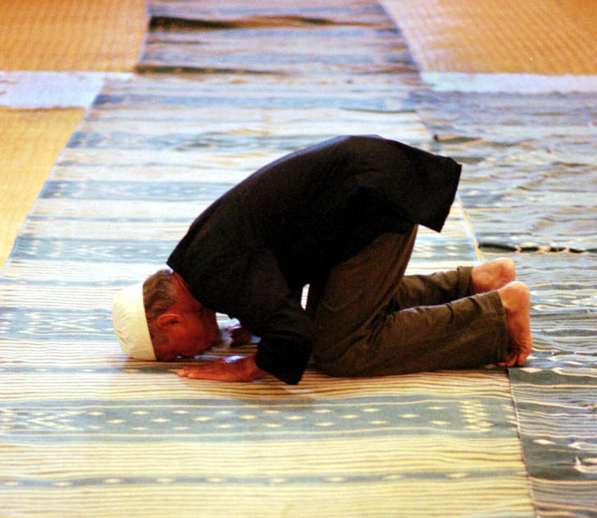
Islam; Forgiveness & Reconciliation
Islam teaches that Allah is forgiving and merciful to all who turn from their sins and to him. Muslims believe:
Muslims should be merciful and compassionate towards others, because Allah is merciful
and compassionate
towards them.
The Qur’an states ‘If a person forgives and makes reconciliation, his reward
will be from God.’
Surah 42:40
However, a Muslim
should not forgive
those who are working against Islam seeking to destroy it or a person’s faith in it.
There are many
sayings of the
Prophet Muhammad (Hadith) stating Muslims should forgive others.

Slide 18
Islamic Views on War
The Arabic word ‘jihad’ means to struggle or strive’. Islam teaches that Muslims should be prepared to struggle or strive in the way of Islam.
The lesser jihad is about the physical struggles against the enemies of Islam. Muslims will sometimes see their jihad as a Holy War, particularly if they feel Islam itself is being attacked.
For Muslims the most important struggle they must undertake is called the greater jihad or the internal jihad. A spiritual and emotional fight to become truly submitted to the will of Allah (The word ‘Islam’ means submission, the word ‘Muslim’ means one who submits to God).
 The Qur’an teaches that Muslims must fight if they are attacked.
 Muhammad himself fought in wars.
 The Hadith permits justifiable wars.
 The Qur’an teaches that anyone who dies in a just war will go directly to heaven.
However, some Muslims believe Islam to be a religion of peace and modern warfare means no war can be just, so oppose all wars.

Slide 19
Fight in the cause of god those who fight you, but do not go beyond the limits, god does not love those who transgress.
An Islamic ‘Just War’
 It must be fought for a Just Cause: either Islam is being attacked, people are suffering, or in self defense.
 It must be a Last Resort: all possible non-violent means of resolving the problem have been tried.
 It must be authorised by a Muslim Authority: By a religious leader or council of leaders.
 It must cause Minimal Suffering: to all sides involved.
 It must not target Innocent Civilians: especially the elderly, the young and women.
 It must end when the Enemies Surrender: Prisoners of war are to be returned.

