Slide 1
Support in St Wilfrid's Sixthform

Slide 2
What we will cover today
St Joseph’s Sixth Form
Support in Sixth Form
Student expectations
What parents can do to help
Organisation
Revision techniques
PSHE, Enrichment Programme
Key dates- Prelims, exams

Slide 3
Student expectations
St Joseph’s Sixth Form
Be here every day on time
Be organised
Take pride in work, folder, books
Use Study Time effectively
Attend catch up and support sessions provided by departments
Let us know if you are worried...don't ignore it!

Slide 4
Ways we will support this
St Joseph’s Sixth Form
Independent Study Log
Help establish positive independent study ethic
Support students on meaningful use of time
Students supported in department areas, year 12 lessons
Monitored by Head of Year
Weekly Monitoring
Regular feedback from departments
Department afterschool study sessions
Pastoral afterschool study sessions

Slide 5
Ways department areas will support this
St Joseph’s Sixth Form
Revision materials
Before School Workshops
After school sessions
1:1 support
Small group support
Working in the subject department
Feedback following Key Tasks and assessments
Providing homework and independent study tasks

Slide 6
What you can do to help?
St Joseph’s Sixth Form
Quiet place to study
Ask questions about their work
Get them to chat through a folder with you and explain what the different sections are, Key tasks, Homework, Class work.
Ask them to talk through their revision timetable, or help them to plan one
Ask us questions

Slide 7
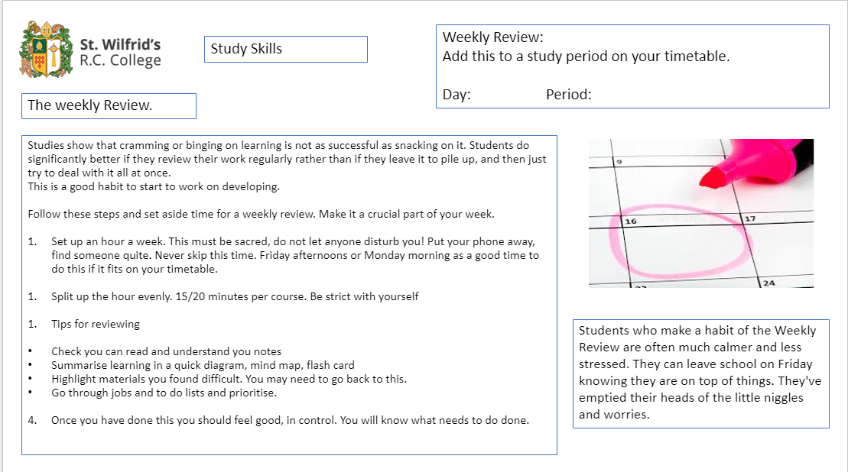
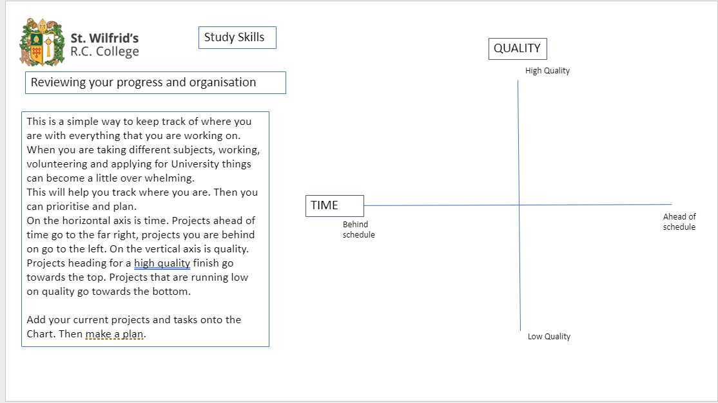
Organisation
Weekly Review
Folder checks
Use a diary-Write everything down
Set reminders
Work your way backways from deadlines
Prioritise
​
St Joseph’s Sixth Form

Slide 8
Planning your study time or Prelim Revision
 | Mon | Tue | Wed | Thur | Fri | Sat | Sun
8:00 | Maths Catch Up |  |  | Maths Catch Up
9-9:55 |  | Engineering | Maths |  | Engineering
9:55-10:55 | Physics | Engineering | Maths | Physics | Engineering | Practice exam Papers. Maths | Revision over topics
11:10-12:10 |  |  |  | Physics |  | Homework | Homework
12:10-1:10 | Maths | Physics | Engineering |  | Maths | Engineering- check coursework | Practice exam Papers. Physics
Lunch
2:10-3:10 | Maths | Physics | Enrichment- Revision |  |  |  | Revision over topics
3:10-4:00 | Organisation. Planning for the week | Subject Catch up session |  | Subject Catch up session | Weekly Review
St Joseph’s Sixth Form

Slide 9
Revision techniques
Mind Maps- Use questions, don’t just copy notes
Flash Cards- Mix them up!
St Joseph’s Sixth Form
Read things out loud in different accents or voices. Then when you are trying to recall the facts, you’ll remember the accent and then hopefully the fact too.
Record yourself reciting key dates, quotes or equations and listen to them as you walk to and from the library/supermarket, while at the gym or when you’re cooking dinner.
Find a friend who is on a different course to you and teach each other about your courses.
Stick Post-it notes everywhere. ​
Literally everywhere. Just being surrounded by your revision notes will mean that something will have to sink in.

Slide 10
PSHE and Enrichment Programme
Newcastle
Newcastle PartnersWhich University?
Budgeting Bonanza
Funployment
Enrichment programme
Life skills
communcation
Presentation
mock interviews
Northumbria
Choosing the right course
I'm the one that you want-writing a personal statement
Revision techniques
NU Entry
Sunderland University
Sunderland Medical School Presentations
Presentation Skills Sessions
Interview skills
First Choice Scheme
Durham Progression Scheme
Higher Education Plus Residential to Cambridge
Notes:
SLD

Slide 11
St Wilfrids’s Sixth Form
Local Labour Market Information
4 Main areas of Development/ strategic Importance
Inform our careers programme
Aware of when making links to careers in subjects
"High Expectations of what students can and should achieve"
Digital
Software, cloud computing, buildings information, modelling, gaming. Emerging specialisms include data analytics, immersive
technologies and cybersecurity
Advanced Manufacturing
Automotive and medicine manufacturing
Health and Life Sciences
Excelling in clinical research, innovation in pharmaceuticals, responding to an aging population
Energy
Offshore Energy and subsea technologies, regional energy and demonstration and innovation
Notes:
SLD

Slide 12
Next Steps and Key Dates
St Joseph’s Sixth Form
Independent Study Log
Weekly Monitoring
Make a Revision timetable for the Prelims
Prelims- 3rd Feb over 2 weeks
Summer Exams start May

