Slide 1
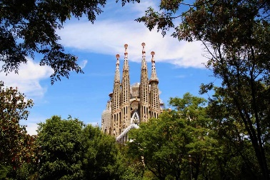
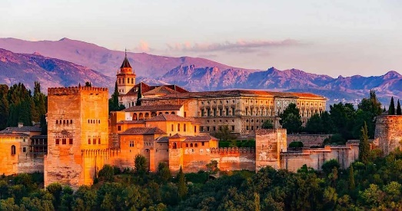
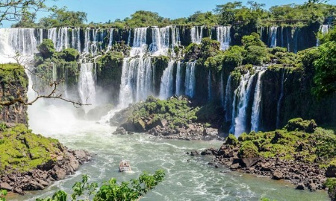
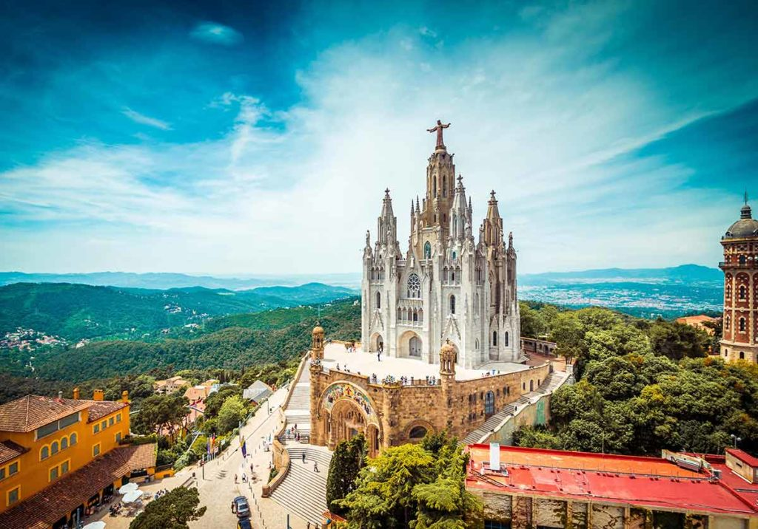
#20Spanish - Name the 20 Hispanic Landmarks / Sites / Attraction
Photo | Name the landmark & its location
1)
2)
3)
4)

Slide 2
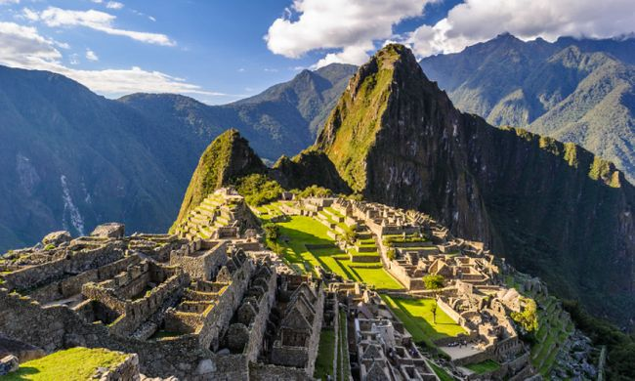
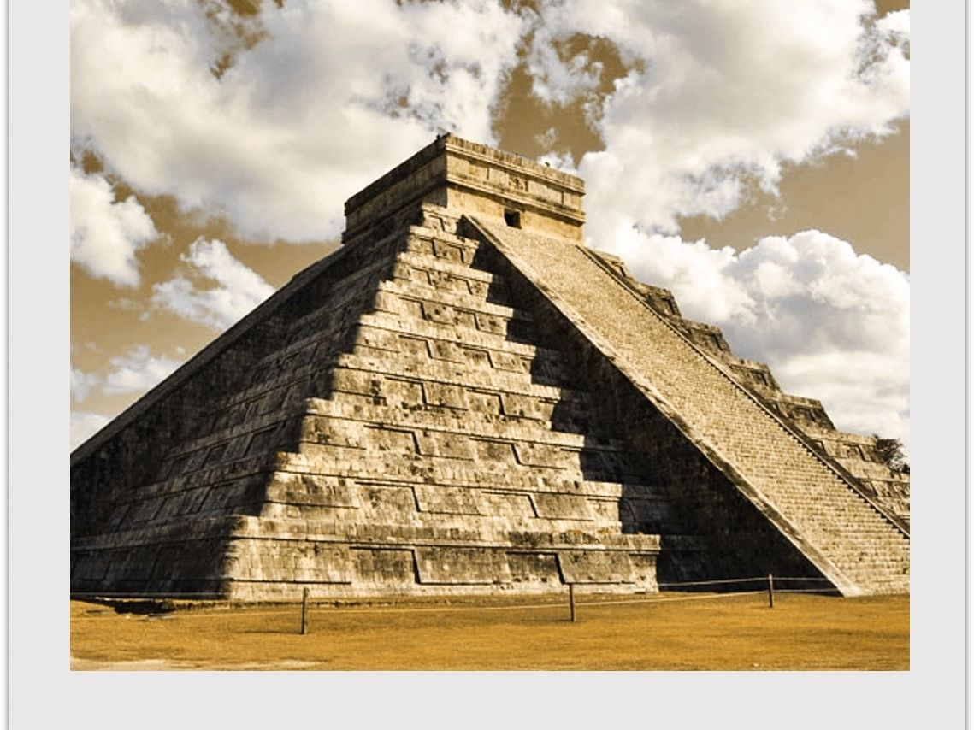
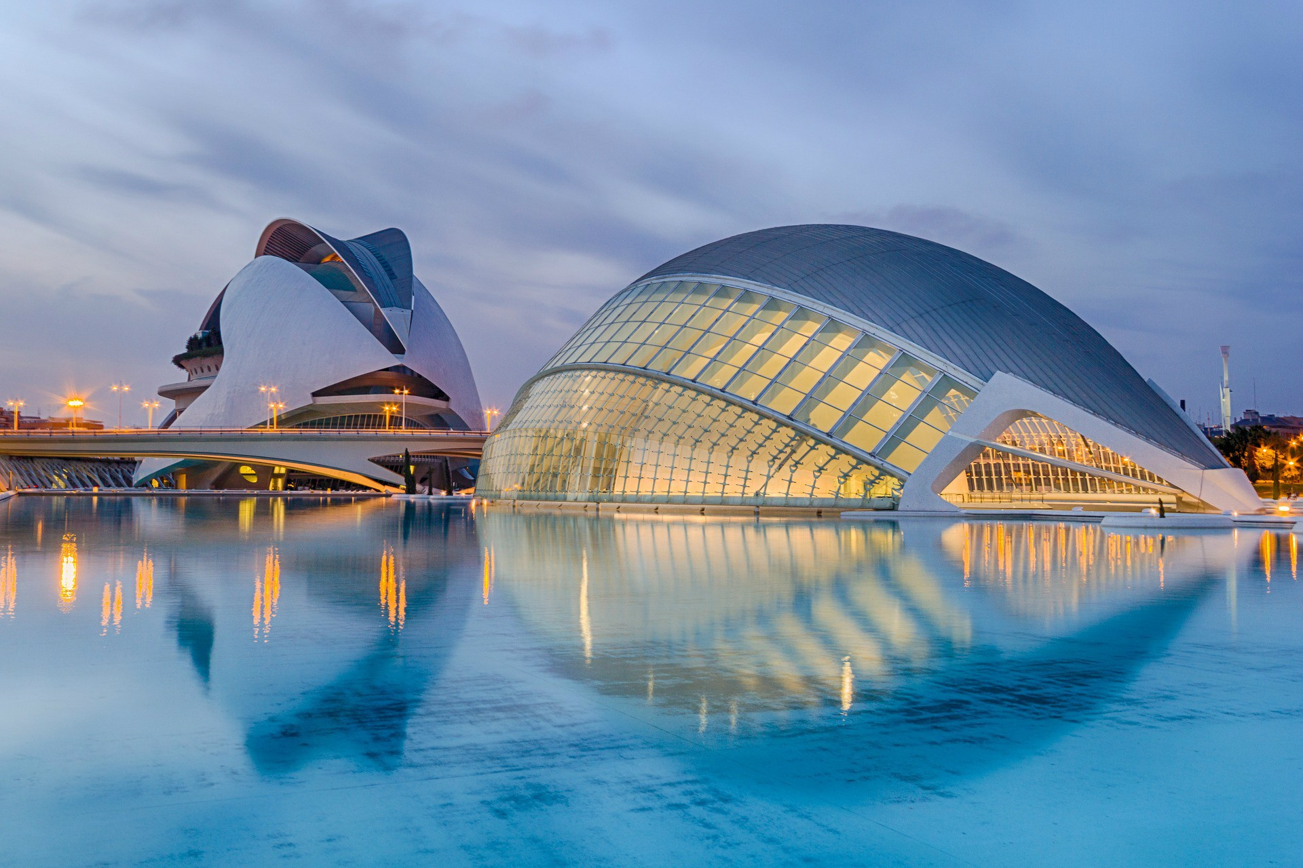
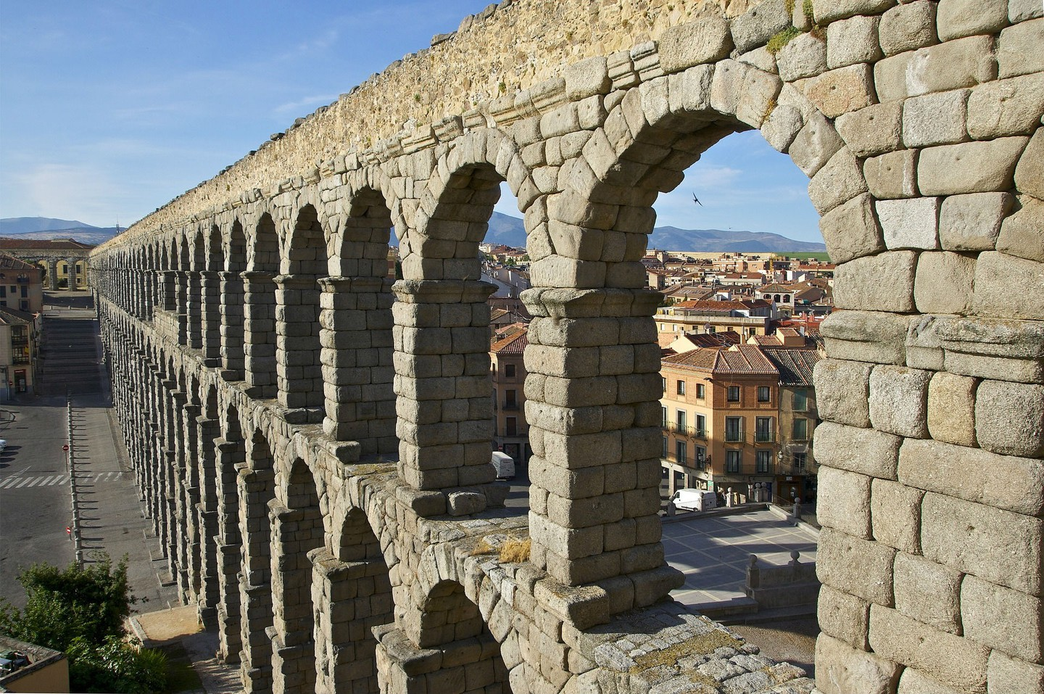
#20Spanish - Name the 20 Hispanic Landmarks / Sites / Attraction
Photo | Name the landmark & its location
5)
6)
7)
8)

Slide 3
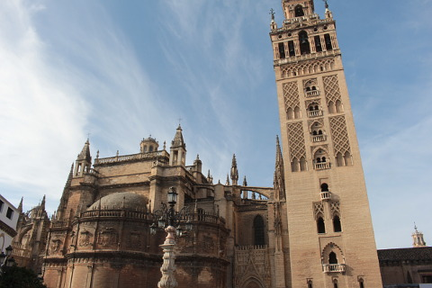
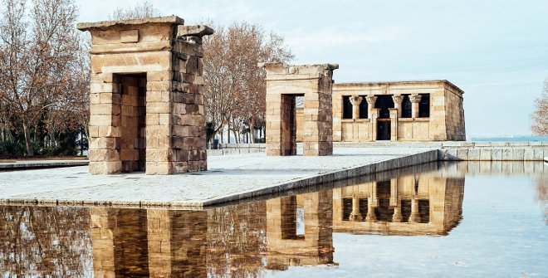
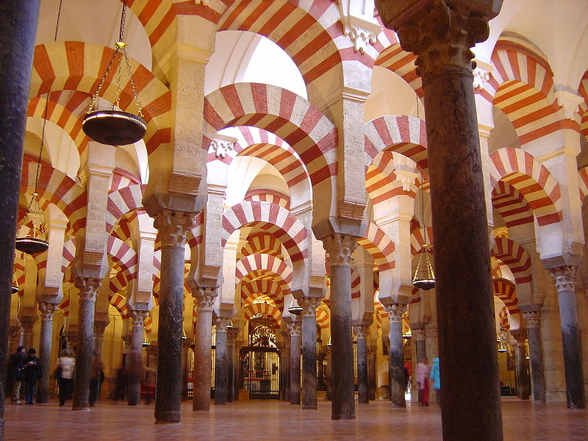
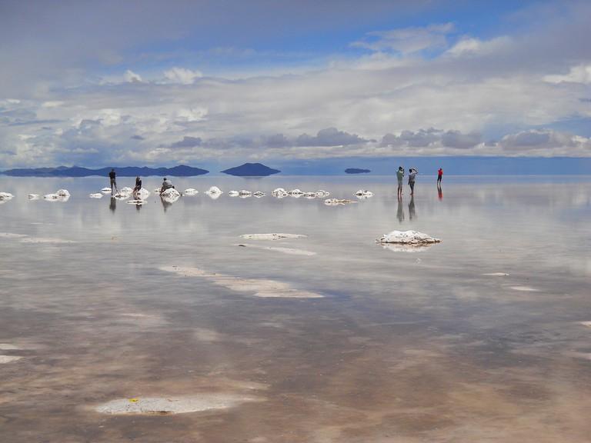
#20Spanish - Name the 20 Hispanic Landmarks / Sites / Attraction
Photo | Name the landmark & its location
9)
10)
11)
12)

Slide 4
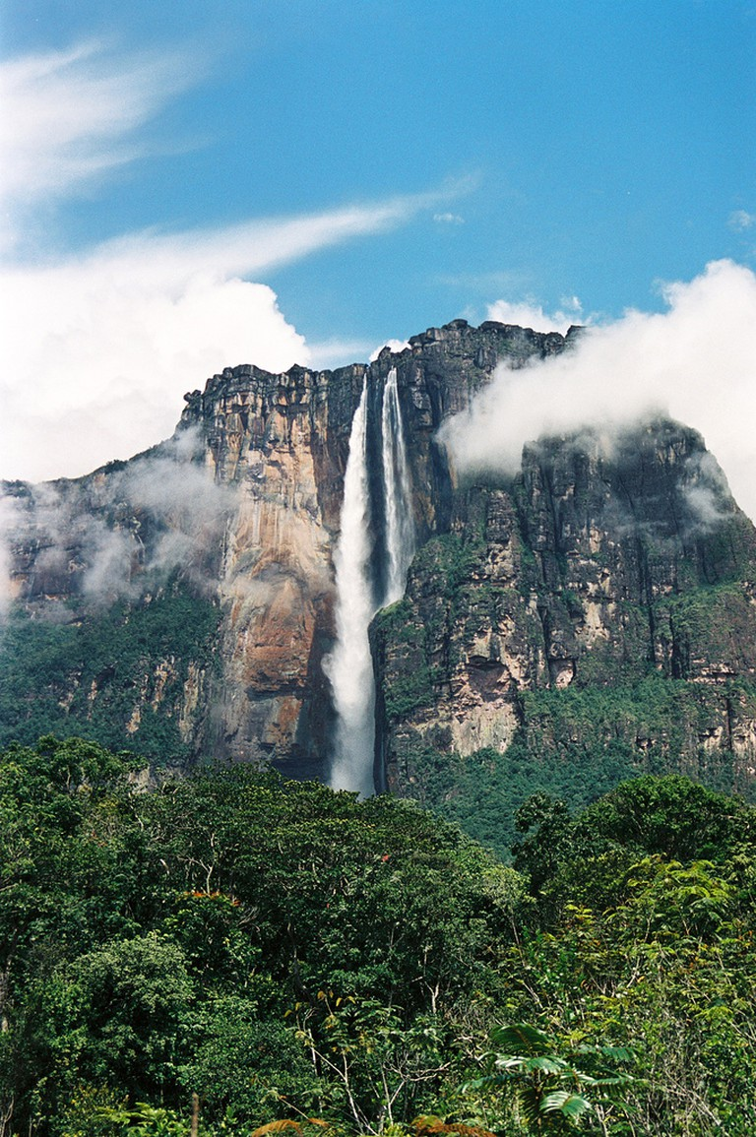
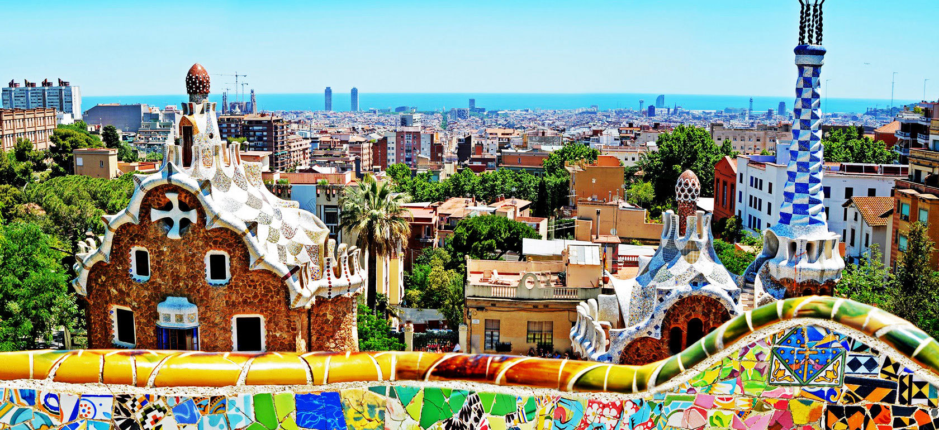
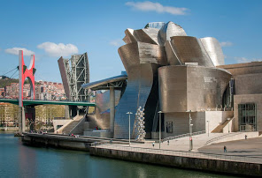
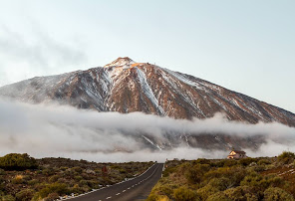
#20Spanish - Name the 20 Hispanic Landmarks / Sites / Attraction
Photo | Name the landmark & its location
13)
14)
15)
16)

Slide 5
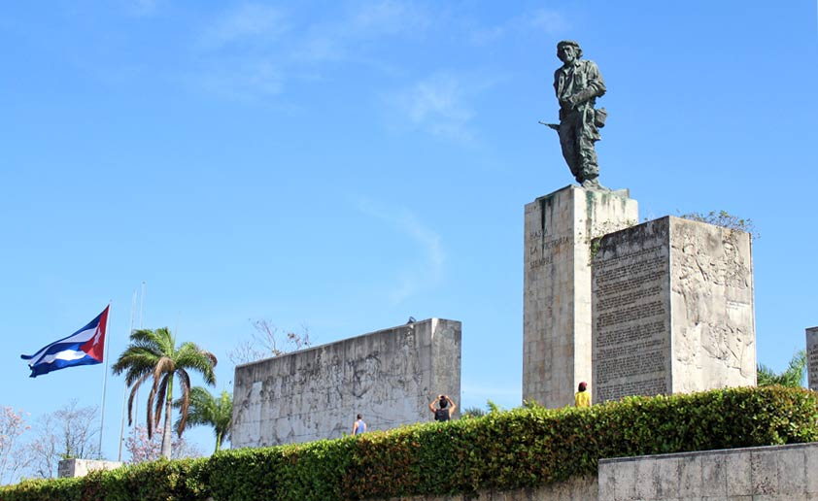
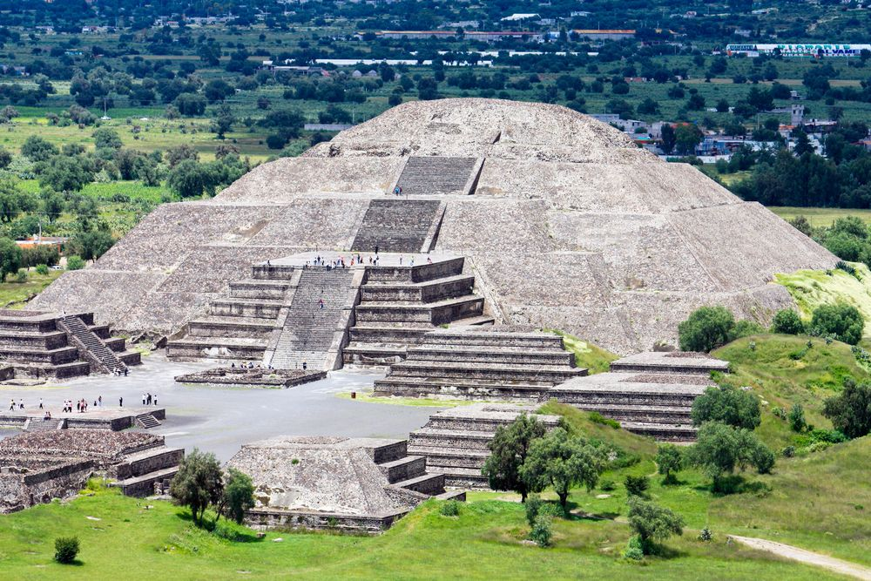
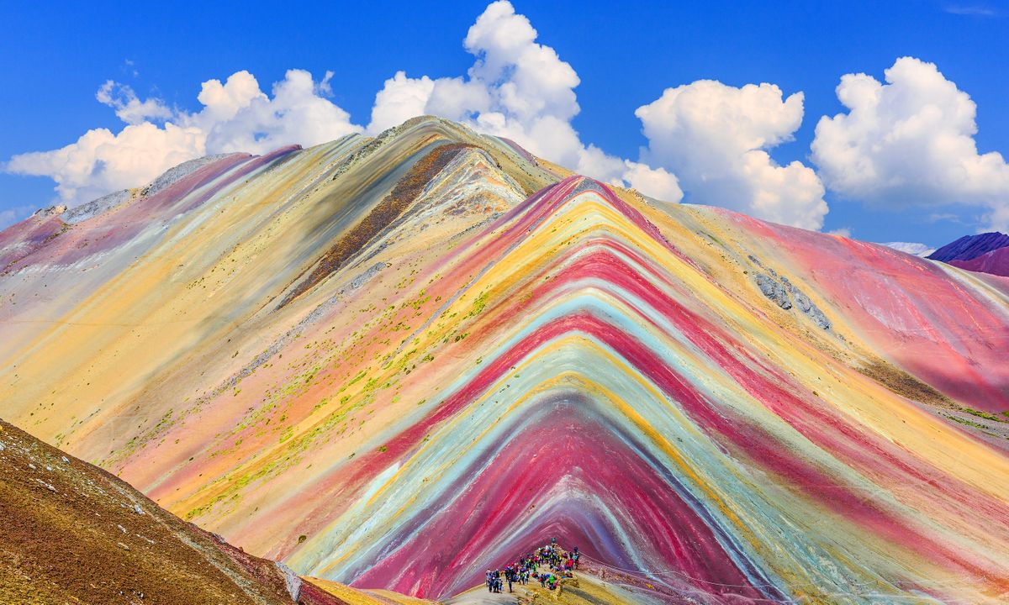
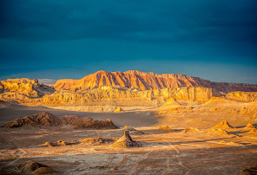
#20Spanish - Name the 20 Hispanic Landmarks / Sites / Attraction
Photo | Name the landmark & its location
17)
18)
19)
20)

