Slide 1
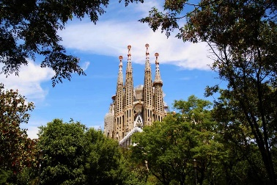
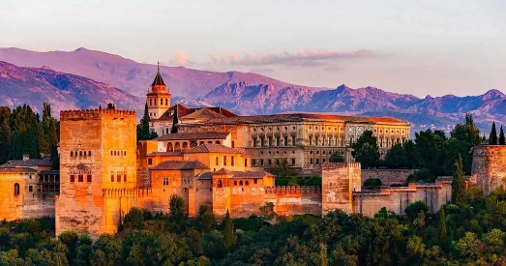
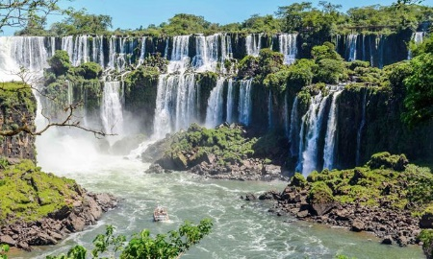
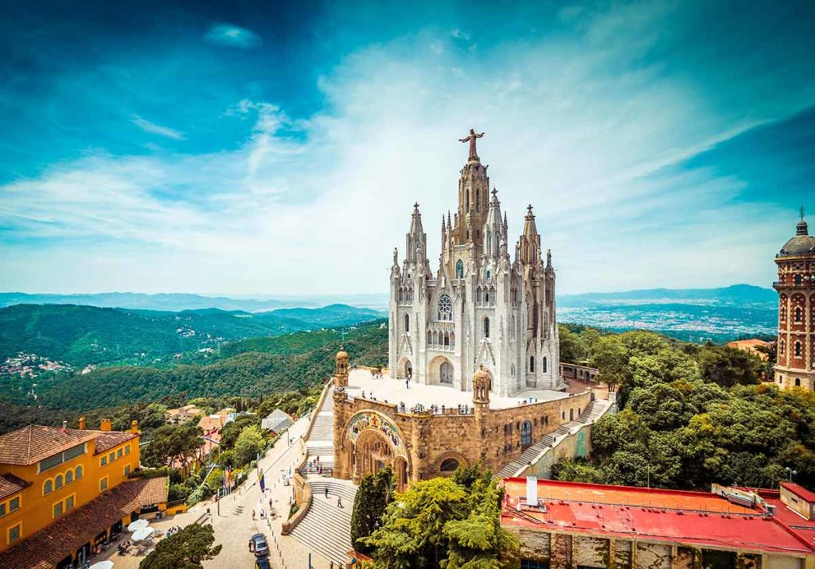
#20Spanish - Name the 20 Hispanic Landmarks / Sites / Attraction
Photo | Name the landmark & its location
1) | Sagrada Familia, Barcelona
2) | Alhambra Palace, Granada
3) | Iguazu Falls, Argentina
4) | Tibidabo Cathedral, Barcelona

Slide 2
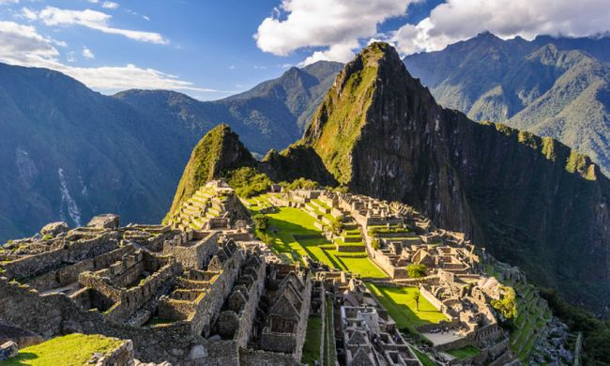
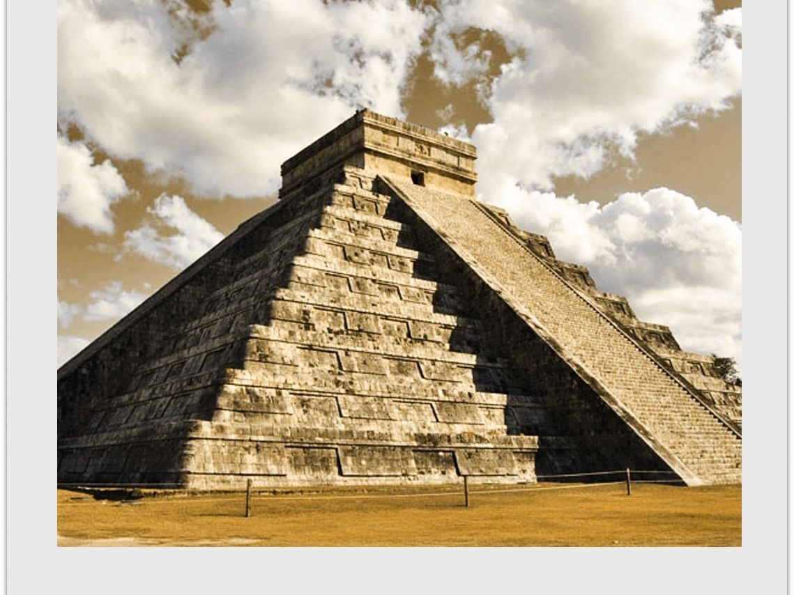
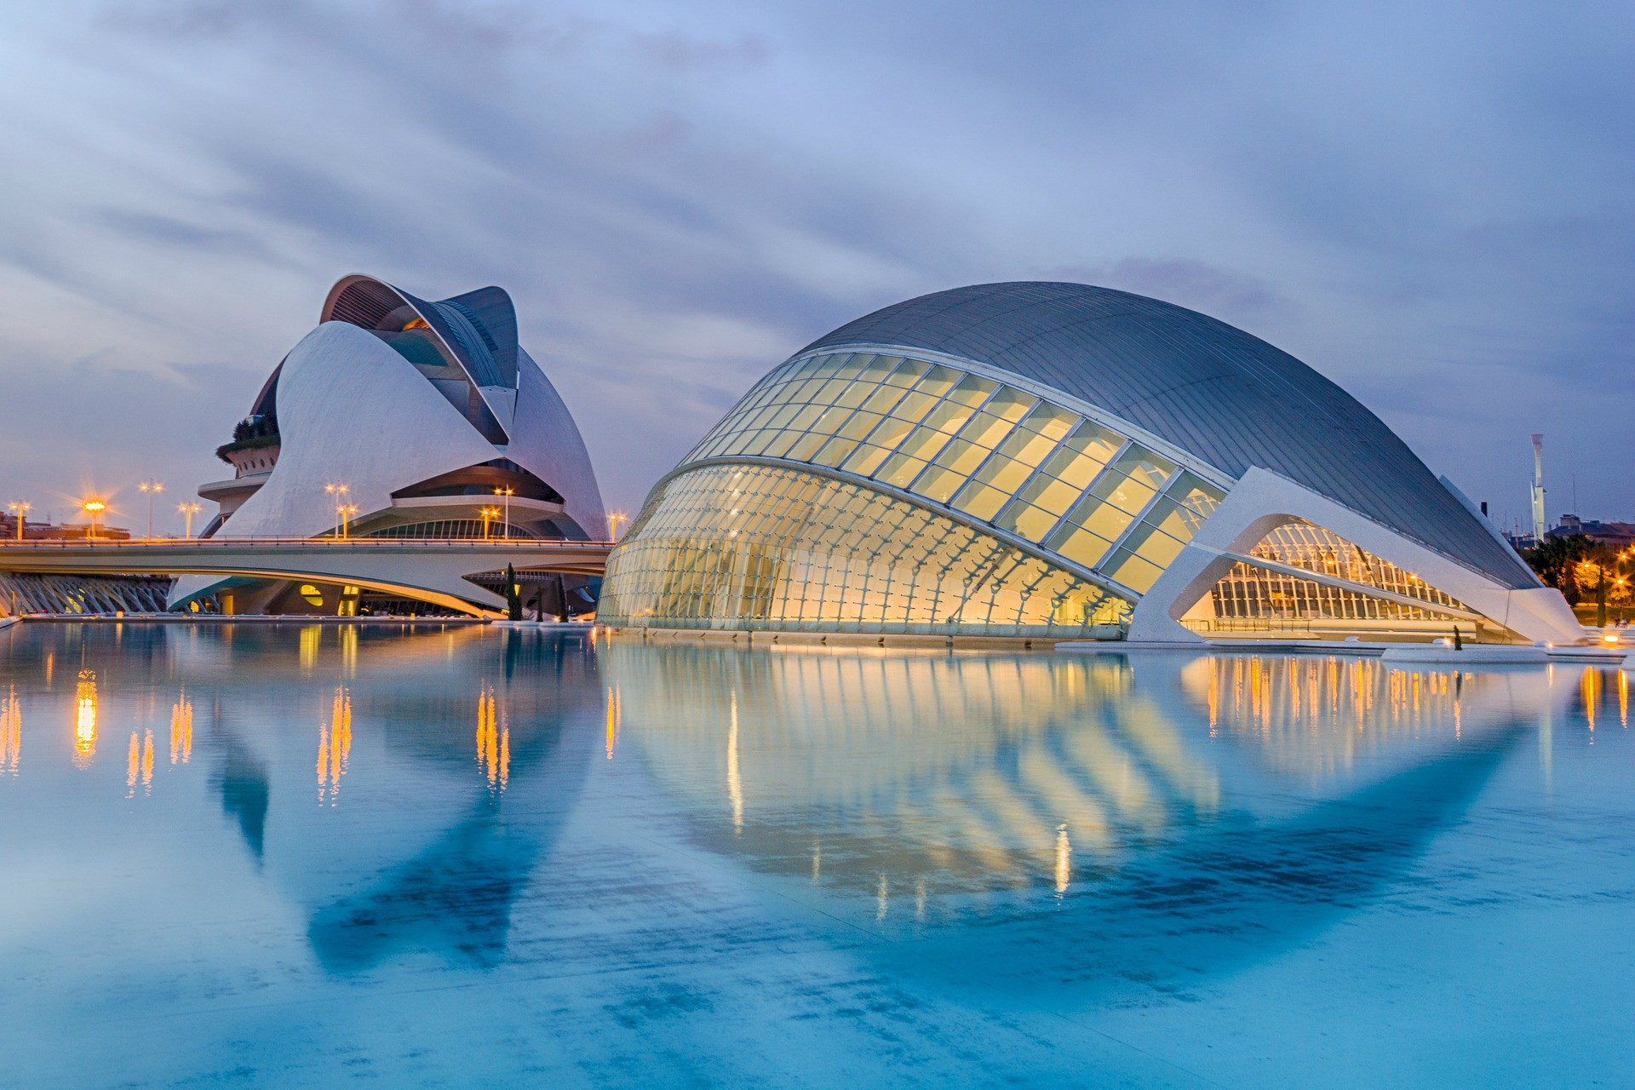
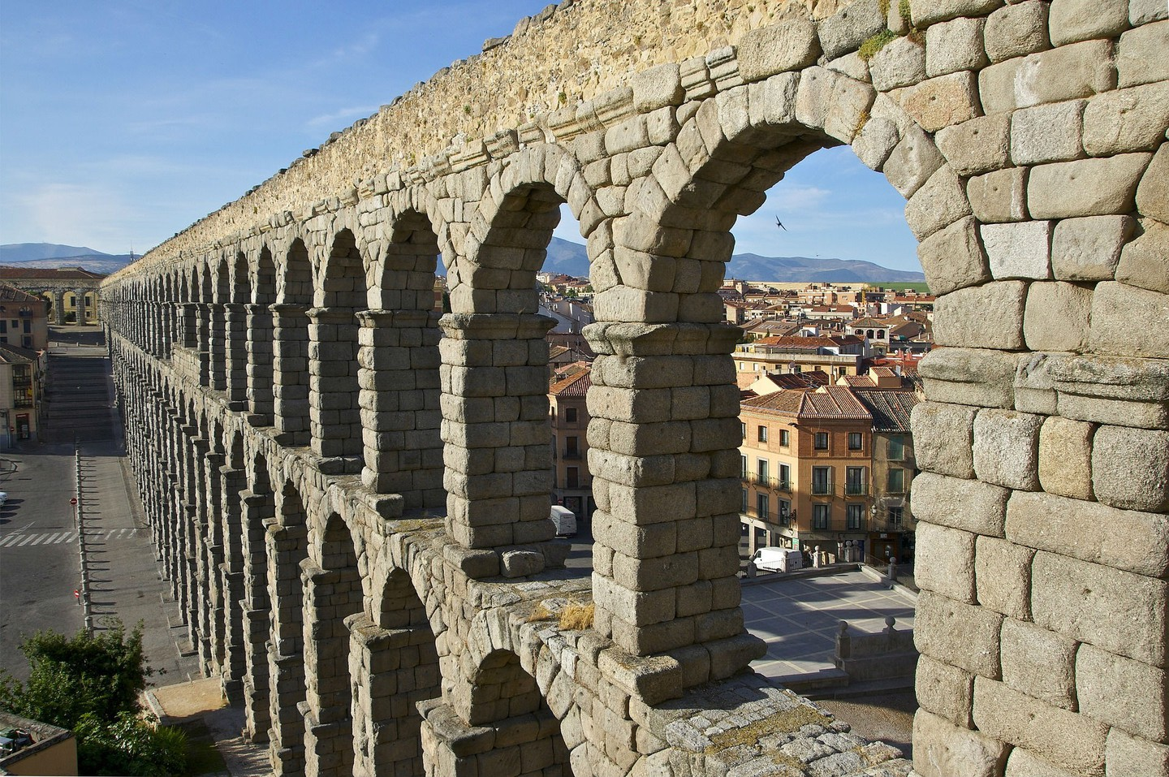
#20Spanish - Name the 20 Hispanic Landmarks / Sites / Attraction
Photo | Name the landmark & its location
5) | Machu Picchu, Peru
6) | Chichen Itza, Mexico
7) | City of Arts & Science, Valencia
8) | Segovia Aqueduct

Slide 3
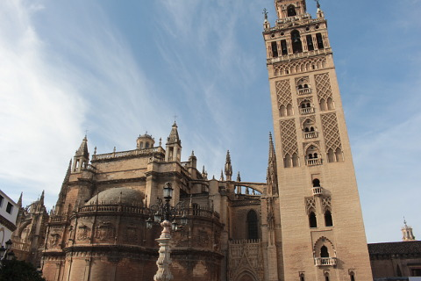
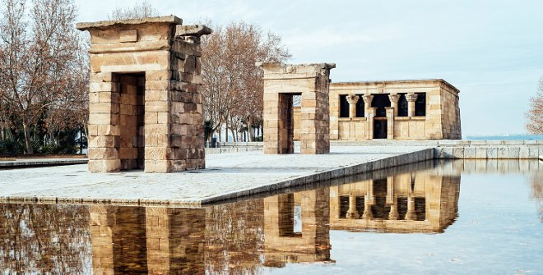
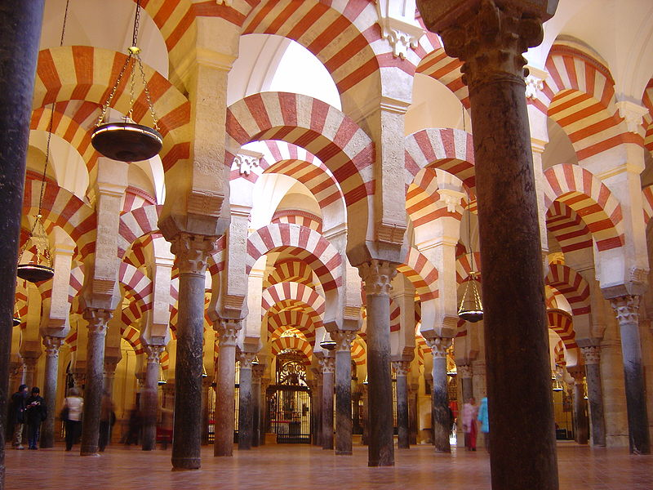
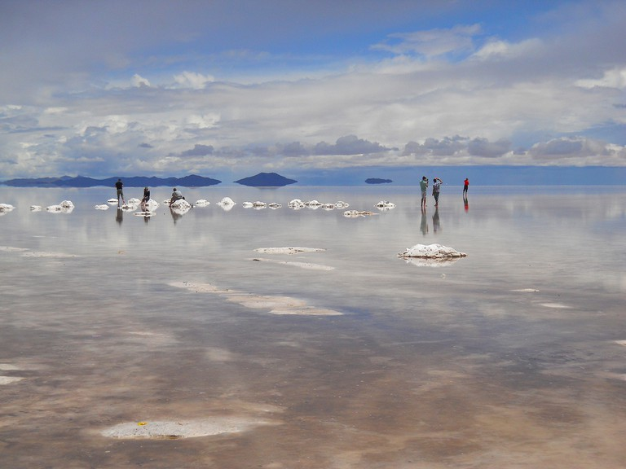
#20Spanish - Name the 20 Hispanic Landmarks / Sites / Attraction
Photo | Name the landmark & its location
9) | La giralda, Seville
10) | Temple Debod, Madrid
11) | The Great Mosque, Cordoba
12) | Uyuni Salt Flats, Bolivia

Slide 4
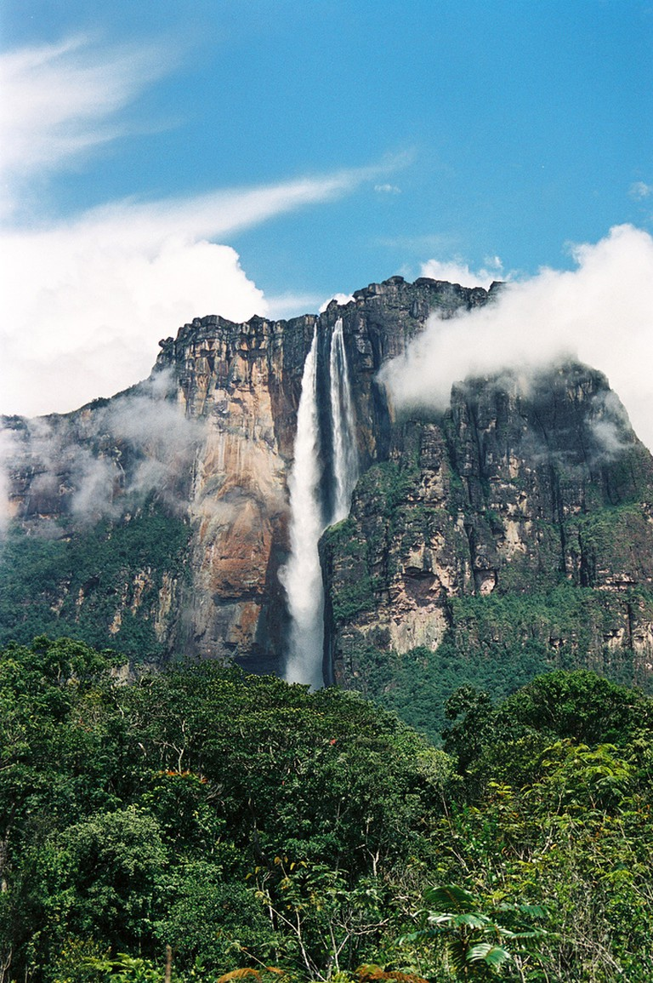
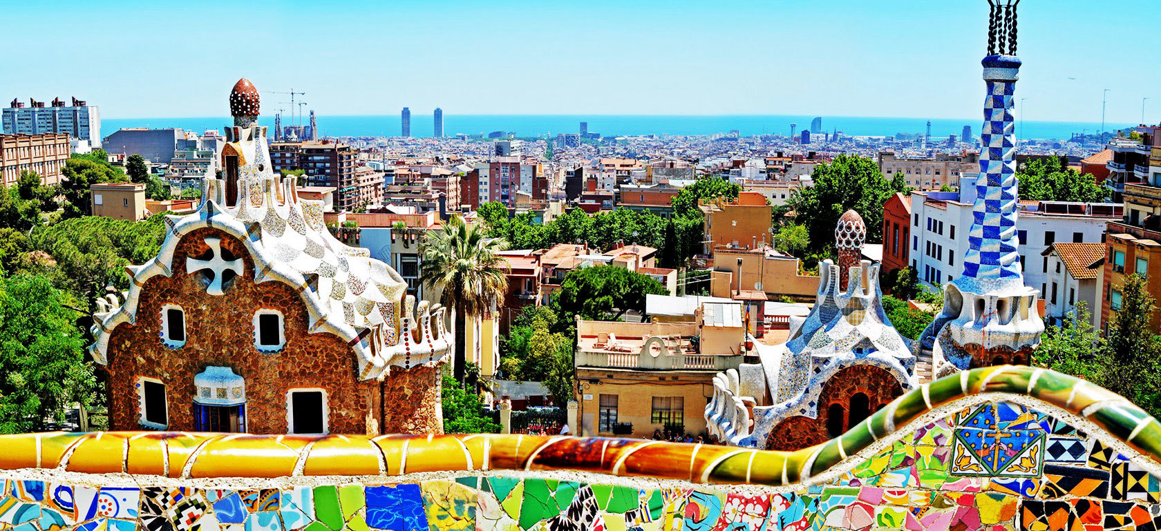
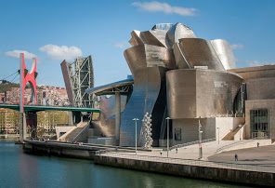
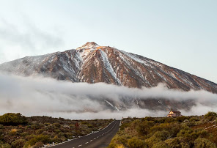
#20Spanish - Name the 20 Hispanic Landmarks / Sites / Attraction
Photo | Name the landmark & its location
13) | Angel Falls, Venezuela
14) | Parc Guell, Barcelona
15) | Guggenheim Museum, Bilbao
16) | Teide National Park, Tenerife

Slide 5
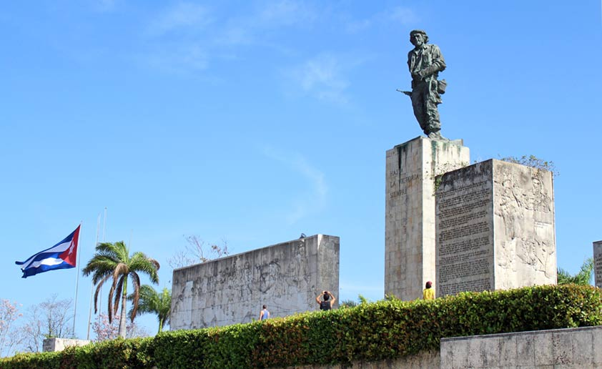
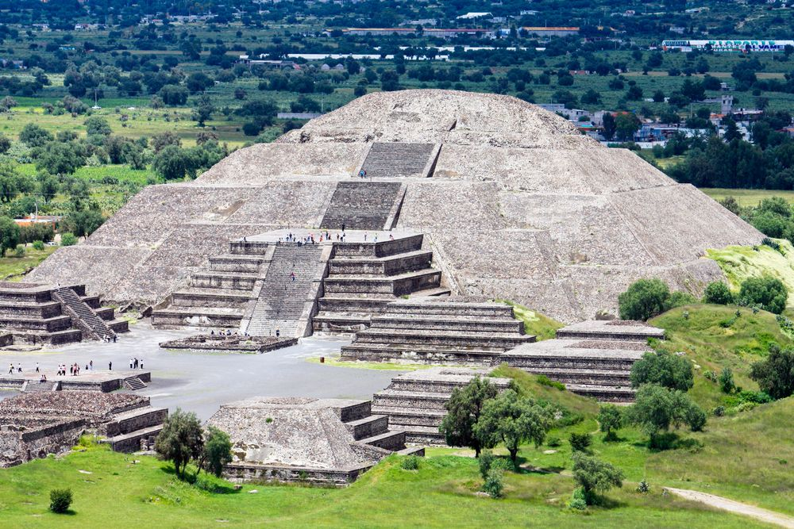
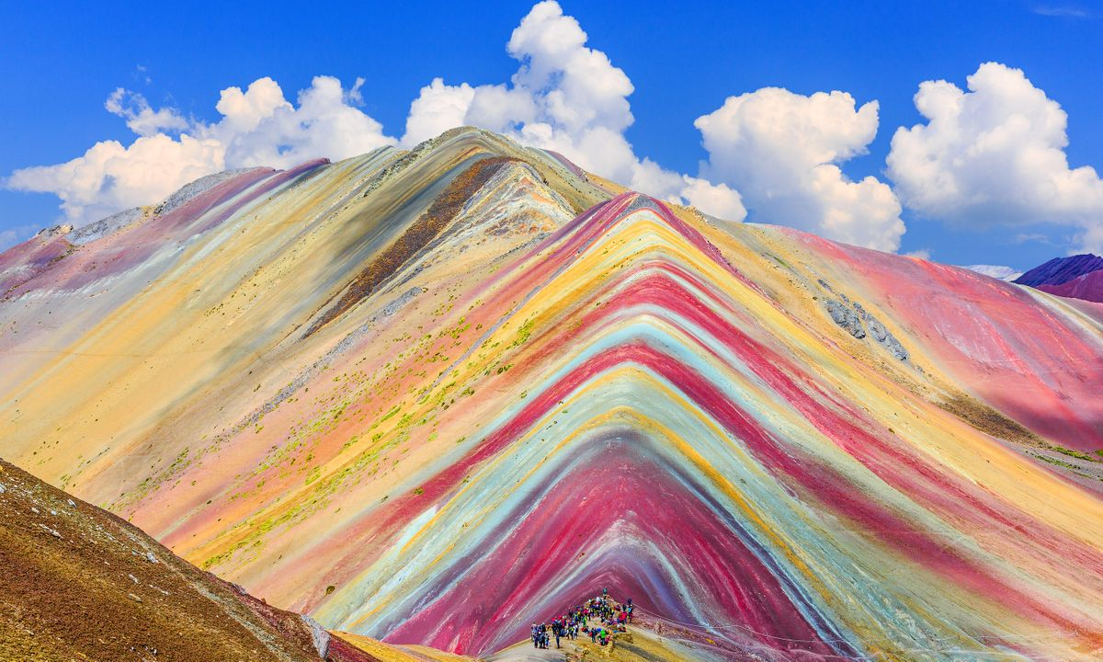
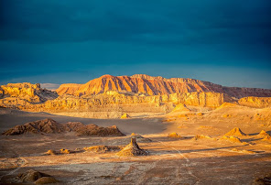
#20Spanish - Name the 20 Hispanic Landmarks / Sites / Attraction
Photo | Name the landmark & its location
17) | Che Guevara Museum, La Havana Cuba
18) | Teotihaucan Pyramids, Mexico
19) | Rainbow Mountain, Cusco Peru
20) | Atacama Desert, Chile

