Slide 1
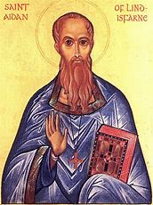
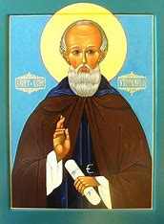
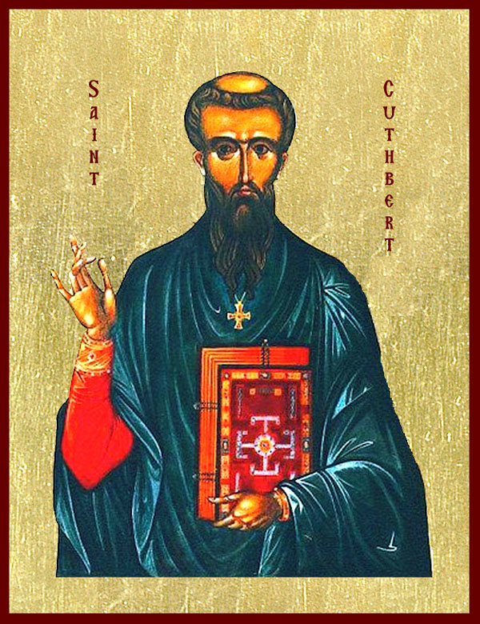
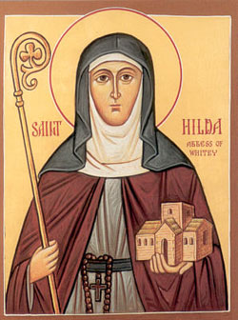
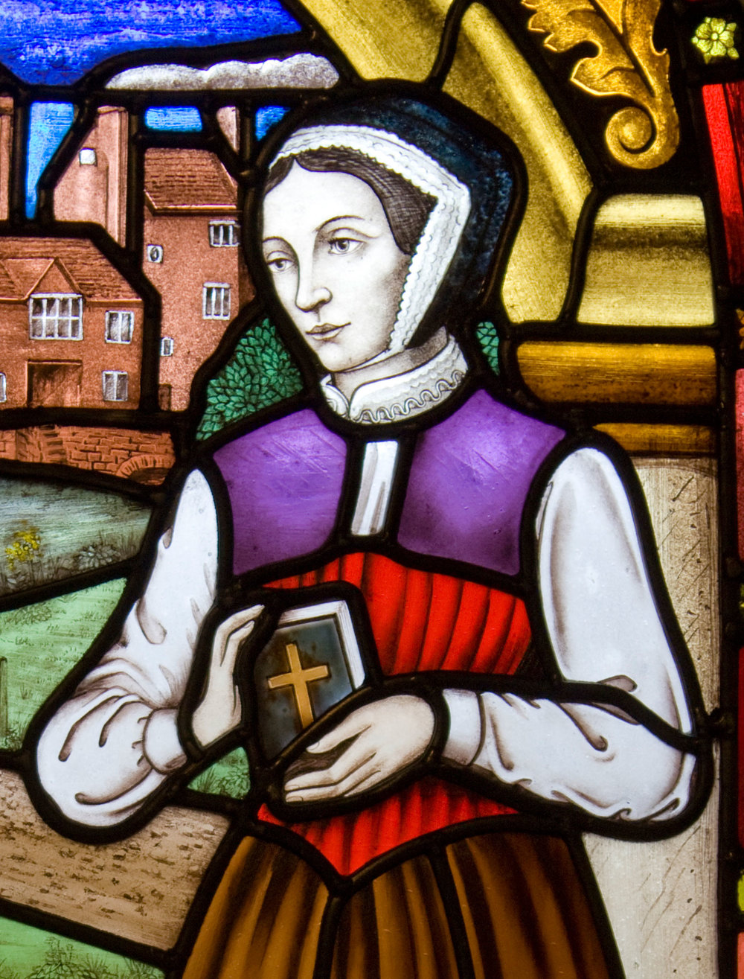
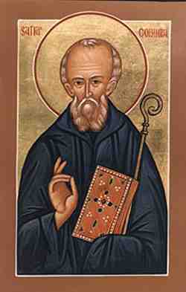
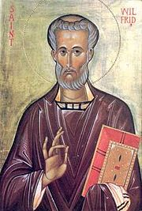
St Wilfrid’s School Saints
St
Aidan
St
Bede
St
Cuthbert
St
Hilda
St
Margaret
Clitherow
St
Columba
St Wilfrid
Your Task: Research any one of our school Saints- who they are, where they lived, what they did, etc.
How to present it: You could make a poster, write a poem or rap, draw a picture, create a fact file, make a collage, a piece of drama or any other idea you can think of to share the life of the Saint.

