Slide 1
Welcome to
St. Wilfrid’s RC College
Cuthbert House
Information for Year 6
Parents, carers and students.

Slide 2
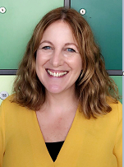
Hello, I am Mrs Tiffin. I am Head of
Cuthbert House and I also teach Maths.
I have been at St Wilfrid’s for over 20 years now but still feel a little nervous/excited at the start of every new academic year.
I am really looking forward to meeting you all and it won’t be long before you feel like you truly belong here.
Exciting times ahead – see you soon.
Mrs Tiffin
Head of Cuthbert House

Slide 3
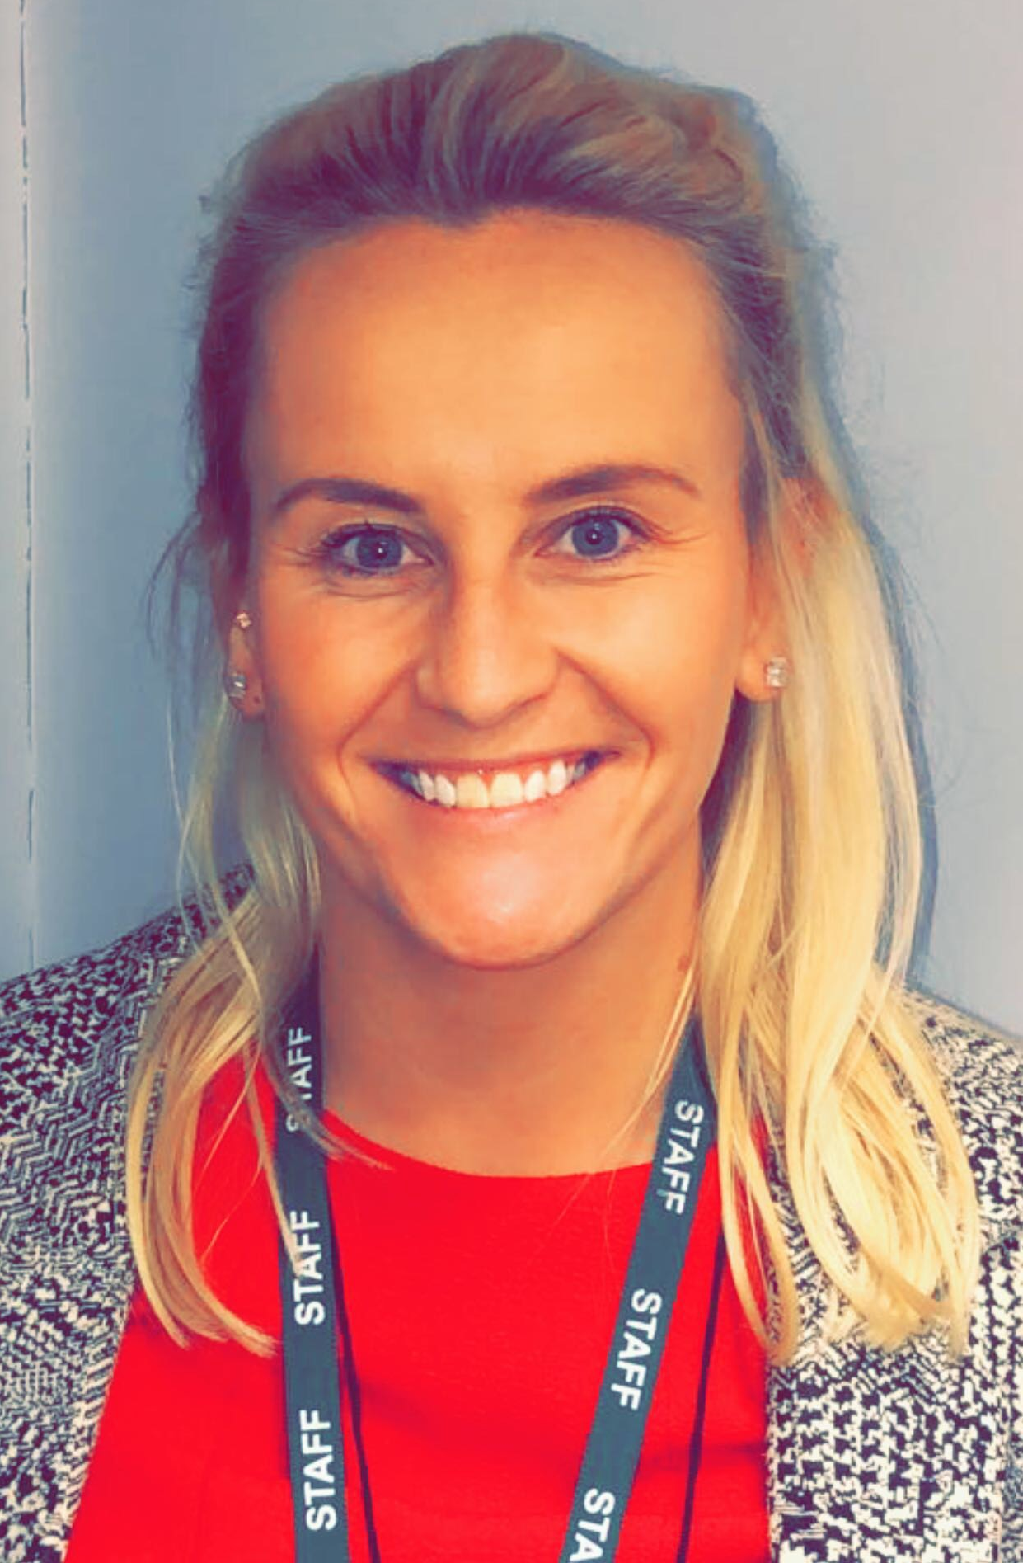
Hi, my name is Miss Robson.
I have been a member of the pastoral team at St. Wilfrid’s since 2018 and I teach History. A good History based GIF or meme will make me laugh!
You’re very welcome at St. Wilfrid’s and I look forward to seeing you after the Summer. I’m sure you will make a wonderful addition to Cuthbert House!
Miss Robson
Assistant Head of Cuthbert House

Slide 4
Pastoral Team
Deputy Head (Pastoral)
Mrs McDiarmid
School Counsellors
Elaine Thompson
Emily Cooke
Attendance Officer
Mrs Woodhouse
Mrs Hudson
School Chaplain
Mrs Boylan
Head of House Aidan
Mr. Manuel
Assistant HOH
Mr. Murphy
Head of House Bede
Miss McCarthy
Assistant HOH
Miss Moreira
First Aid Manager
Mrs Reed
Head of House Cuthbert
Mrs Tiffin
Assistant HOH
Miss Robson
Head of House Hilda
Miss Marshall
Head of House Margaret Clitherow
Mrs Kennedy
Pupils are allocated to house using sibling links, friendship groups and other key factors
Notes:
Refer to safeguarding – “We take it very seriously at St. Wilfrid’s”. Point out the picture on the wall of the safeguarding team– note where it is. Any safeguarding issue is dealt with as priority by a member of the team.
Mention the two Y7 form tutors (Miss Dyer 7B1 and Miss Jones 7B2) attached to Bede House. State that the pupils met the form tutors on Thursday and Friday during their transition days.
As a parent/carer your first point of contact would be through a message in the planner for the tutor or HoH. If you feel you need to contact the HOH directly then this can be done through phoning the school number 0191 4569121 or emailing HOH – all details will be on the last slide so that they have time to copy them down.

Slide 5
Pastoral Team
Deputy Head (Pastoral)
Mrs McDiarmid
Head of House Cuthbert
Mrs Tiffin
Assistant HOH
Miss Robson
School Counsellors
Elaine Thompson
Emily Cooke
Attendance Officer
Mrs Woodhouse
Mrs Hudson
School Chaplain
Mrs Boylan
First Aid Manager
Mrs Reed
7 Cuthbert 1
Miss E Stephenson
Notes:
Refer to safeguarding – “We take it very seriously at St. Wilfrid’s”. Point out the picture on the wall of the safeguarding team– note where it is. Any safeguarding issue is dealt with as priority by a member of the team.
Mention the two Y7 form tutors (Miss Dyer 7B1 and Miss Jones 7B2) attached to Bede House. State that the pupils met the form tutors on Thursday and Friday during their transition days.
As a parent/carer your first point of contact would be through a message in the planner for the tutor or HoH. If you feel you need to contact the HOH directly then this can be done through phoning the school number 0191 4569121 or emailing HOH – all details will be on the last slide so that they have time to copy them down.

Slide 6

School Uniform
The school has a rigid policy concerning uniform; it must be adhered to at all times.
Extreme haircuts (tramlines, patterns, ‘V’ cuts or colours) are not acceptable. Hair must be no shorter than no.2
Make up or jewellery, including plastic retainers, must not be worn.
Mobile phones should be switched off and kept in lockers during the school day. Any phone seen will be confiscated and parents/carers will need to come and collect it at the end of the school day.

Slide 7
PE Kit
PE kit will potentially also be required but for this academic year there will be no expectation for this item to be initialled in order to allow them to be ordered online.
Black shorts
Black football socks
Black tracksuit bottoms (plain)
White polo shirt with or without college badge
Football boots
Optional tracksuit
Trainers

Slide 8
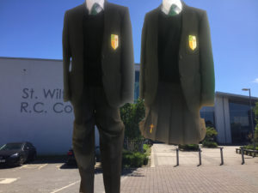

School Uniform
Black blazer with school badge and braid attached.
Regulation grey school skirt worn at the knee or tailored school trousers (no tight fitting trousers).
Regulation white shirt buttoned to neck.
Clip-on tie (green with gold diagonal stripes).
Sensible outdoor coat (plain, dark colours).
Plain black tights or black socks.
Plain black sensible school shoes without logos (no trainers shoes, or plimsolls).

Slide 9
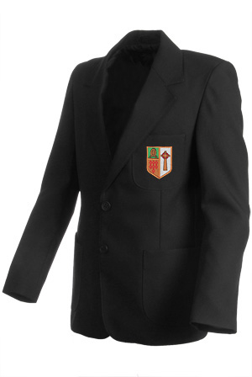

School Uniform
COLOURED HOUSE BRAID TO BE SEWN ON BLAZER POCKET ABOVE SCHOOL BADGE
Initial Images
2E Rekendyke,
Eldon Street,
South Shields
NE33 5BZ
0191 4558128
Notes:
Pupils should have braids and badges sewn on. Pupiils have 6 weeks to do this. Sanctions will be issued if they are not sewn on after a warning has been given – just in case a parent asks we normally place pupils on groundings but don’t dwell on the –ve in the delivery of the presentation.

Slide 10
School Equipment
All pupils must have a school bag to carry books and equipment.
Pupils must come to school equipped with a pen, pencil, ruler, eraser, sharpener and planner.
Pupils will also require an apron for Design and Technology and a set of cheap headphones / earphones for music lessons.
Notes:
Planners will be given to pupils the 1st day of school – show the parents the planner
Good practice is to encourage your child to do their homework each evening and not let it pile up.
Support your child by taking a quick look at their planner each evening. Don’t leave it until the end of the week to check their homework.
Planners need signing each week.

Slide 11
The School Day
School starts at 08.45am each morning. Pupils should be on site by 08.40am.
Pupils can enter school via the Temple Park Road entrance or the Grey Hen entrance; not via Harton Lane.
Pupils should not be brought in the main entrance by car, there is no drop off facility in the school car park.
12.10pm lunchtime for Y7 pupils; no pupils are allowed off site at lunchtime.
15.10pm School finishes for the day. Pupils should not be collected in the school car park as there is no vehicle access for parents/carers.

Slide 12
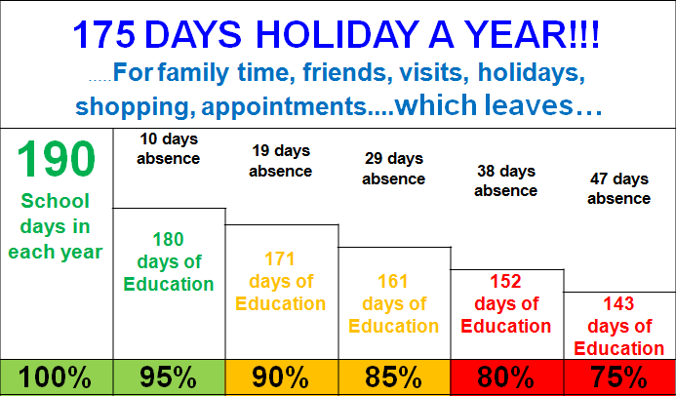
Attendance
We expect all pupils to achieve a minimum of 95% attendance each year.

Slide 13
Attendance
If your child is going to be absent please contact school before 8.45 am on the first day of absence.
If your child needs to attend a medical appointment in school time, please send notification via the planner into school in advance to receive a pass out from the Head of House.

Slide 14
Rewards
The school promotes high standards of behaviour,
self discipline and learning through positive encouragement and rewards.
When pupils do something well, teachers will recognise this by awarding:
Credits
Excellence awards
Special certificates
Celebration experiences
Prize Lottery

Slide 15
Sanctions
Debit & Code of Conduct
Behaviour Referral
Detention
Internal Exclusion
Notes:
HoH will contact parents if we feel there is an issue with the amount of debits a pupil is receiving. We want to ensure that any issues are dealt with quickly. Sometimes a pupils may be struggling and that is the underlying reason for not completing work – so we need to support pupils. In order to do this we must have your up to date contact information. HoH can update the school system if you email any change of phone numbers email addresses and home addresses to her.
Again, look at your child’s planner to monitor their progress.
Ask parents if they could you also supply Mrs McIntosh with details of any duplicate reports that you would like sending home

Slide 16
Subjects
At KS3 all pupils study:
English, Mathematics, Science, RE, PE, Music, History, Geography, French, Technology and Art. Some will study Mandarin.
PSHE and Citizenship are delivered one lesson per week and via a series of events and assemblies throughout the year.

Slide 17
Who to contact?
Mrs Tiffin
Head of Cuthbert House
Or
Miss Robson
Assistant Head of House
0191 456 9121
etiffin@st-wilfrids.org
mrobson1@st-Wilfrids.org
www.st-wilfrids.org
Notes:
It’s “L” for Louise at the beginning of the email – people read it as an “I”
Email is better as I can pick it up when I’m not in my office but it’s no problem phoning and leaving a message
I haven’t put yourself down as a contact John, as it gets very confusing as to who has dealt with an issue. Best if everything comes to me and I’ll delegate where necessary.
I’ve put my picture on so people can put a face to the name – apologise for me –Also apologise for the blue dress too – it should be red for Bede House. ☺
Reiterate the need for contact information to be up to date. Many messages are sent out via school text service “group call”. We also can’t contact you in emergency if we don’t have up to date numbers.
Can you also ask parents to contact me if they require duplicate reports / module data sent to two households. We often get irate dads on the phone but we can’t send out the information if we don’t have the details!

