Slide 1
Welcome to St. Wilfrid’s RC College Hilda House
Parents/Carers Meeting July 2020

Slide 2
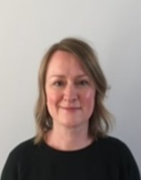
Hello, my name is Miss Marshall and I am Head of Hilda House (the best house in school). ​
I teach geography and have been part of the pastoral team at St Wilfrid’s since 2002! ​
​
I enjoy baking, learning new creative skills and looking after my allotment with my children. ​
I look forward to welcoming you to St Wilfrid’s, and to Hilda House. This year the house trophy is ours!
Miss Marshall
Head of Hilda House

Slide 3
Pastoral Team
Deputy Head (Pastoral)
Mrs McDiarmid
School Chaplain
Mrs Boylan
First Aid Manager
Mrs Reed
School Counsellors
Elaine Thompson
Emily Cooke
Attendance Officer
Mrs Woodhouse
Mrs Hudson
Head of House Aidan Mr Manuel
Assistant HOH
Mr Murphy
Head of House Bede
Ms McCarthy
Assistant HOH
Miss Moreira
Head of House Cuthbert
Mrs Tiffin
Assistant HOH
Miss Robson
Head of House Hilda
Miss Marshall
Assistant HOH
{name}
Head of House Margaret Clitherow Mrs Kennedy
Pupils are allocated to houses using sibling links, friendship groups and other key factors.

Slide 4
Temporary School Uniform
The only uniform required from September is the following:
Approved knee-length grey pleated skirt with embroidered school logo or grey full-length regulation school trousers (tight fitting or jean-style prohibited). School trousers for all pupils must be full-length (to the bottom of the leg) and not of a short or cropped style. They can be tailored but not skinny-style trousers.
White school shirt that buttons all the way to the neck.
School jumper with logo (optional).
Black formal school shoes.

Slide 5
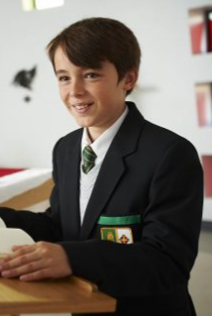
School Uniform after October Half Term
Black blazer with school badge and braid attached.
Regulation grey school skirt worn at the knee or tailored school trousers (no tight fitting trousers).
Regulation white shirt buttoned to neck.
Clip-on tie (green with gold diagonal stripes).
Sensible outdoor coat (plain, dark colours).
Plain black tights or black socks.
Plain black sensible school shoes without logos (no trainers shoes, or plimsolls).

Slide 6
PE Kit
PE kit will also be required but for this academic year there will be no expectation for this item to be initialled in order to allow them to be ordered online.
Black shorts
Black football socks
Black tracksuit bottoms (plain)
White polo shirt (with or without college badge)
Football boots
Optional tracksuit
Trainers

Slide 7
School Uniform Policy
The school has a rigid policy concerning uniform; it must be adhered to at all times.
Extreme haircuts (tramlines, patterns, ‘V’ cuts or unnatural colours) are not acceptable. Hair must be no shorter than a number 2.
Make up or jewellery, including plastic piercing retainers, must not be worn.
Mobile phones should be switched off and kept in lockers during the school day. Any phone seen or heard will be confiscated and parents/carers will need to come and collect it at the end of the school day.

Slide 8
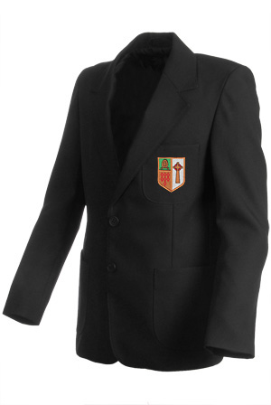
School Uniform Supplier
House braid to be sewn onto blazer pocket above school badge.
Our uniform provider is:
Initial Images
2E Rekendyke, Eldon Street, South Shields NE33 5BZ
0191 4558128
sales@initialimages.co.uk

Slide 9
Equipment
All pupils must have a school bag to carry books and equipment.
Pupils must come to school equipped with a pen, pencil, ruler, eraser, sharpener and their planner, which they will be given in September. Planners should be signed by parents/carers each week (you child’s form tutor will let them know which day).
Pupils will also require an apron for DT and a set of headphones/earphones for music lessons (nothing fancy!).

Slide 10
The School Day
Pupils should be on site by 08:40. Registration starts at 08:45 each morning.
Pupils can enter school via the Temple Park Road entrance or the Grey Hen entrance (the Harton Lane entrance is now closed).
Pupils should be encouraged to walk or cycle into school. If they live further away, then the Scholar’s or a public bus would be a good alternative. Please do not bring pupils to the main entrance by car as there is no drop off facility in the school car park.
12:10 is lunchtime for Y7 pupils. All pupils must remain on site at lunchtime.
15:10 is when school finishes for the day.

Slide 11
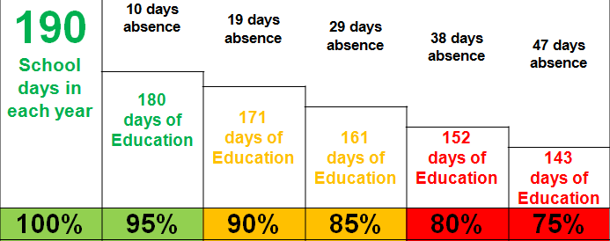
Attendance
We expect all pupils to achieve a minimum of 95% attendance each year.
During the school year there are 175 days’ holiday for family time, friends, visits, holidays, shopping, appointments, etc, which leaves…

Slide 12
Attendance
If your child is going to be absent please contact school before 08:45 on the first day of absence.
If your child needs to attend a medical appointment in school time, please send a note in their planner (with evidence) as far in advance as possible in order to obtain permission from Head of House.

Slide 13
Rewards
The school promotes high standards of behaviour,
self discipline and learning through positive encouragement and rewards.
When pupils do something well, teachers will recognise this by awarding:
Credits
Excellence awards (worth five credits)
Special certificates
Celebration experiences
Prize lottery

Slide 14
Sanctions
If a pupil’s behaviour falls short of the high standards we expect, they will be issued with one of the following sanctions:
Debit
Behaviour referral
Detention
Internal exclusion

Slide 15
Pupil Profiles
KS2 data and other key information is used to start to build up an individual pupil profile, which will continue through until Year 11.
The profile will enable the school to set pupils in academic lessons according to their specific ability.
Classes are taught in set ability groups. This is monitored closely to ensure all pupils can reach their full potential.
Information is continually added to profiles. These will be sent to parents/carers three times a year.
At the end of each academic year, pupils will sit formal examinations.

Slide 16
Subjects
At KS3 all pupils study English, Mathematics, Science, RE, PE, Music, History, Geography, French, Technology and Art. Some will also study Mandarin.
PSHE and Citizenship are delivered once a week and through a series of events and assemblies throughout the school year.

Slide 17
Contact
Miss Marshall Head of Hilda House
0191 456 9121
lmarshall3@st-wilfrids.org
www.st-wilfrids.org

