Slide 1
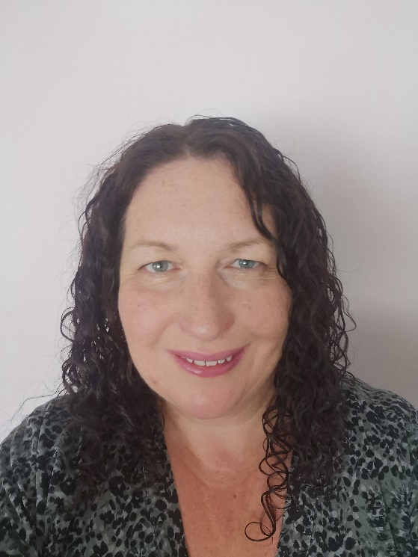
Hello, my name is Mrs Lisgo and I teach RE.
I will be starting at St Wilfrid's in September just like you! I am really looking forward to meeting and getting to know you all.
During lockdown I have been on lots of walks with my family and our Golden Retriever dog. His favourite place to walk is on the beach!
I hope you have a wonderful summer and I can’t wait to meet you all.
7A1
Mrs N Lisgo

Slide 2
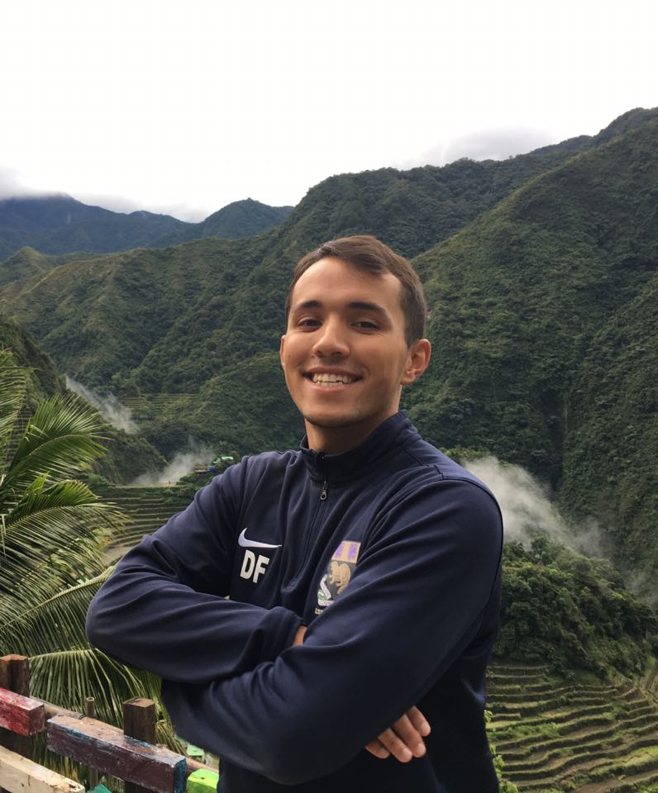
Hi Guys!
I’m Mr Fuller and I joined St Wilfrid’s as a Maths teacher last year. I hope you’re all excited about the journey ahead – we’re all looking forward to meeting you.
I love sports and I’m a huge Arsenal fan. Since there was no football for 3 months during lockdown I’ve spent my time reading, running, cycling and cooking.
Everyone at St Wilfrid’s is looking forward to sharing this adventure with you. Stay safe, rest up and get ready for the year ahead!
See you all soon!
7A2
Mr D Fuller

Slide 3
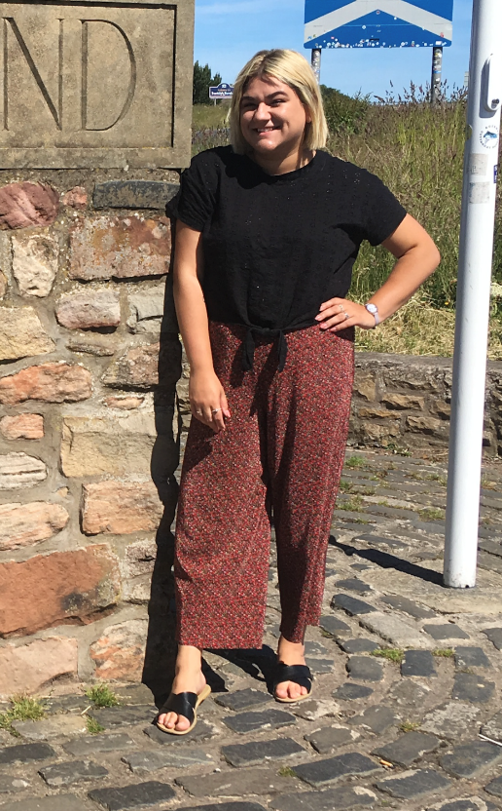
Hi 7B1! I’m Miss Suljic and I’ve been teaching English at St Wilfrid’s since last year! I am SO excited to meet all of you in September. Everyone at St. Wilfrid’s is so excited for you to join us in September.
While I’ve been in lockdown, I’ve learned how to bake some really good cakes and treats (well, I think they’re really good! Maybe you can help me judge ?)
Usually, when I’m not at school, I’m usually out and about walking my dog (Rex), watching Marvel movies, or reading books on the sofa.
I hope you all have a safe and restful summer and I can’t wait to meet you all.
7B1 Miss Suljic

Slide 4
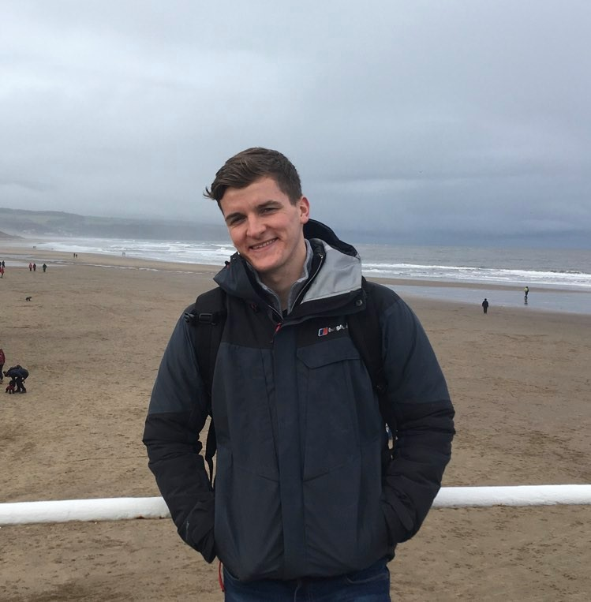
Hello everyone,
My name is Mr. Howcroft and I am a Geography teacher at St’ Wilfrid’s.
I hope you are all exciting about starting your new journey and joining us at St. Wilfrid’s, we are all so excited to meet you!
As a Geography teacher I enjoy visiting new countries and experiencing new cultures, whilst also keeping a firm eye on most sporting events!
We look forward to seeing you at St. Wilfrid’s to see what amazing talents you can add to Bede House! Enjoy the summer break and I will see you all soon!
7B2 Mr M Howcroft

Slide 5
Hi year 7! I’m Miss Stephenson and I’ll be your form tutor in September, I also teach English at St. Wilfrid’s.
I can’t wait to meet you all.
I was a year 7 form tutor last year too, in Cuthbert House. (A brilliant house to be a part of!) I really enjoyed it so I’m excited to do it all again. Next year is only my second year at St. Wilfrid’s so I remember how it feels to be arriving somewhere new, it’s a very friendly place though so you have nothing to worry about!
During lockdown I’ve been cycling a lot, running (a bit) and reading. I hope you’ve all been staying safe and having a relaxing time, no matter what you’ve been doing.
Bring on September! (After a relaxing and fun summer break, of course.)
7C1 Miss E Stephenson

Slide 6
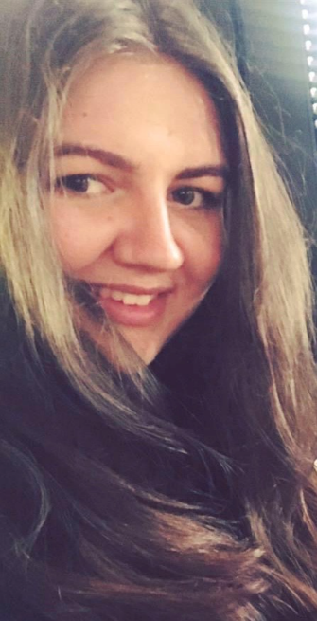
Hi 7H1 !!!
I hope everyone is excited to join St Wilfrid’s and Hilda house! I am very excited to be a Hilda tutor again.
I am very lucky, I said goodbye to my lovely year 11 tutor group and now get an even better year 7 tutor group (hopefully)….
My name is Miss Tennet, I am a lead practitioner in maths at St Wilfrid’s.
I love travelling and seeing new places. I am also a HUGE Disney fan ☺. During lockdown I have loved spending lots extra time with my family and baking lots of sweet treats.
Have a lovely summer. I can’t wait to meet you all in September.
7 H1
Miss H Tennet

Slide 7
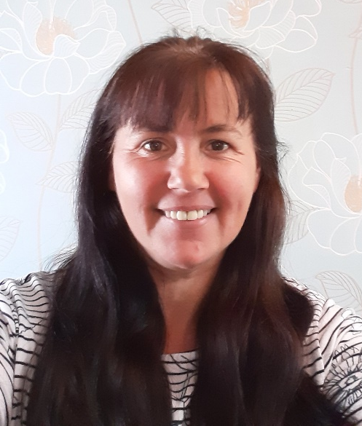
Hello Everyone
Not long now until you are part of St Wilfrid’s School.
St Wilfrid’s is a very friendly place so I am sure you are going to love it!
I am very excited about meeting you and getting to know you all.
I am Head of Art at St Wilfrid’s (The best subject of course!!)
I spend my time drawing and painting, sewing, gardening and walking my wonderful dog George.
Enjoy the summer holidays and I will see you all soon.
7 H2
Mrs S Gribben

Slide 8
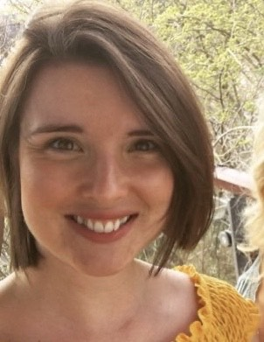
Hola,
My name is Miss Hume and I’m one of the Lead Practitioners and Head of Spanish here at St. Wilfrid’s. I am so excited to meet you all and be your form tutor in September!
I love languages and travel – I spent 1 year living in Mexico and 4 years living in Chile. Back in the UK, I now satisfy my craving for all things Latin American by eating tonnes of tacos, watching lots of TV shows in Spanish, reading lots of books set in Spain or Latin America and of course, speaking lots of Spanish with my pupils.
I cannot wait to meet you all in September y espero que tengan un excelente verano (and I hope you all have an excellent summer) xx
7MC1 Miss R Hume

Slide 9
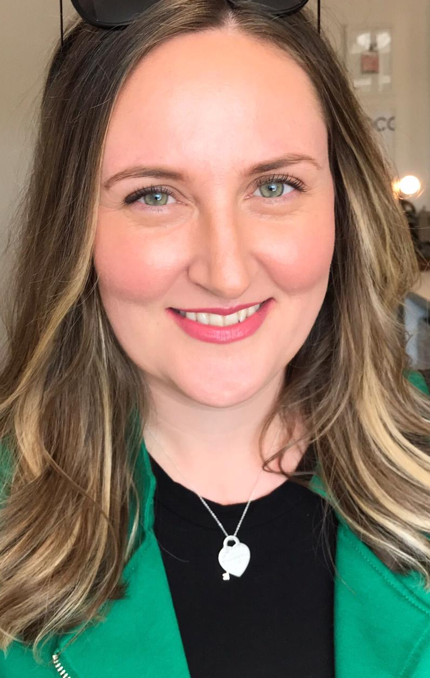
Hello! My name is Mrs Barrett and I am the Head of Modern Foreign Languages at St Wilfrid’s.
I have worked here for 9 years now, so I know the school really well. I will be able to help you figure everything out ☺
I’ve been spending most of my time in lockdown with my children who are 3 and one year old. We’ve enjoyed playing, reading and baking (and eating!) lots of banana bread.
I hope you are looking forward to joining us at St Wilfrid’s, it’s a very special place and I’m sure you will enjoy it. I am really excited to meet you in September!
À bientôt!
(that’s ‘see you soon!’ in French)
7MC2 Mrs C Barrett

