Slide 1
Welcome to St Wilfrid’s RC College Transition Information for Parents 2020

Slide 2
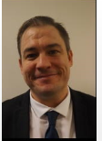
Photo supplied by Kate Reed
Hello, my name is Mr Price. I am the Acting Head Teacher here at St Wilfrid's .
I have been at St Wilfrid’s since 2010, it is an amazing place to work.
I am really looking forward to meeting you all.
During lockdown I have been in school planning for your arrival and also training my new Cockapoo puppy.
Have a fantastic summer and see you very soon.
Mr Price
Acting Head Teacher

Slide 3
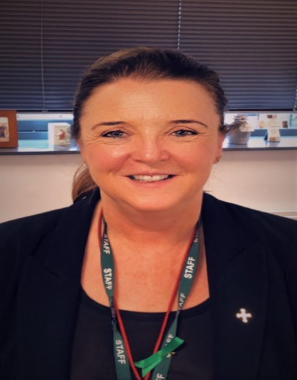
Photo supplied by Kate Reed
Hello, my name is Mrs McDiarmid. I am in charge of safeguarding, behaviour and attendance.
I have been a teacher at St Wilfrid’s since 2011, it is a happy place to work.
I am really looking forward to meeting you all.
During lockdown I have been reading lots of books, cycling and completing C25K.
Have an awesome summer and see you very soon.
Mrs McDiarmid
Deputy Head Teacher

Slide 4
Firstly, and most importantly, we are a Catholic school and everything we do is driven by the schools Motto
Excellentia per fidem, per scientiam, per adiuvatum.
Excellence through faith, learning and support.

Slide 5
Catholic Ethos & Discipline

Slide 6
Catholic Ethos
The Catholic Faith is at the heart of all we do. The Gospel values of Faith, Hope and Love are the guiding principles by which we live and work.
Through our programmes of liturgy, worship, retreats, Religious Education and charity work, we aim to enable our students to value the notion of service to others while offering opportunities to reflect on their own individual faith journeys.
By creating the conditions for our students to be the best they can be we are preparing the way for them to achieve the fullness of life as promised by Christ and to be active citizens of the 21st century, bringing hope to their families, friends, community and nation.
We aim to encourage in all members of our school a love of learning, a love of each other and a love of God.

Slide 7
Behaviour and Discipline: Ofsted Oct 2018
Pupils are highly courteous and polite towards staff and visitors. Behaviour is excellent.
The behaviour of pupils is outstanding. During the inspection, the standard of pupils’ behaviour in lessons was never less than impeccable. Conduct around the school was equally impressive, with calm and orderly movement a matter of routine.
Pupils conduct themselves towards staff and visitors with good manners and courtesy. The strength of relationships between staff and pupils is a significant reason why the standard of learning across the school is so high.

Slide 8
Discipline
We have a name for being a calm and disciplined school. We work hard at this and ask all pupils and parents to work with us to maintain this reputation.
Good discipline and self control underpins the whole school day.
Bullying, disruption, insolence to staff will never be tolerated.
We run a strict school we concentrate on the small things such as attitude, behaviour and effort.
We speak to each other with respect.
We expect the highest standards of uniform and footwear, and do not accept extreme haircuts, make-up, jewellery etc.
■ St Benedict said: “The good of all concerned may prompt us to a little strictness in order to amend faults and to safeguard love”.

Slide 9
Our Pastoral System
We operate a House system which your child will join – St Aidan, St Cuthbert, St Bede, St Hilda and St Margaret Clitherow (St Columba 6th form).
Siblings remain in the same House so that strong links are made between families and the Heads of House.
Each House has a strong sense of identity, reinforced via powerful corporate House image and regular inter House competitions including cross country, dance, football and quizzes.
We celebrate achievement through Praise and Reward assemblies, post-cards home, certificates and prizes.
Each child is also placed into a from group with a dedicated Form Tutor who is key to our pastoral system.

Slide 10
Pastoral Team KS3 & 4
School Counsellors
Mrs Thompson
Miss Cooke
School Chaplain
Mrs Boylan
Attendance
Mrs Woodhouse
Mrs Hudson
Deputy Head
Mrs McDiarmid
Medical Assistant
Mrs Reed
Heads of House
Aidan House
Mr Manuel
Cuthbert House
Miss Tiffin
Bede House
Miss McCarthy
Hilda House
Miss Marshall
Margaret Clitherow House
Mrs Kennedy
Assistant HoH
Mr Murphy
Assistant HoH
Miss Robson
Assistant HoH
Miss Moreira
Assistant HoH
TBC
Form tutors
Pupils are allocated to House using sibling links, friendship groups and other key factors

Slide 11
Year 7 Form Tutors
Mrs N Lisgo 7A1
Mr D Fuller 7A2
Miss M Suljic 7B1
Mr M Howcroft 7B2
Miss E Stephenson 7C1
Miss H Tennet 7H1
Mrs S Gribben 7H2
Miss R Hume 7MC1
Mrs C Barrett 7MC2

Slide 12
Pastoral Support in St Wilfrid’s
First port of call with any minor issue in school is the Form Tutor, they should be able to advise your child with any minor work or friendship issue.
For more serious problems please contact your child’s Head of House via phone or email - they will return your call within 24 hours. They will deal with any worries or issues you have.
Each child is supplied with a school planner, this can be a good method of communicating information to your child’s tutor. This needs to be checked and signed every week by a parent or carer.

Slide 13
Attendance and expectations
We expect all pupils to have a minimum of 95% attendance. Mrs Woodhouse and Mrs Hudson support our pupils to ensure that they achieve this target. We also work closely with the local authority if pupils are finding it difficult to achieve this target.
Please try to make medical/dental appointments after school or towards the end of the school day to reduce the amount of time your child has away from school. If this is impossible, send a letter into school so that your child can receive a pass out from their Head of House.
School starts at 8.45 am. We expect pupils to be on time and ready to work.

Slide 14
The School Day

Slide 15
Main achievements
Judged as Outstanding in all areas by OFSTED, October 2018.
World Class award status, a quality mark to non-selective state schools that offer the best education to young people in the UK.
Outstanding examination results across the school and high predictions for this year.
Teaching School Status, recognising the excellent learning experience our pupils receive from highly strained staff.

Slide 16
What else makes this school special ?

Slide 17
Developing the whole child
Professional, caring staff who are dedicated to welcoming every child, and ensuring that each one reaches their full potential .
A broad curriculum, enriched by a wide range of extra opportunities for children of all abilities, outlooks and interests.

Slide 18
Partnership between Home and School
We have developed and continue to build fantastic partnerships with you the parents. Our job is made much easier if we have your support.
Our aim is the same as yours, that while at school your child is safe, happy and successful.
I look forward to counting on your support for the years to come.

