Slide 1
Modern Foreign Languages
Year 7 pupils starting in September 2020 will be learning French.
Pupils in 7S will also have the exciting opportunity to learn Mandarin as a second foreign language alongside French.
Meet the St Wilfrid’s MFL Team………
Can you guess which languages they speak? And what they’re currently learning?

Slide 2
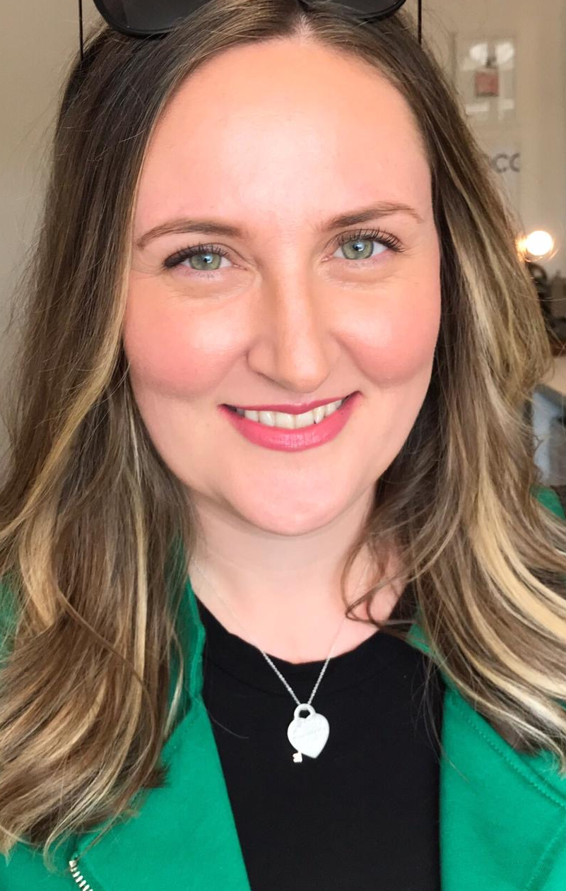
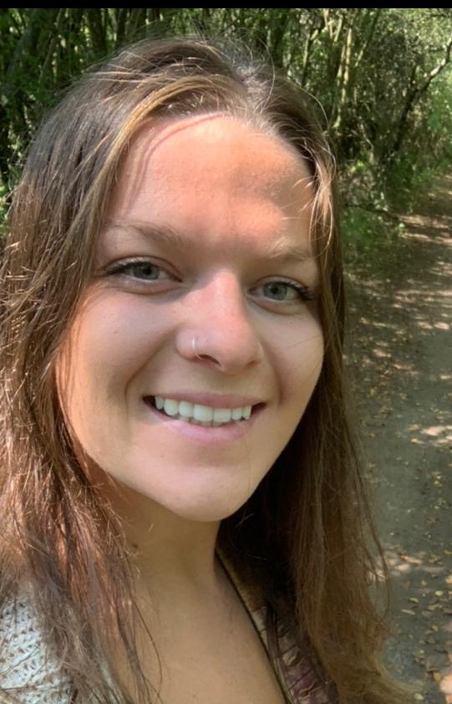
Je m’appelle – I am called
Je parle – I speak
J’apprends – I’m learning
Bonjour! Je m’appelle Madame Barrett.
Je parle français, allemande et un peu néerlandais.
J’apprends l’espagnol.
Bonjour! Je m’appelle Mademoiselle Quested.
Je parle français, espagnol et italien.
J’apprends le russe.
*un peu – a little bit

Slide 3
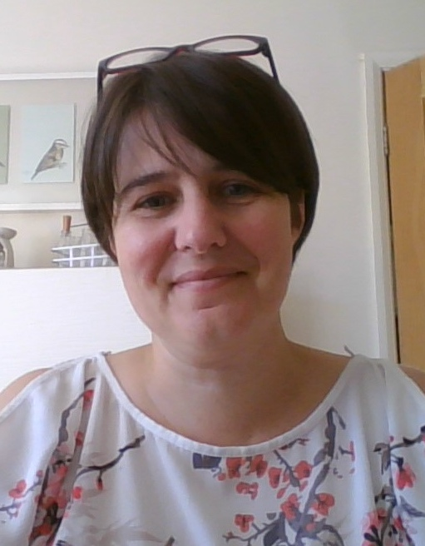
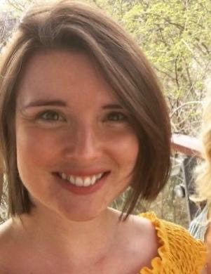
Je m’appelle – I am called
Je parle – I speak
J’apprends – I’m learning
Bonjour! Je m’appelle Madame Masters.
Je parle français et espagnol.
J’apprends le mandarin.
Bonjour! Je m’appelle Señorita Hume.
Je parle espagnol, portugais et un peu français.
*un peu – a little bit

Slide 4
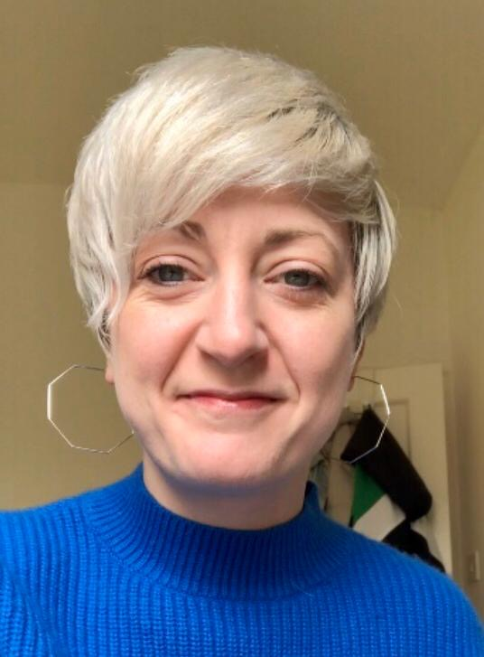
Je m’appelle – I am called
Je parle – I speak
J’apprends – I’m learning
Bonjour! Je m’appelle Señorita Moreira.
Je parle espagnol et portugais.
Bonjour! Je m’appelle Mademoiselle McCarthy.
Je parle français, portugais, espagnol, catalan et un peu quechua.
J’apprends l’italien.
*un peu – a little bit

Slide 5
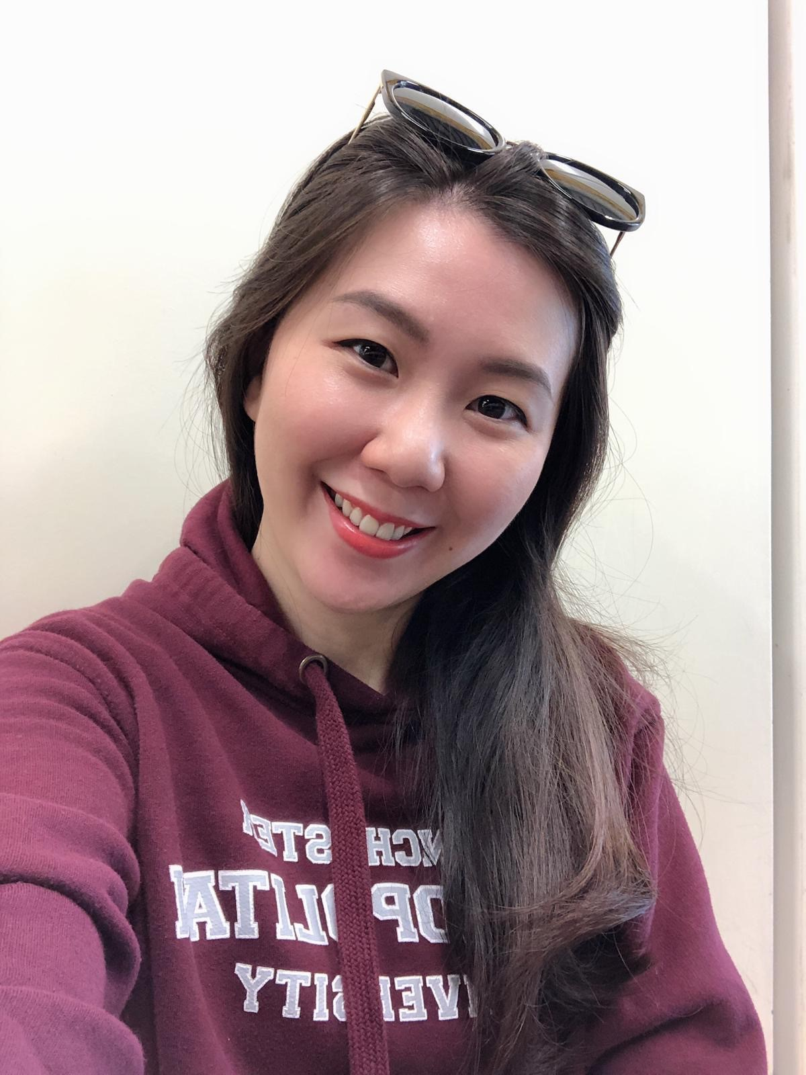
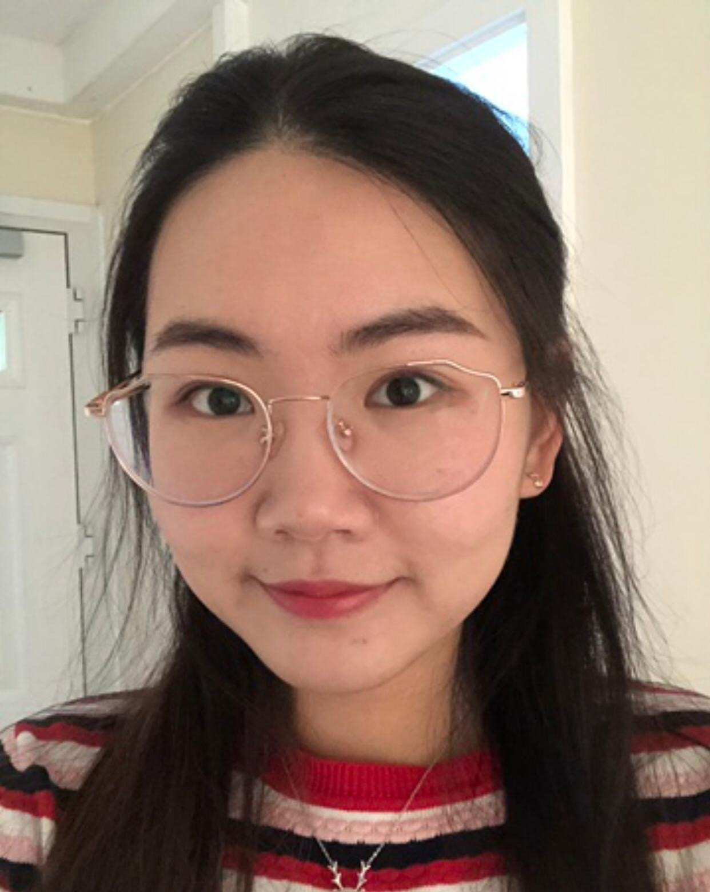
Je m’appelle – I am called
Je parle – I speak
J’apprends – I’m learning
Bonjour! Je m’appelle Miss Chia.
Je parle mandarin, malais, cantonais, anglais et un peu coréen.
J’apprends le français et l’allemand.
Bonjour! Je m’appelle Miss Tong.
Je parle mandarin, anglais et un peu japonais.
J’apprends l’espagnol.
*un peu – a little bit

Slide 6
How many languages did you recognise?
l’anglais – English
le français – French
l’allemand – German
l’espagnol – Spanish
le russe – Russian
le mandarin - Mandarin
l’italien - Italian
le portugais – Portuguese
le catalan - Catalan
le quechua – Quechua
le malais – Malay
le cantonais – Cantonese
le coréen – Korean
le japonais - Japanese
As you can see, we love languages!

Slide 7
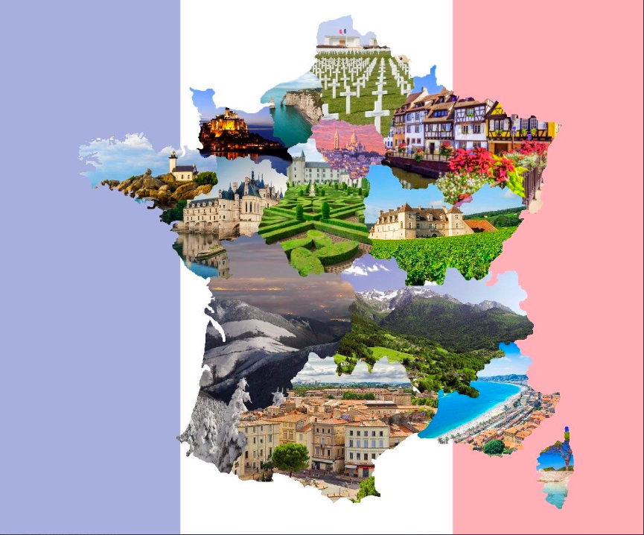
Year 7 Transition activities

Slide 8
Pour commencer... Quick Quiz!
How many teachers do you think there are in the MFL (Modern Foreign Languages department?)
6 8 10
Which 3 languages do we teach at St. Wilfrid’s?
Bengali French German Mandarin Spanish
3. How many languages do you think there are in the world? (Guess!)

Slide 9
Self-correct your answers, how did you do??
Answers:
8
French, Spanish, Mandarin
6,500

Slide 10
For this session we are going to focus on two Key Questions to prepare you for life at
St. Wilfrids in September.
Ton collège est comment? = What is your school like?
Tu étudies quelles matières? = What subjects do you study?
By the end of this session you will be able to answer these questions in French!

Slide 11
This is an example of what we call a ‘Sentence Builder’ at St. Wilfrids and you will be using them in September. Read it from left to right. For example: Dans mon collège, il y a un terrain de foot énorme = In my school there is an enormous football pitch
Ton collège est comment? = What is your school like?
Dans mon collège, il y a .. (in my school, there is..) | un terrain de foot (a football pitch) un gymnase (a gym) un terrain de jeu (a playground) un laboratoire (a lab) une cantine (a canteen) une salle de réunion (an assembly hall) une salle d’art (an art room) une salle informatique (an IT suite) une chapelle (a chapel) | moderne (modern) démodé/démodée (old fashioned) énorme (enormous) utile (useful) génial/géniale (great)
How many sentences can you make in French using the sentence builder above?
Can you try reading it out loud in a French accent?

Slide 12
On paper, write the English for these school facilities
Dans mon collège, il y a… (In my school there is…)

Slide 13
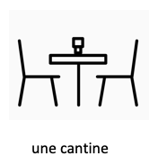

Slide 17
Tu étudies quelles matières? = What subjects do you study?
Lundi (on Monday) Mardi (on Tuesday) Mercredi (on Wednesday) Jeudi (on Thursday) Vendredi (on Friday) | j’étudie (I study) | l’art plastique (art) l’anglais (English) l’EPS (PE) la musique (music) le français (French) l’espagnol (Spanish) le mandarin (Mandarin) la religion (religion) la géographie (geography) l’histoire (history) la technologie (DT) l’informatique (IT) les sciences (science) les maths (maths) le théâtre (drama) l’éducation civique (PSHE)
Use the sentence builder to write 3 sentences about what subjects you study.
Example:
Lundi j’étudie l’art plastique = On Monday I study art
Jeudi j’étudie l’EPS = On Thursday I study PE

Slide 18
See Marie’s timetable at St. Wilfrid’s in September. (Periods 1-6 and their timings are the same as what you will have!)
Answer the questions below ☺
Heure | Lundi | Mardi | Mercredi | Jeudi | Vendredi
1. 9h00 – 9h55 | Le français | la religion | l’art plastique | la religion | l’anglais
2. 9h55-10h55 | la musique | Le français | le théâtre | les sciences | les sciences
10h55-11h10 | Recré | Recré | Recré | Recré | Recré
3. 11h10 – 12h10 | l’anglais | les sciences | la religion | le théâtre | la religion
4. 12h10 -13h10 | Déjeuner | Déjeuner | Déjeuner | Déjeuner | Déjeuner
5. 13h10 – 14h10 | les maths | les maths | l’EPS | les maths | l’art plastique
6. 14h10 -15h10 | les sciences | l’informatique | Le français | la géographie | la géographie
What does Marie have period 3 on a Tuesday?
What does Marie have period 6 on a Friday?
How many RE lessons does Marie have?
What does Marie have after Art on Wednesdays?
When does she have PE?
What do you think the words ‘Récré’ and ‘Déjeuner’ mean?

Slide 19
Answers:
Science
Geography
4
Drama
Period 5 on Wednesday
Récré is breaktime and Déjeuner is lunchtime.
How many did you get??

Slide 20
Finally, to finish off, have a go at answering these questions on your paper!
(Use the sentence builders to help you, but if you can answer without them, that’s fantastique!!
Ton collège est comment? = What is your school like?
Tu étudies quelles matières? = What subjects do you study?

Slide 21
We look forward to meeting you soon!
Au revoir!
Sayonara!
Adiós!
Zàijiàn!
Adéu!
Tschüß!
Tchau!
Tot ziens!

