Slide 1


St Wilfrid’s RC College January Remote Learning
Remote Learning Provision Year 11/13
Livestream lessons via GoogleMeets. Students are to attend livestream lessons delivered by their teachers, following their timetable.
‘How to use GoogleMeets’ tutorials for students are available on their Google Classroom year group class streams.
Remote Learning Provision Year 7-9, Year 12
There will be a blend of livestream lessons and recorded lessons. At least one livestream lessons via GoogleMeets will take place per subject, per week. Students are to attend livestream lessons delivered by their teachers, following their timetable.
How to use GoogleMeets’ tutorials for students are available on their Google Classroom year group class streams.
Teachers will be available via Google Classroom chat during the recorded timetabled lesson time to provide support and guidance with the lesson tasks and content.
Responsibilities when Remote Learning is taking place
Student The pupil’s role during a period of self-isolation or forced home learning is to follow their timetable throughout the remote school day logging on to Google Classroom: Lessons Log onto Google Classroom and complete all work set for that day as per the timetable. Follow the provided lesson instructions. Seek support when needed through the GC chat function Use the self-assessment mechanisms to assess work Complete assessments in the allotted time and submit as requested by your subject teacher. Respond to feedback given Engagement and Effort All work should be completed with maximum effort Behaviour, Safeguarding and AUP (Acceptable User Policy) Follow academy behaviour policy. Follow AUP guidelines at all times. Behaviour, Safeguarding and AUP – Livestream Lessons Attend livestream lessons per your timetable Cameras are automatically turned off. Do not attempt to turn them on; this will not work. Ensure that microphones are on mute Attend the tutorial individually, not with other members of the household Ensure that you are in an area which is free from distractions Use chat’ only to direct questions to the teacher Do not engage in off subject conversation with other invitees *Pupils who have been absent for any reason are expected to complete previously assigned work or work missed during absence on return to school. If pupils do not engage with online learning during the absence and parents have been contacted with no impact, when the pupil returns staff should set an achievable and realistic deadline for completion of this work. This should only result in one debit per series of incomplete work. | Parent/Carer The parent/carer’s role during a period of self-isolation or forced home learning is to ensure that their child is following their timetable, completing the work set and submitting it by the deadlines given. The role of the parent is to ensure that their child continues to engage if absent, and well enough, or self-isolating. Parents should continue to monitor, encourage and motivate their child to complete work set, always to the best of her/his ability. Parents can support by observing the following: Ensuring that each day their child logs in to Google Classroom and opens relevant lessons. If using paper copies of work, they must have these resources ready to commence their day. Assignments will regularly be set by class teachers. These should be completed by the deadline set and submitted in the format indicated by the teacher’s instructions. Paper copies to be brought back in upon return and quarantined for 72 hours. Pupils who have been absent for any reason will be expected to complete previously assigned work or work missed during absence on return to school. To contact the HoH of the child if they are experiencing any access issues via email. Behaviour, Safeguarding and AUP – Livestream Lessons Ensure your child is attending livestream lessons per the timetable Ensure that your child attends tutorials individually, not with other members of the household Ensure that you are in an area which is free from Ensure that if your child misses a livestream lesson that they catch up on the work by watching the recording. Technical support and forgotten passwords support is available at: helpdesk@st-wilfrids.org Support with lesson tasks: students must contact their class teacher using the Google Classroom chat function.

Slide 2


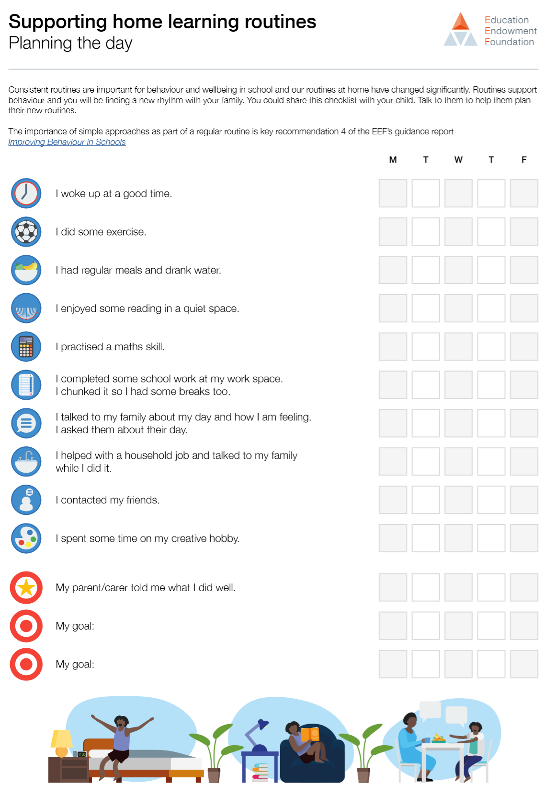





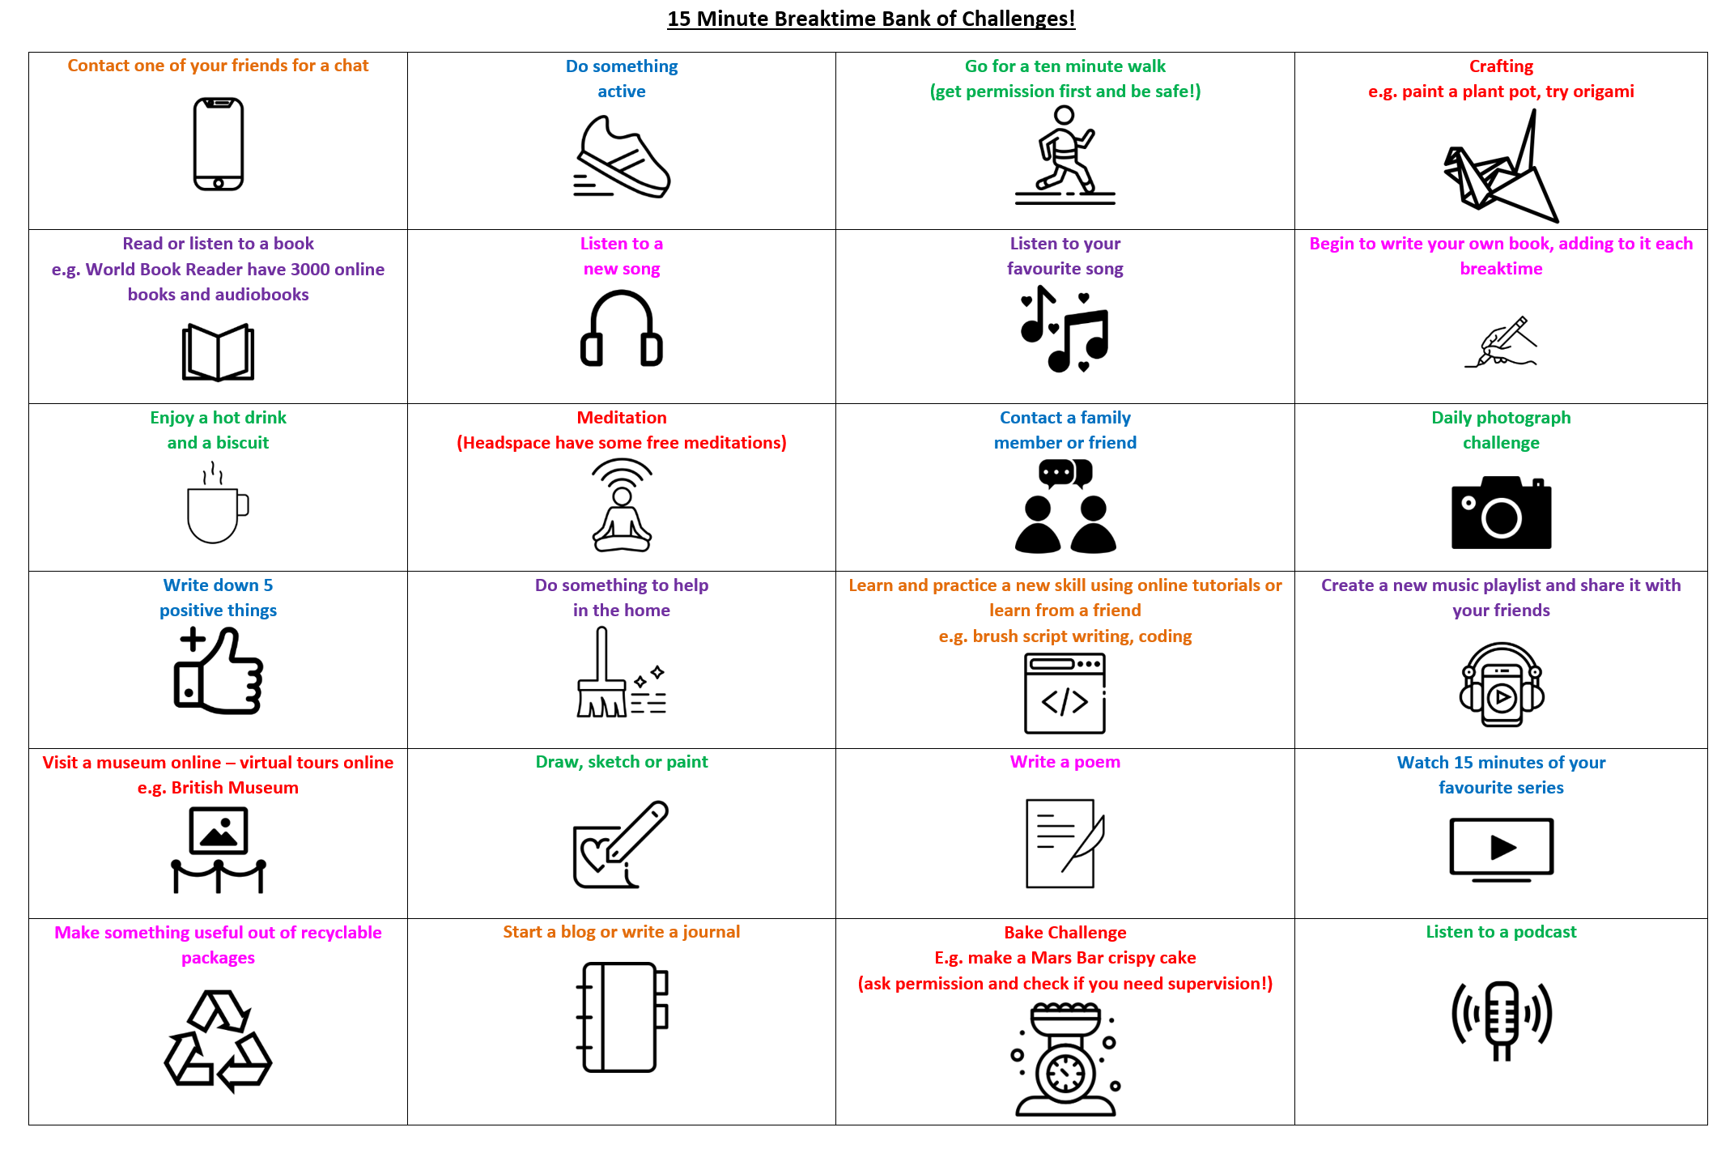
Thank you very much for your support in encouraging your child to engage with their learning at home.
The ethos behind our online learning is that the systems that we put into place during the school closure ensure that all members of our school community feel supported throughout and beyond the period of closure, so that staff and students return to school mentally and physically healthy. As part of this, we have produced this Parent Home Learning Toolkit to provide information and strategies to support to you.
As you know, each subject sets tasks each week for your child to complete per the timetable of each student.
As part of this, we understand that you may be experiencing a variety of roles when supporting your child and it is our intention to lessen the parental load in creating this toolkit.
Roles that you may be experiencing:
Conversational roles: questioning, prompting, support for enquiry and understanding
Encouraging engagement: helping to goal set, organise their workload/how time is spent, encouraging your child to start the work, encouraging your child to persist with the work, creating a home learning environment, encouraging wellbeing breaks
Supporting with accessing: interpreting instructions, correcting mistakes, supporting with log ins, helping them to locate resources
Environment
Create a quiet, comfortable, distraction free area
Be prepared to revise
Equipment, resources and refreshments
We encourage students to get involved in these activities and to take regular breaks where they take the time to refresh themselves.
We recommend helping your child to set a routine and set goals for their day.
We have produced a home learning timetable planner for students to use to plan their day and set goals.
The EEF have produced a home learning routine planner that you can download here:
https://educationendowmentfoundation.org.uk/public/files/Publications/Covid-19_Resources/Resources_for_parents/Supporting_home_learning_routines_-_Planning_the_day.pdf
They have also produced a useful video:
https://educationendowmentfoundation.org.uk/public/files/videos/EEF_Supporting_daily_routines_during_school_closures.mp4
Set targets
Give yourself goals to achieve so you know if you’re on track
Take breaks
Set regular break times when you take time to refresh
Learning Timetable
Students must follow their school timetable when completing work.
To keep motivated, they can create and use a timetable where they can also set motivational goals.

