Slide 1
GCSE to A-level Spanish bridging work
Hola chicas y chicos,
I’ve prepared a selection of bridging work for you to have a go at to ensure you keep up your Spanish between now and September and are fully prepared to start the course. I am so excited to be teaching you next year and am so excited you’re thinking of taking Spanish!
Many of you by now will have seen my “Fun ways to keep your Spanish up at home” poster so do make sure you’re trying some of those activities in your down time ☺
The bridging work I’ve put together for you is a mixture of grammar/language from GCSE that I want you to be super confident with before we tackle A-level together as well as some cultural based activities to broaden your knowledge of the Hispanic world.
There are 48 grammar worksheets. Please aim to complete 2 or 3 a week and that should take you through to the start of the A-level.
Your cultural activities are on the next page. I’ve given you a list of 20 and if you could aim to complete 1 of those a week, that would be fab. ☺
I would like you to keep a diary/journal of the activities you have done, one page per week would be ideal with a list of the grammar worksheets you have completed and which cultural activity you have done (you don’t have to do any of them in order, just pick what interests you) Feel free to summarise what you’ve read/listened/watched and decorate it too if you like. (example on the next page) These could be lovely for you to look back on and for us to discuss when we’re back in school. You could also email me your pages each week so I can have a nosey and share some on our Twitter page too (you can say if you want them done anonymously!)
Any questions, drop me an email at rhume@st-wilfrids.org and remember to follow us on Twitter at @stwmfl and share anything you think we’d find interesting with us so we can share with others too ☺

Slide 2
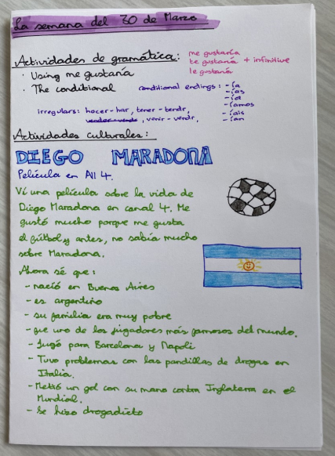
Date: the week of the 30th March
List of the grammar activities you’ve done that week (with some notes of key points)
A little summary of what you’ve done as the cultural activity that week. I picked number 9 from the list – watching a film about Diego Maradona and have made some notes on it in Spanish.

Slide 3
1. Watch these two videos about Frida Khalo: https://www.facebook.com/bbcnews/videos/1756091271141745/
and https://www.facebook.com/watch/?v=446254082583055 and create an infograph about her
2. Read about Yalitza Aparicio https://remezcla.com/lists/culture/yalitza-aparicio-broke-barriers/ and watch these videos https://www.facebook.com/watch/?v=513023639424861 and https://www.facebook.com/watch/?v=243444813237777 then write about why you think she’s a role model for Mexican women and indigenous groups in Mexico. Bonus: You could also watch the film she stars in, Roma, on Netflix.
3. Watch this documentary from 2014 called the War on Democracy. https://vimeo.com/16724719 Look at the US’ involvement in politics in Latin America
4. Pick one of the following Spanish festivals and find out more about how it’s celebrated: Las fallas, La tomatina, Castellers de Tarragona,
5. Read about bullfighting in Spain and the San Fermín festival. Should it be legal? Create a for and against poster.
6. Look up a recipe for tortilla española or patatas bravas (in Spanish) and try making them at home. They’re both veggie friendly ☺
7. Watch this video which combines flamenco dancing and tourism in Madrid and note down your thoughts on it: https://www.facebook.com/madridcultura/videos/513201902422738/?v=513201902422738
8. “Racism is a big problem in the Spanish football league” – research this statement and write your answer saying how far you agree with the statement. You could look at an incident involving Dani Alves and a hashtag that became used on social media called #todossomosmacacos.
9. Watch this All 4 film about Diego Maradona, an Argentinean footballer. Is he considered a good role model? Why/why not? https://www.channel4.com/programmes/diego-maradona
10. Research the rivalry between Barcelona FC and Real Madrid – why do you think it exists
11. Why does Cataluna want independence from Spain? In your opinion, do you think they should get it?
12. Watch this documentary on Spanish history. If you love history, watch all 3. If you’re not so sure, just watch episode 3 https://www.bbc.co.uk/iplayer/episodes/b06rwgdf/blood-and-gold-the-making-of-spain-with-simon-sebag-montefiore
13. Watch this documentary on the Spanish civil war. It’s quite upsetting at times – have tissues and chocolates at the ready https://www.bbc.co.uk/iplayer/episode/m000bynq/storyville-facing-francos-crimes-the-silence-of-others
14. What happened in Chile on September 11th 1973? What consequences did this have?
15. Who was Gabriel García Márquez? What is “magic realism”?
16. Come up with a factfile (in Spanish) about a UNESCO World Hertiage site from a Spanish speaking country such as: Galapagos Islands, Macchu Pichu, The Alhambra, Rapa Nui – Easter Island.
17. Read up about the International Women’s Day parade in Mexico and in Chile (sometimes known as #8M) this year – what happened, what did people do, why is it so necessary there?
18. Read about the 68 Hearts and 68 Voices project from Mexico here: https://68voces.mx/. Choose one of their stories, read it, watch it and write a summary of it in Spanish.
19. Find a news artilcle in the Soanish news today (elpais.com, bbcmundo.com) read it and try to summarise it in Spanish and English.
20. Check out the hastag #YoMeQuedoEnCasa (I stay at home) that is trending during the Coronavirus pandemic. Note down your ideas on the things you come across.

