Slide 1
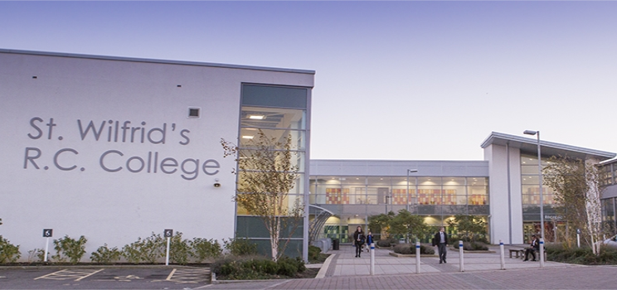
What adjective would be most appropriate to describe the school: a) Inviting b) Imposing c) Inspiring d) Interesting Be prepared to justify your decision. Challenge: Can you describe the school using your own ambitious adjective?
Support Box
Inviting = offering the promise of an attractive or enjoyable experience
Imposing = grand and impressive in appearance
Discuss.
2 Minutes.

Slide 2
Learning Objective
To create an opening to a description using ambitious adjectives.

Slide 3
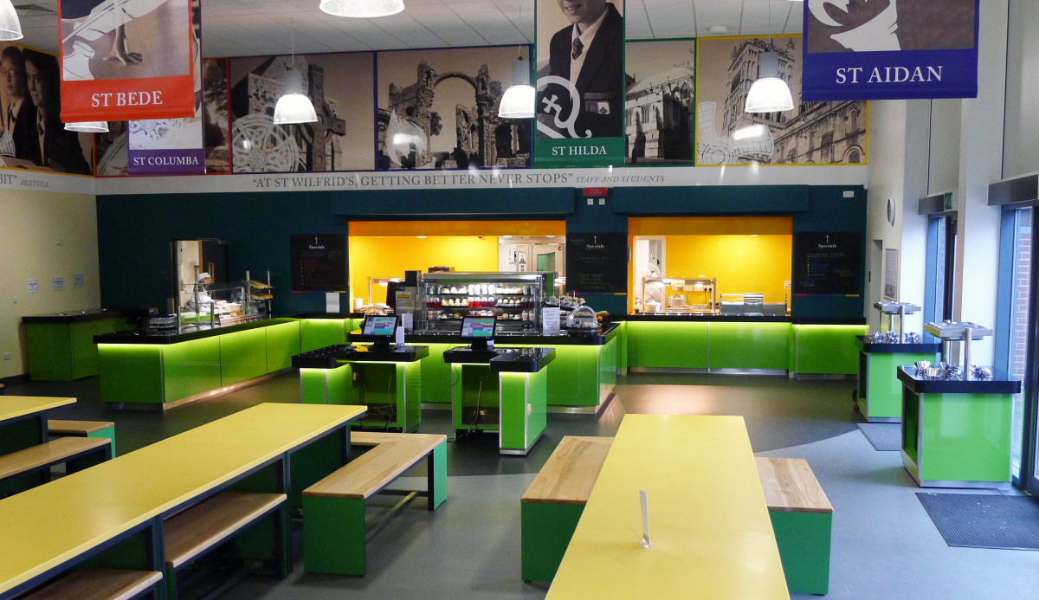
Below is an image of your future dining hall. If you were to zoom in on three things, what would they be and why?
Model
I would zoom in on
the selection of cakes
as it would allow me
create a sensory image
(a description using
the senses).

Slide 4
Choose one section of the image that you could zoom in on in a descriptive opening and create a word bank of 5-10 ambitious adjectives.
Model
Glossy
Lime
Illuminated
Glistening
…

Slide 5
Write an opening to a description based on your first experience of the dining hall.
Success Criteria
You must:
Include a range of ambitious adjectives
Use first person
Zoom in on the senses
Challenge:
Can you vary your sentence types to include a range of simple, compound and complex sentences?
Model
Immediately drawn to the cake stand, I stood, memorised, by the selection on offer. Cheesecake? Cheesecake at school? I couldn’t believe my luck. I had hit the metaphorical jackpot. The stand invited me to assess its indulgent offerings. Handcrafted cookies called my name and I was wholly captivated by their scrumptious scent. The sweet, almost sickly, smell of chocolate tickled my nostrils, but, at heart, I still longed for the sticky toffee pudding from my primary school…
Sentence Starters
Offering a wide array of dishes, the catering staff…
Excitedly, I pointed at…
Feeling overwhelmed by the sight of...
Hungrily, I wolfed down my dinner…

Slide 6
Give yourself a WWW (what went well) and EBI (even better if) based on the success criteria.
If you are confident that you have met the success criteria, consider the following:
Have you included a range of punctuation?
Have you varied your sentence lengths?
Have you varied your sentence starters?
Model
WWW: I have included a range of ambitious adjectives, including ____ and _____…
EBI: I had included a range of sentence starters (for example, beginning a sentence with a verb).
Success Criteria
You must:
Include a range of ambitious adjectives
Use first person
Zoom in on the senses
Challenge:
Can you vary your sentence types to include a range of simple, compound and complex sentences?

