Slide 1



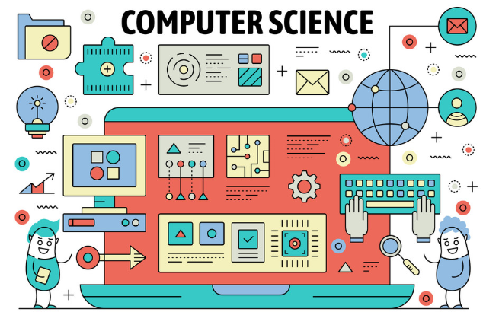


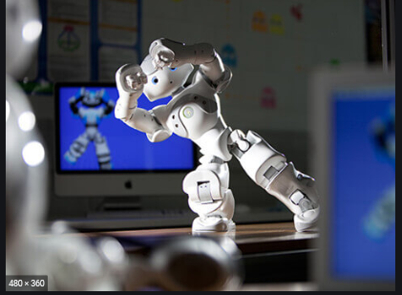


At St Wilfrid’s

Slide 2
What will you study in year 7 and 8?
Spreadsheet Modelling
Using computers safely
Word Processing
Programming
User Interfaces
Understanding computers
Software and hardware
File management
Input and output devices
Keeping data safe
Python programming
Social networking

Slide 3
Meet Team ICT and Business, we are looking forward to meeting you soon .
How many of our questions/challenges can you complete?

Slide 4
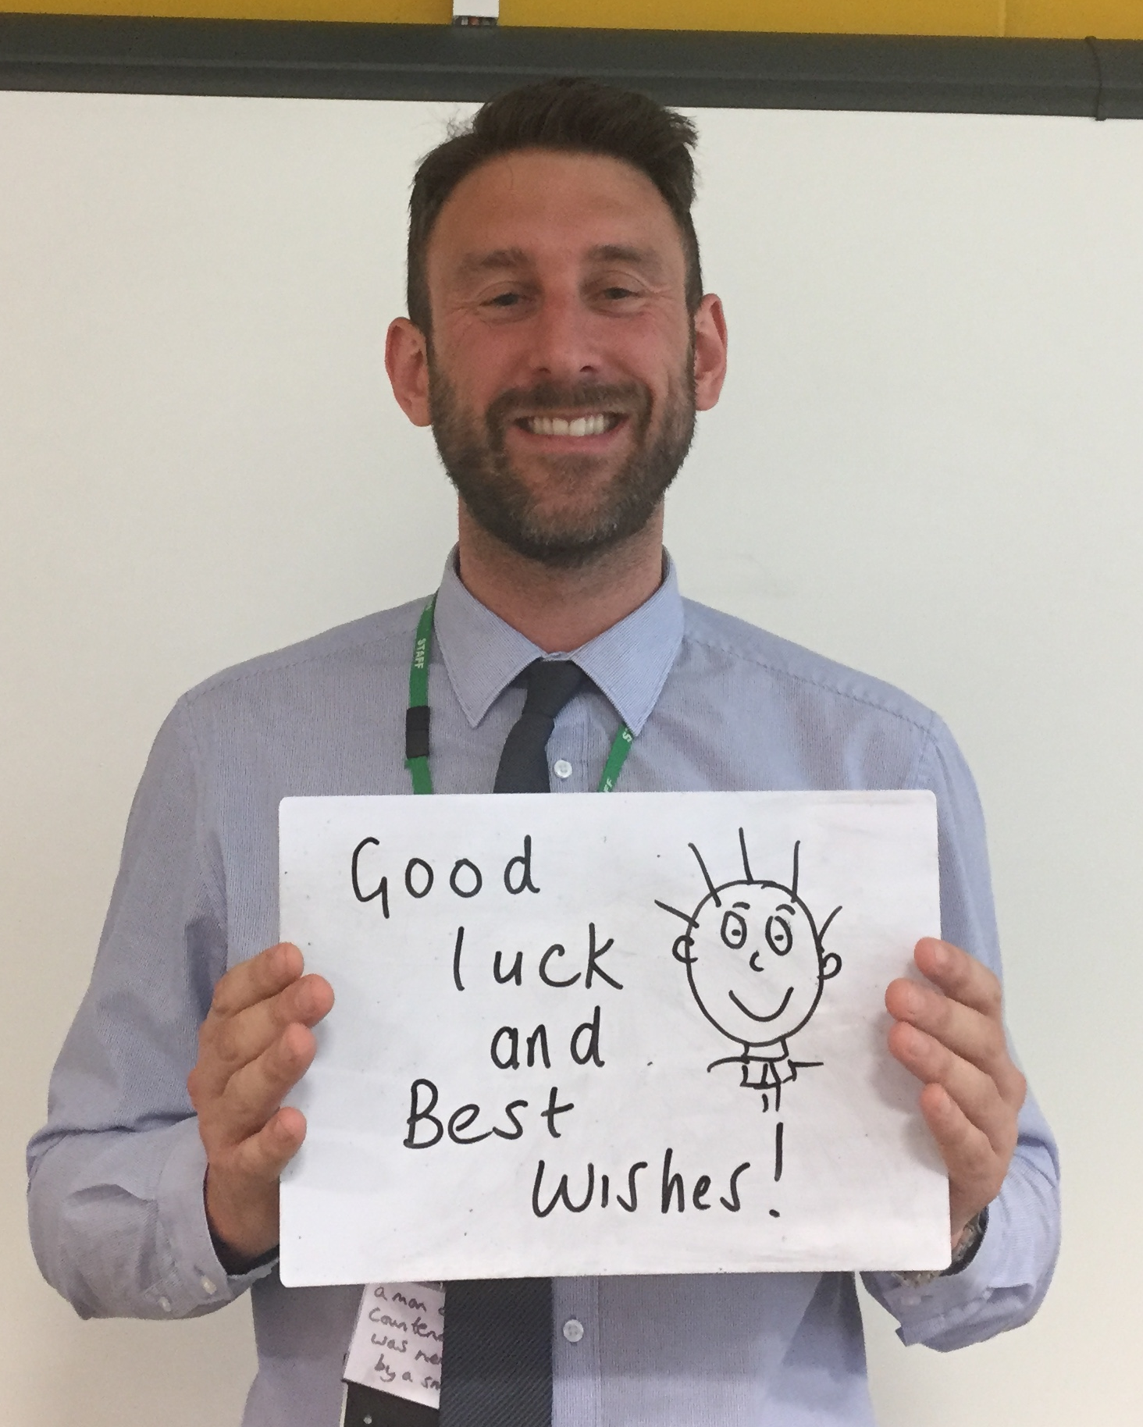
Mr Dann
Head of ICT and Computer Science
A little bit about me…
I graduated with an ICT and Media degree from Sunderland University in 2003. I spent a few years working in the ICT industry, working in technical support and even spent some time working for the BBC. I decided to train to be a teacher in 2006.
I have been teaching for 13 years and most of this has been spent here at St Wilfrids. This is a great school and I am sure you will feel at home in no time at all. During your time here you may be in one of my classes as I teach KS3 ICT, GCSE Computer Science, BTEC Digital IT and a number of courses in Sixth Form too.
I like to spend my time doing physical activities, such as running, cycling and going to the gym. I have two daughters. Esme who is 11, and Madison who will be 9 this August.
My challenge for you…is to practice your programming and logical thinking skills. Visit the code.org website on a PC, laptop or tablet. Have a go at one of the cool activities. You can even code your own flappy bird game!
Hello,
I’m Mr Dann
I’m Head of ICT and Computer
Science here at St Wilfrid’s!
See you all soon!

Slide 5
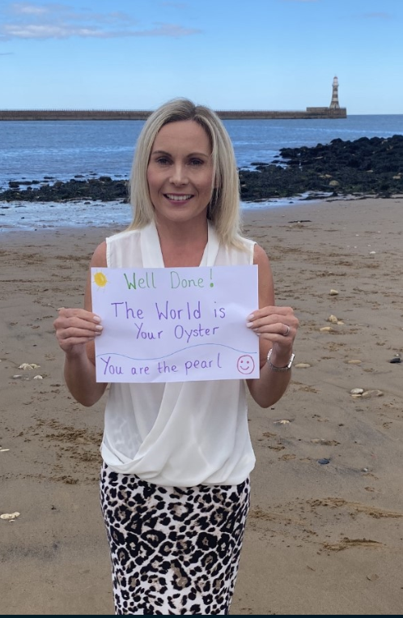
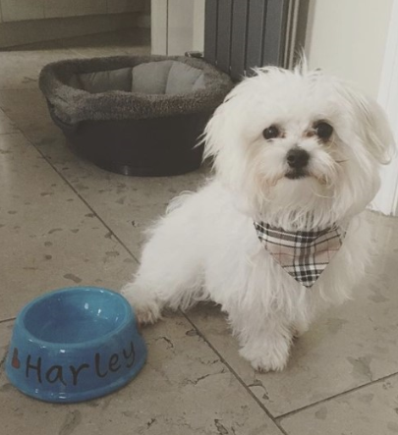
Mrs McKenzie
Head of Business Studies
A little bit about me…
I graduated with a Business degree from Newcastle Business School at University of Northumbria! I was offered a job in as a finance assistant for a large tour operator but turned it down to complete my PGCE at Sunderland University.
I have taught for almost 16 years in total, 3 of which have been at St Wilfrids. I really enjoy working here. I teach ICT to key stage 3 and 5, Business Studies to Key stage 4 and 5 and travel and tourism at key stage 4.
I love going to the gym, running, cycling, visiting new places, spending time with friends and family and snuggling my Maltese dog, Harley. Isn’t he adorable? I have a daughter, Grace who is 11 and just like you , she is preparing for secondary school.
My challenge is to come up with an idea for a new business venture. You should come up with a business name, a unique idea and a logo to represent your new business. You never know, one day you might be able to actually run this new venture for real !
Hello,
I’m Mrs McKenzie ☺
I’m Head of Business Studies here at St Wilfrid’s!
I look forward to teaching some of you in ICT next year.

Slide 6
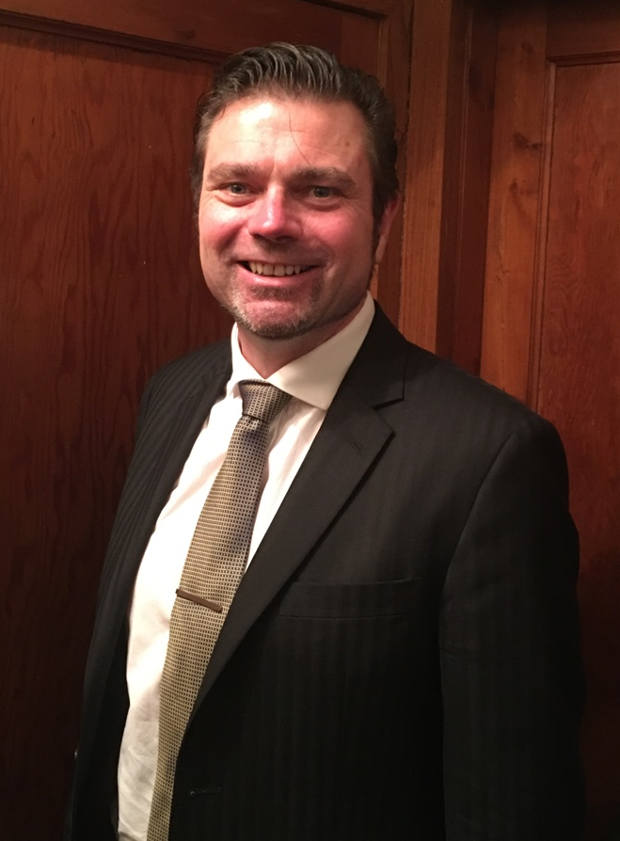
Mr Gordon
Computer Science Teacher
A little bit about me…
I graduated with a degrees from Sunderland University and Huddersfield University. I spent majority of my career teaching in sixth form colleges, teaching older students Computer Science and programming. I’ve also worked in the software industry where I tested software and taught customers how to customise their software.
I have been teaching for more than 20 years, the last 4 years here at St Wilfrids. This is a great school and I am sure you’ll fit in well. During your time here you may be in one of my classes as I teach KS3 ICT, GCSE and A level Computer Science. You may see me also involved with online safety of our students.
I like to spend my time teaching martial arts and riding my motorcycles.
My challenge for you…is to build your game programming skills by showing the robot how to deliver his parcels https://bbc.in/2YoHTcx
Hello,
I’m Mr Gordon
Computer
Science teacher at St Wilfrid’s!
See you all soon!

Slide 7
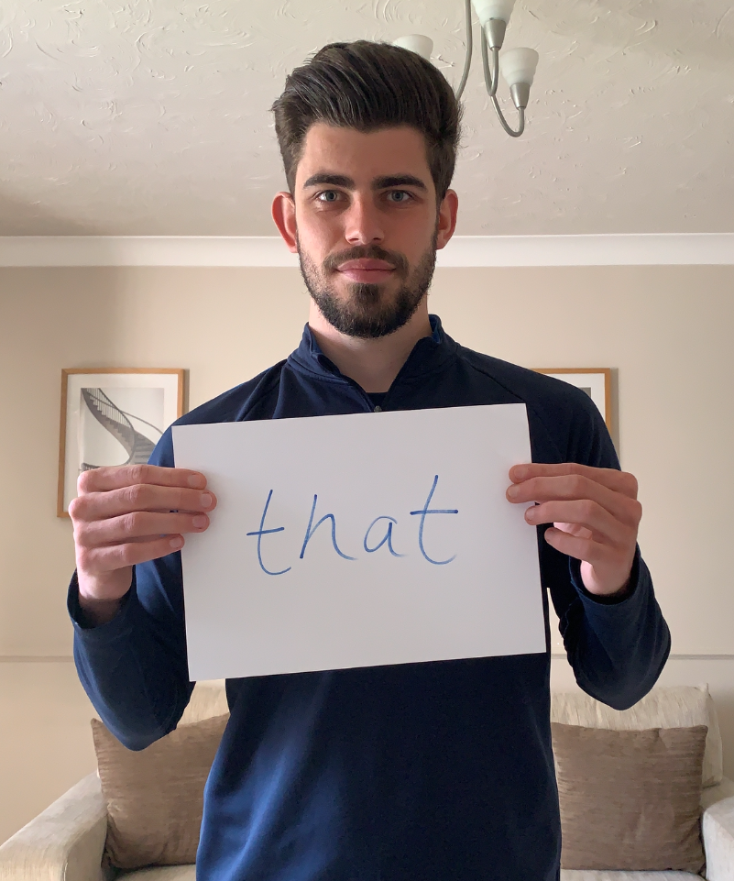
Mr Taylor
Teacher of P.E. and Teacher of I.C.T.
A little bit about me…
I graduated with a degree in Sports Coaching from Northumbria University in 2017. I decided to train to be a teacher in 2018, having spent time working in various schools and local communities around South Tyneside delivering sports sessions.
I have been teaching for 2 years and have spent both of these years at St. Wilfrid’s. I also went to St. Wilfrid’s as a pupil as well as being part of the first cohort of Sixth Formers at St. Wilfrid’s. I enjoy teaching at St. Wilfrid’s, and I can’t wait for you all to be part of our school community. Some of you may have me as your ICT teacher next year, as well as your P.E. teacher too!
I enjoy spending my time playing as much sport as possible including football, cricket, cycling and golf, as well as socialising with family and friends.
My challenge for you… Choose your favourite sport, and I would like you to think about all of the ways that computers and technology are used within that sport, and can you come up with any new ideas that could be added to that sport relating to I.T.?
Hello,
I’m Mr Taylor
I am a Teacher of P.E. and I.C.T. here at St Wilfrid’s!
See you soon!

Slide 8
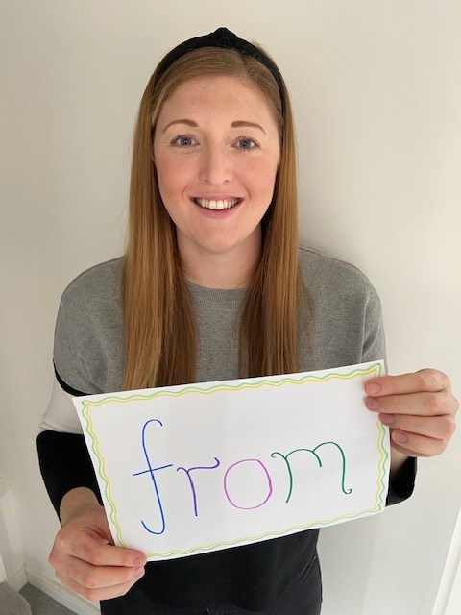
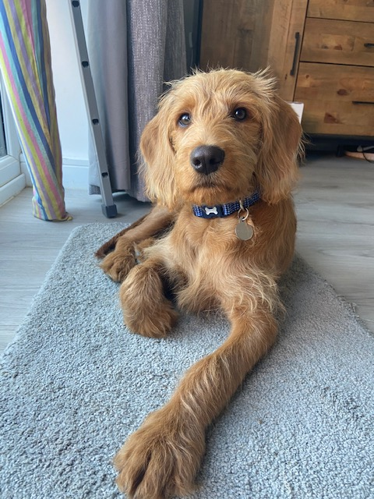
Miss Trotter
Head of Girl’s PE
A little bit about me…
I graduated with a masters degree in Sport and Exercise Science from Sheffield Hallam University in 2011. I have always had a passion for sport and physical activity and completed my PGCE with Northumbria University in 2013.
I have been teaching for 7 years, having spent the last 2 years teaching at St. Wilfrid’s. I’m sure you will all enjoy being part of the St. Wilfrid’s community as much as I have over the last 2 years. I teach Core PE to all year groups, BTEC Sport at KS4 and KS5 and will also be teaching ICT to Year 7 next year. Throughout my teaching I have taught a range of subjects, including teaching ICT at my previous school.
In my spare time I enjoy being physically active by playing netball, going to the gym and running/cycling. I also really enjoy spending time with my friends and family and also with our new puppy – who, like Mrs Charlton’s new puppy, is also called Alfie!
My challenge for you… Create a poster that tells us all about you! Use whichever ICT programme you would like to do this. You could include some fun facts about yourself, what your favourite hobbies are, what your favourite food is – be creative!
Hello,
I’m Miss Trotter
I’m Head of Girl’s PE here at St Wilfrid’s!
I look forward to meeting you and teaching some of you for PE and ICT next year!

