Slide 1
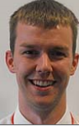
Maths department mystery
Situation: The police have been called to a local school. Lying on the floor is the body of a maths teacher, Mr Hurst! Police search the school and find 4 clues written down by witnesses to the death. You are the lead investigator, the clues are attached for you to decipher. There is also a list all of the other teachers in the maths department, because each and every person will need to be eliminated to enable you to find the suspect! There are a possible 12 suspects. Each clue will eliminate some of the remaining suspects. When all the clues have been solved the identity of the killer will be revealed.

Slide 2
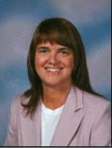
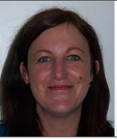
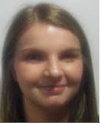
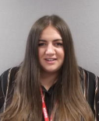
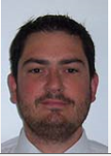
Name: Mrs Ellison
Role: Teacher of maths
Hair colour: Brown
Car colour: White
Right/ left handed: Right
Name: Mrs Armstrong
Role: Head of maths
Hair colour: Brown
Car colour: Silver
Right/ left handed: Right
Name: Ms Tiffin
Role: Head of house
Hair colour: Brown
Car colour: Blue
Right/ left handed: Right
Name: Mrs Maxwell
Role: Assistant Head
Hair Colour: Brown/ blonde
Car colour: Black
Right/ left handed: Right
Name: Miss Woods
Role: Teacher of maths
Hair colour: Brown
Car colour: Red
Right/ left handed: Right
Name: Miss Tennet
Role: Teacher of maths
Hair colour: Brown
Car colour: Black
Right/ left handed: Left
Name: Mr Ward
Role: Teacher of maths
Hair colour: Brown
Car colour: Red
Right/ left handed: Right
Name: Mr Allen
Role: Head of Y13
Hair colour: Brown
Car colour: Blue
Right/ left handed: Right

Slide 3
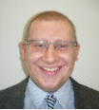
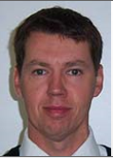
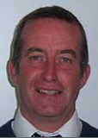
Name: Mr Robinson
Role: Teacher of maths
Hair colour: Blonde
Favourite colour: Blue
Right/ left handed: Right
Name: Mr Boyle
Role: Teacher of maths
Hair colour: Brown
Car colour: Red
Right/ left handed: Left
Name: Mr Smith
Role: Teacher of maths
Hair colour: Brown
Car colour: Black
Right/ left handed: Right

Slide 4
Use the wanted posters to complete the table to show all the information about the suspects.
Suspect name | Role | Hair Colour | Car colour | Right/ left handed | Guilty?

Slide 5
Clue 1 – Get into shape.
Total number of sides of 5 squares
An octagon has ___ sides
A square based pyramid has ___ vertices
The total sides of a triangle, square and a hexagon
The total sides of an octagon, a heptagon and a hexagon
The total sides of 2 nonagons
A rhombus has ___ sides
A pentagon has ___ sides
Total sides of an octagon and a decagon
Half the number of sides of a decagon
The number of sides in a triangle multiplies by the number of sides in a hexagon
A parallelogram has ___ sides
Total sides of 3 hexagons
14. A nonagon has ….. sides
15. The total sides of a quadrilateral, pentagon and decagon
16. Number of vertices in a trapezium, subtract the number of vertices in a triangle
17. A tridecagon has ….. sides
18. An isosceles triangle has ….. line of symmetry
19. The midpoint, number of sides, between a decagon and an 18 sided shape
Answer
Notes:
Answer: The murderer is a man

Slide 6
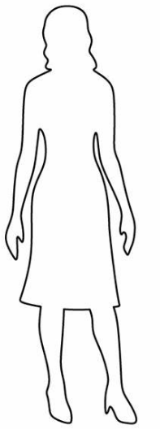
The police need help to investigate the issue so we are relying on you to discover the truth.
One women seems to be wanting to help but wants to keep some of her information a secret.
She has told us her name is Miss Kippax-Jones. Could she be a suspect?

Slide 7
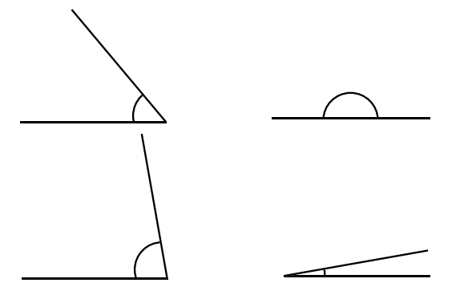
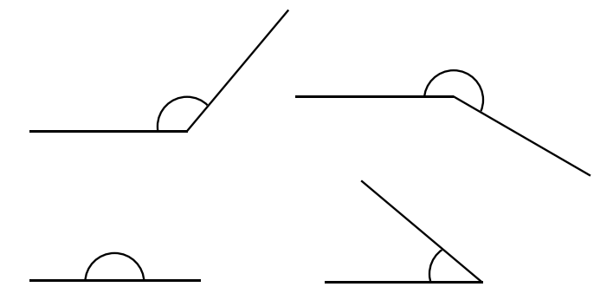
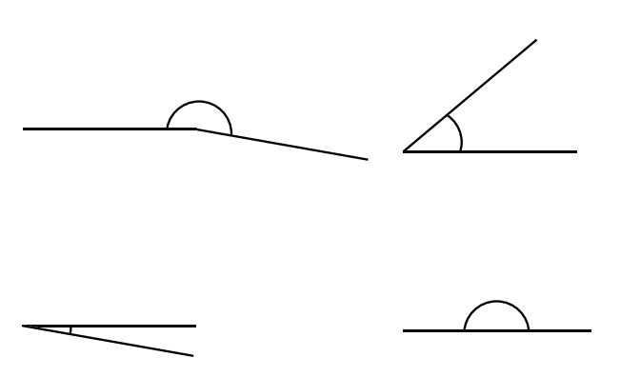
7.
8.
1.
2.
9.
10.
3.
4.
11.
12.
5.
6.
13.
14.
Notes:
Measure each angle using a protractor.
Answer: The murderer has dark hair

Slide 8
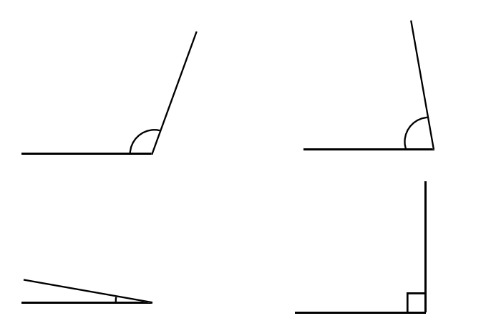
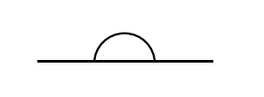
Answer
15.
1.
16.
17.
18.
19.
Notes:
Measure each angle using a protractor.
Answer: The murderer has dark hair

Slide 9
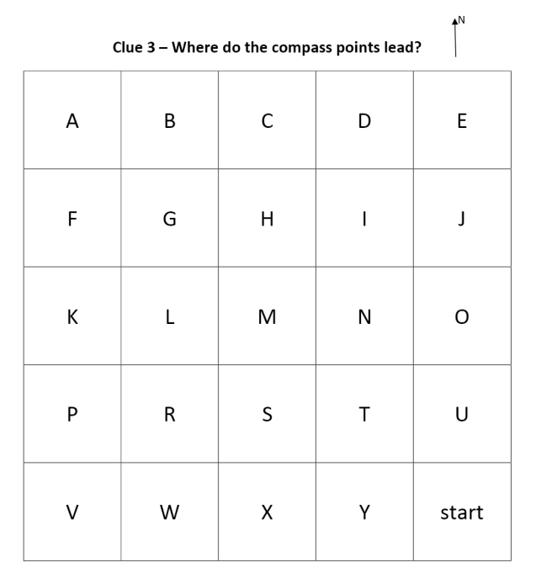
Answer
Notes:
Answer: Killer is right handed

Slide 10
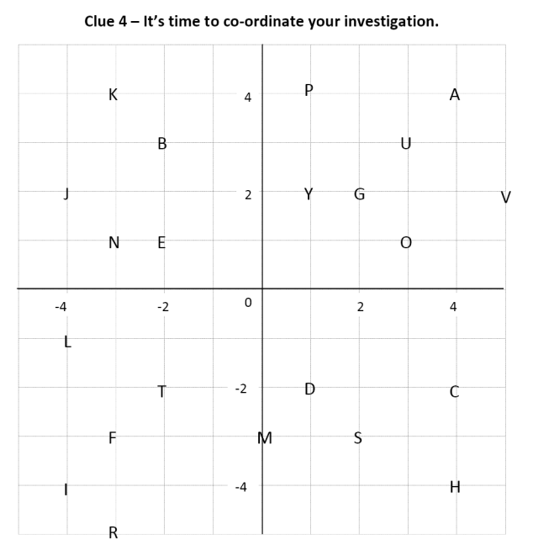
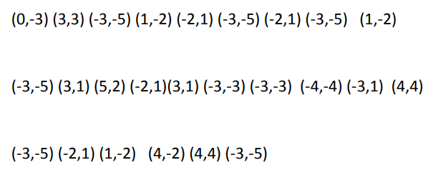
Match the co-ordinate to the correct letter
Answer
Notes:
Answer: Murderer drove off in a red car

Slide 11
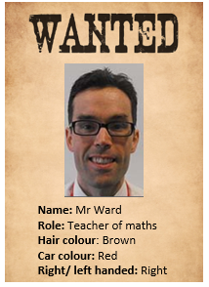
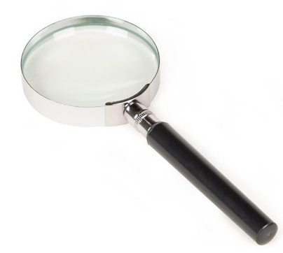
Who do you think the suspect is?
Clues: Male, dark hair, right handed and drove off in a red car.
Mr Ward says he was not involved and does not know what happened to Mr Hurst.
On the afternoon, when Mr Hurst was found Mr Ward says he was teaching at St Joseph’s Catholic Academy. We will have to look at Mr Ward’s timetable to check….

