Slide 1


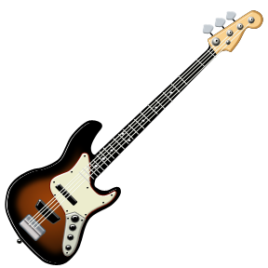

Music at St. Wilfrid’s

Slide 2
Musical Instruments
Everyone will learn to play the keyboard in class music lessons at St. Wilfrid’s.
You also have the chance to learn an instrument in a small group or individual lesson if you want to. There is an extra cost for these lessons.
Additionally, we run free clubs at lunch times.

Slide 3

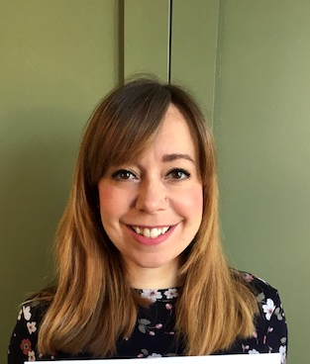
Meet The Teachers
Mrs Watson
I play the flute and piano. I also sing and play a little bit of clarinet and guitar. I love watching and performing musical theatre.
Miss Green
I play the violin and sing. I also play a bit of ukulele. I love singing in a choir and playing and listening to music from the 1600s.

Slide 4
Task: watch the following clips introducing the instruments of the orchestra.
Answer the questions on the next slide.
https://www.youtube.com/watch?v=KEt1Mm8sSkA
https://www.youtube.com/watch?v=yE0aSxziNdY
https://www.youtube.com/watch?v=MP2_6OLummA
https://www.youtube.com/watch?v=xGKpngesISI

Slide 5
Choose 3 instruments from the video clips and complete the following….
Name of Instrument
What family from the orchestra is it from (woodwind, brass, strings or percussion)
Draw a picture of it.
Describe the sound it makes.
Write down anything you notice about how the person is playing it.
Would you like to learn this instrument? Why/why not?

Slide 6
We’re really looking forward to meeting you and welcoming you to the Music Department.

