Slide 1


A-Level Chemistry Bridging Unit
In this booklet you will find everything you need to successfully transition between GCSE and A-Level Chemistry!
You should complete the sessions assigned during the summer holidays. This will make sure you start back in Year 12 in the best possible position. You should be completing around 1.5 hours per session. You should then bring this booklet and all associated work to your first Chemistry lesson in September.
If you attended ALL of our bridging sessions in school, you can skip session 1 if you like as we covered this information during our sessions. Feel free to complete if you would like some more practice, however!
We can’t wait to see you in September to continue your Chemistry journey!
Any questions at all, contact Miss Vaughan at:
Email: evaughan@st-wilfrids.org

Slide 2

Did you know…….
If you pour a handful of salt into a full glass of water, the water level will actually go down rather than overflowing the glass.
The only letter that doesn’t appear on the periodic table is J.
Although oxygen gas is colourless, the liquid and solid forms of oxygen are blue.
The human body contains enough carbon to provide graphite for 9,000 pencils.
Hydrofluoric acid is so corrosive that it will dissolve glass, but it is considered to be a weak acid.
One bucket full of water contains more atoms than there are buckets of water in the Atlantic ocean.
Bee stings are acidic, while wasp stings are alkaline.
Water freezes faster when it is warm, not cold.
Mars looks red due to the high levels of rust (iron oxide) on its surface.
20% of the world’s oxygen is produced in the Amazon Rainforest.
DNA is flame retardant. Scientists are using DNA to try and produce flame-retardant clothing.
Vanadium Oxide is the only known substance which is in a conductor of electricity but not heat.
Olympic gold medals are made of at least 95% silver.
Uranus is a planet that is extremely rich in flammable gases like methane and hydrogen. None of these gases burn, however, as Uranus does not contain enough oxygen.
The sun doesn’t have any oxygen – so how does it burn? Well it doesn’t! The heat and light come from nuclear fusion reactions, not combustion reactions.
The smell we recognise after a thunderstorm is the smell of ozone (O₃). Lightening heats up the air to 50,000 degrees Celsius, which can cause some oxygen in the air to combine into ozone which we can smell.
The hydrogen atoms that make up your body are 13.7 billion years old
We can’t reach absolute zero. It is a theoretical temperature. The closest we have come is the range of a billionth of 1K.
Helium changes your voice as it is a less dense gas, so sound travels around 2-3 times faster through it.
If you peed in space it would vaporise into a gas immediately due to the lack of air pressure.
Lobsters have blue blood, as their version of haemoglobin, hemocyanin, has a copper atom at its centre, responsible for the blue colour.
Metals don’t have a smell. The smell we associate with them is due to a reaction where the metals decompose the oils present in our skin, making 1-octen-3-one, which is responsible for the smell.

Slide 3

Preparing Yourself
Before we start looking at how to prepare ourselves for the content of A-Level Chemistry, it would be useful for us to use this extra time we have to prepare ourselves to be the best possible A-Level Chemistry students we can be!
To do this I have put some self-reflection questions on this page that I would like you to complete. If you attended our bridging sessions in school then you will have already done these and don’t need to do them again!
We will discuss our ideas when we’re back together in September. ☺
Self-reflection Questions
Which parts of GCSE Chemistry did you enjoy the most?
What did you find difficult in GCSE Chemistry?
Give three ways that you think you ensured you made maximum progress at GCSE Chemistry
Give five attributes that you think an A-Level Chemistry student must have
What do you envisage being your biggest challenge at A-Level?
What are you most excited for during the A-Level Chemistry course?

Slide 4
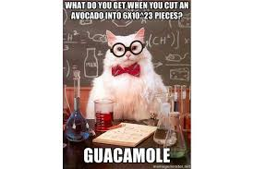
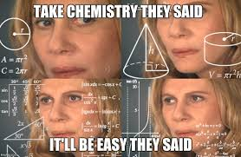
Session
One
I know how much you all loved the calculations part of GCSE Chemistry! We’re going to spend some time this week recapping the calculations that come up again at A-Level.
These include:
Relative Atomic Mass and Relative Formula Mass
Concentration
Calculations using Moles
Empirical and Molecular Formulae
Some of the A-Level calculations include those from the Separate Chemistry course. This is an ideal time for those of you that did Combined Science to get up to speed. These calculations are:
Atom Economy
Percentage Yields
Molar Volumes
Use the following resources to revise and brush up on the above calculations:
  Your GCSE revision guide
  https://www.bbc.co.uk/bitesize/guides/z2ty97h/revision/1
  https://www.bbc.co.uk/bitesize/guides/zpk2srd/revision/1
  https://www.bbc.co.uk/bitesize/guides/zg9rxfr/revision/1
  https://www.bbc.co.uk/bitesize/guides/zwbyjty/revision/1
  Pages 37-40 in your ‘Head Start to A-Level Chemistry’ book
  https://www.youtube.com/watch?v=UQV9tLkQI3k
Write a ‘calculations summary sheet’ that includes key formulae that you need to learn off by heart. This will come in very useful in Year 12!
Complete and self-assess the exam questions on the next couple of pages.

Slide 8
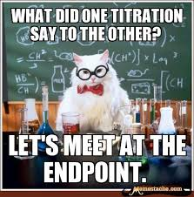
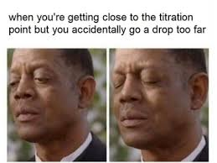
Session Two
Similarly to your GCSE course, you’re A-Level Chemistry course contains required practicals that you must carry out.
The first one you will carry out will be a Titration to find the concentration of an unknown substance. Separate Chemists will be familiar with titrations from Year 10. Combined scientists this is again a great opportunity to get caught up!
Your task this week is to produce an ‘Idiot’s Guide to Titrations.’
The format you produce this in is entirely up to you, but it should include:
The names of pieces of key equipment and what they are used for
A general method to use during the practical
Common mistakes or issues that people come up against, and how to make sure this doesn’t happen to you
Calculations that must be carried out on your results
Potential sources of information
https://www.bbc.co.uk/bitesize/guides/zg9rxfr/revision/3
https://www.youtube.com/watch?v=jnG9Ut--yUA
https://www.youtube.com/watch?v=UAkibS8DOqY
https://www.youtube.com/watch?v=UAkibS8DOqY
https://www.youtube.com/watch?v=LsYXOa38OgE&list=PLxkbSWenXKXp3i8gRXvpM3FMC36yTe1U1
https://chemrevise.files.wordpress.com/2016/08/1-25-titrations.pdf

Slide 9
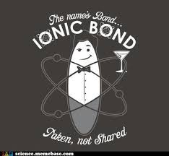
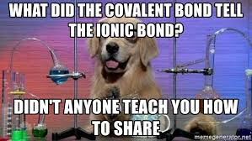
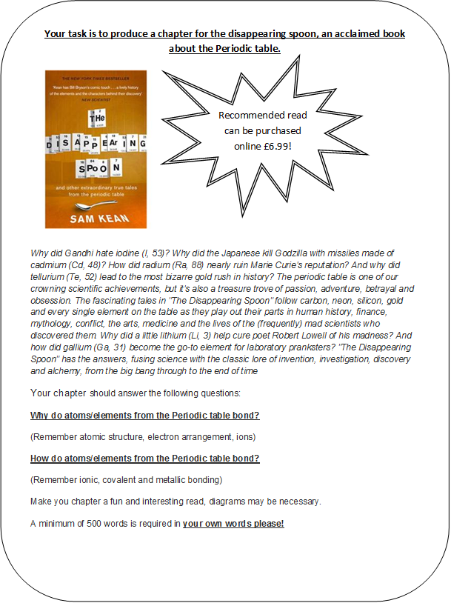
Session Three
At GCSE we looked in-depth at Ionic, Metallic and Covalent bonding. We look at this in even more detail at A-Level. To prepare for this you should complete the task below. You could read ahead using your bridging book from Kindle, and any other online resources you can find and add some A-Level detail in! Particularly I would love it if you included some information on dative covalent bonds!

Slide 10
Further Reading

Slide 11
Something to Watch
Videos to watch online (again, these are just suggestions, we do not expect you to have watched them all!)
Rough science – the Open University – 34 episodes available
Real scientists are ‘stranded’ on an island and are given scientific problems to solve using only what they can find on the island.
Great fun if you like to see how science is used in solving problems. There are six series in total
http://bit.ly/pixlchemvid1a
http://www.dailymotion.com/playlist/x2igjq_Rough-Science_rough-science-full-series/1#video=xxw6pr
or
http://bit.ly/pixlchemvid1b
https://www.youtube.com/watch?v=lUoDWAt259I
A thread of quicksilver – The Open University
A brilliant history of the most mysterious of elements – mercury. This program shows you how a single substance led to empires and war, as well as showing you come of the cooler properties of mercury.
http://bit.ly/pixlchemvid2
https://www.youtube.com/watch?v=t46lvTxHHTA
10 weird and wonderful chemical reactions
10 good demonstration reactions, can you work out the chemistry of …. any… of them?
http://bit.ly/pixlchemvid3
https://www.youtube.com/watch?v=0Bt6RPP2ANI
Chemistry in the Movies
Dantes Peak 1997: Volcano disaster movie.
Use the link to look at the Science of acids and how this links to the movie. http://www.open.edu/openlearn/science-maths-technology/science/chemistry/dantes-peak
http://www.flickclip.com/flicks/dantespeak1.html
http://www.flickclip.com/flicks/dantespeak5.html
Fantastic 4 2005 &2015: Superhero movie
Michio Kaku explains the “real” science behind fantastic four http://nerdist.com/michio-kaku-explains-the-real-science-behind-fantastic-four/
http://www.flickclip.com/flicks/fantastic4.html

Slide 12
Who to follow on Twitter
Below is a list of people you might find it useful and interesting to follow on Twitter:
@ASFC_CHEMISTRY – Ashton Sixth Form College Chemistry who do great YouTube videos
@UKScienceguy – The famous face behind the revision YouTube videos
@IFLScience – Funny science content
@TEDx – watch TED events and streams from around the world
@NCL_medresearch – The Faculty of Medical Sciences at Newcastle University
@NewcastleMedSch – Newcastle University Medical School
@TakeThatChem – Science Fun
@ScienceMagazine – cutting-edge research
@BillNye – The Science Guy
@neiltyson – Astrophysicist
@ProfBrianCox – Particle Physics Professor
@newscientist – Twitter account for the magazine
@BBCScienceNews
@royalsociety
@NASA
@NatGeo
@RoySocChem – Royal Society of Chemistry
@ChemistryWorld – Chemistry Magazine published by the Royal Society of Chemistry.
@MaChemGuy – Makes great A-Level Chemistry YouTube videos
@ChemistryALevel
@compoundchem – Great chemistry infographics

