Slide 1
Transition Pack for A Level Biology
Get ready for A-level!
A guide to help you get ready for A-level Biology, including everything from topic guides to days out and online learning courses.
Enjoy! We look forward to welcoming you in September!
St Wilfrid’s Biology Team!

Slide 2
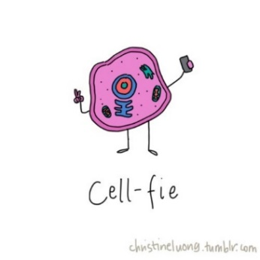
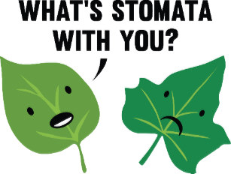
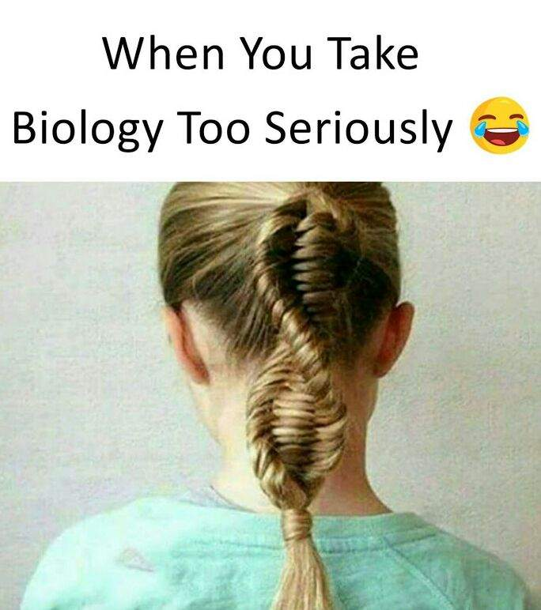
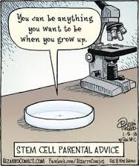
So you want to study A-level Biology?
This pack contains a programme of activities and resources to prepare you to start A level in Biology in September. It is aimed to be used after you complete your GCSE throughout Summer Holidays to ensure you are ready to start your course in September.
You must…
Complete all activities in this booklet
Bring this to your first A level Biology lesson
You will be joining our google classroom when we finalise numbers – look our for details!

Slide 3
Say what?! Interesting things you probably never knew about biology!
The study of living organisms was first called biology in 1799.
Before that, the word “biology” was used to refer to biographical writing.
The biggest flower in the world is that of Rafflesia arnoldii, or corpse lily of Sumatra which grows to about the size of an umbrella.
Our bodies contain more bacterial cells than human cells.
The total mass of all the bacteria on Earth is greater than that of all the animals.
The saliva a human produces in a lifetime is enough to fill two swimming pools.
According to research in 2008, football teams wearing red shirts have an advantage thanks to our deep-rooted biological response to the colour.
Scientists are trying to recreate smaller versions of Neanderthal brains! https://www.theguardian.com/science/2018/may/11/scientists-to-grow-mini-brains-using-neanderthal-dna
Lisa Kudrow (Phoebe from friends) has a biology degree!
Task 1: Find 10 interesting facts about biology of your own! Write these down ☺

Slide 4
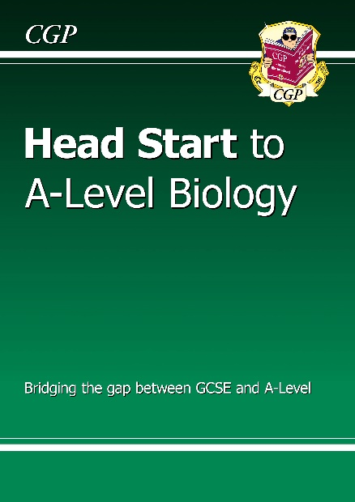
Before we go any further….
You need to download the Kindle App from the app store / play store!
Once you have downloaded the Kindle app → download this book (it’s free!). You should use this book as a source of information throughout your bridging work! You will also be given a hard copy on enrolment day too ☺
Sign up to SENECA learn: https://www.senecalearning.com/ (if you haven’t got an account already!) and join this class: sgpnimiuox
(the assignment is there for you to complete as week 7’s activies)
If you need any help doing this then e-mail Miss Russell or Mrs Forster!

Slide 5
Week 1 activity: Video must watches! (the amoeba sisters are your new besties!) You must make notes as you watch and bring them with you at the start of term ☺
Protein Synthesis
If you were not a triple scientist last year, you need to know how proteins are made by transcription and translation. You will learn more about this in year 12. Check this out! If you were a triple scientist, have a little recap watch.
https://www.youtube.com/watch?v=oefAI2x2CQM
2. Cell division
Remind yourself of mitosis and meiosis by watching this video. Create a Venn diagram to compare and contrast them.
https://www.youtube.com/watch?v=zrKdz93WlVk
3. Biological molecules
In year 12, you need to know much more about different biological molecules. Triple scientists learned how to test for them. If you did not do this, brush up on testing for particular molecules (e.g. starch, proteins, fats, reducing sugars) and watch this clip as an intro to the molecules:
https://www.youtube.com/watch?v=YO244P1e9QM
Week 2 activity: Practical skills
In year 12, you will complete an enzymes practical and an osmosis required practical.
Task: Watch the following videos and compare and contrast them to the practicals you did in year 10. E.g. are there any extra steps? Is the analysis different? Is there a different independent variable? What measurements must you take?
Enzymes: https://www.youtube.com/watch?v=A8Ts4V_osvo
Osmosis: https://www.youtube.com/watch?v=k1O9jBHgsxs
As an A level biologist, you will have to meet certain criteria during a practical.
Task: Make a list of skills you think will be important and what your teacher will be looking for when assessing your practical competencies.

Slide 6
Week 3 activity: Prepare a 5 minute presentation
Prepare a 5 minute presentation on the topic you chose to look at in your journal article to present to others. You will be presenting this in your first few lessons in year 12.
A huge skill we develop in A level Biology is presentation skills. If you plan to go to university to study in the future (any subject!) you will be marked on your ability to present key ideas. Why not start practicing this now ☺
The presentation must…
Be in PowerPoint format
Last 5 minutes
Include information about the topic, why you chose it, what research is ongoing, gaps or issues with the research

Slide 7
Week 4 activity: Movie time!
Watch all of the trailers of the following movies. I would like you to write a short paragraph to link each one to biology in as many ways as possible.
Jurassic Park (one of my favourite films!)
https://www.youtube.com/watch?v=QWBKEmWWL38
Five feet apart – on Netflix (this one made me cry!!)
https://www.youtube.com/watch?v=XtgCqMZofqM
Splice
https://www.youtube.com/watch?v=t6o_Vl2f07Q
Into the Wild
https://www.youtube.com/watch?v=g7ArZ7VD-QQ
The Immortal Life of Henrietta Lacks
https://www.youtube.com/watch?v=FaFJya7FVSM
Contagion (very relevant with the current situation!)
https://www.youtube.com/watch?v=4sYSyuuLk5g
Next – find a movie or documentary of your own to link to science and write a paragraph about it. This may be one you have seen or may be one you choose to watch for the first time!
Super challenge – can you spot any incorrect science in the trailers/movie?

Slide 8
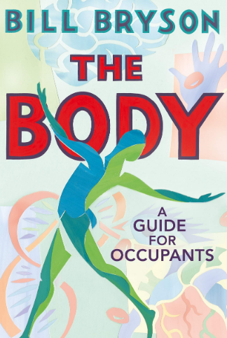
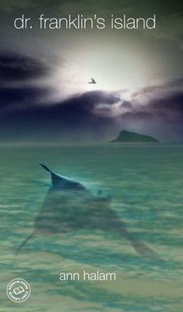
Book Recommendations
Check out some of these amazing biology books to keep you busy!
This is going to hurt by Adam Kay
A real life diary kept by a junior doctor during his training years. Lots of highs and lows and insight into how it really is to train as a doctor!
Both me and Mrs Forster have read this and LOVED it!!!
The Body by Bill Bryson
This book explores your amazing body and gives you facts about your organs, how we survive and how absolutely mind blowing your body actually is!
The Immortal Life of Henrietta Lacks by Rebeca Skloot
This is the story of how a poor woman used her cancer cells to make the first immortalised human cell line. The book tells of her struggles and strengths as she made one of the greatest medical contributions ever!
Dr Franklin’s Island by Ann Halam
A fiction book which sees 3 teenagers end up stranded on an island where there is a large research facility. The teenagers are captured and imprisoned by Dr Franklin, who performs transgenic experiments on them!

Slide 9
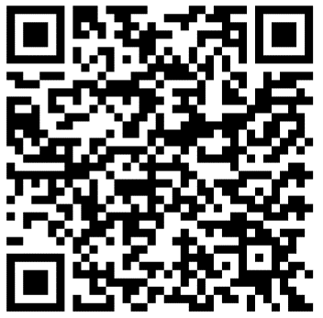
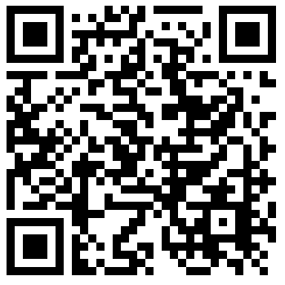
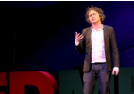
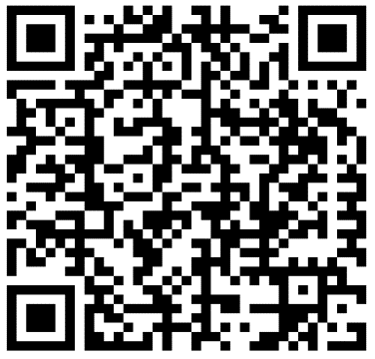
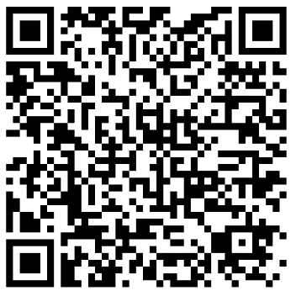
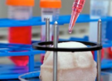
Movie Recommendations
If you have 30 minutes to spare, here are some great presentations (and free!) from world leading scientists and researchers on a variety of topics. They provide some interesting answers and ask some thought-provoking questions. Use the link or scan the QR code to view:
A New Superweapon in the Fight Against Cancer
Available at : http://www.ted.com/talks/paula_hammond_a_new_superweapon_in_the_fight_against_cancer?language=en
Cancer is a very clever, adaptable disease. To defeat it, says medical researcher and educator Paula Hammond, we need a new and powerful mode of attack.
Why Bees are Disappearing
Available at : http://www.ted.com/talks/marla_spivak_why_bees_are_disappearing?language=en
Honeybees have thrived for 50 million years, each colony 40 to 50,000 individuals coordinated in amazing harmony. So why, seven years ago, did colonies start dying en-masse?
Why Doctors Don’t Know About the Drugs They Prescribe
Available at : http://www.ted.com/talks/ben_goldacre_what_doctors_don_t_know_about_the_drugs_they_prescribe?language=en
When a new drug gets tested, the results of the trials should be published for the rest of the medical world — except much of the time, negative or inconclusive findings go unreported, leaving doctors and researchers in the dark.
Growing New Organs
Available at : http://www.ted.com/talks/anthony_atala_growing_organs_engineering_tissue?language=en
Anthony Atalla's state-of-the-art lab grows human organs — from muscles to blood vessels to bladders, and more.
© Copyright The PiXL Club Ltd, 2016

Slide 10
Science on Social Media
Before your course, you need to set up a twitter account. Miss Russell and Mrs Forster will tweet important information throughout your course, along with useful links for your study (and all round super interesting nerdy stuff!). @missrussellbio @mrsklforster
Science communication is essential in the modern world and all the big scientific companies, researchers and institutions have their own social media accounts. Here are some of our top tips to keep up to date with developing news or interesting stories:
Follow on Twitter:
Commander Chris Hadfield – former resident aboard the International Space Station @cmdrhadfield
Tiktaalik roseae – a 375 million year old fossil fish with its own Twitter account!
@tiktaalikroseae
NASA’s Voyager 2 – a satellite launched nearly 40 years ago that is now travelling beyond our Solar System
@NSFVoyager2
Neil dGrasse Tyson – Director of the Hayden Planetarium in New York
@neiltyson
Sci Curious – feed from writer and Bethany Brookshire tweeting about good, bad and weird neuroscience
@scicurious
The SETI Institute – The Search for Extra Terrestrial Intelligence, be the first to know what they find!
@setiinstitute
Carl Zimmer – Science writer Carl blogs about the life sciences
@carlzimmer
Phil Plait – tweets about astronomy and bad science
@badastronomer
Virginia Hughes – science journalist and blogger for National Geographic, keep up to date with neuroscience, genetics and behaviour
@virginiahughes
Maryn McKenna – science journalist who writes about antibiotic resistance
@marynmck
Find on Facebook:
Nature - the profile page for nature.com for news, features, research and events from Nature Publishing Group
Marin Conservation Institute – publishes the latest science to identify important marine ecosystems around the world.
National Geographic - since 1888, National Geographic has travelled the Earth, sharing its amazing stories in pictures and words.
Science News Magazine - Science covers important and emerging research in all fields of science.
BBC Science News - The latest BBC Science and Environment News: breaking news, analysis and debate on science and nature around the world.

Slide 11
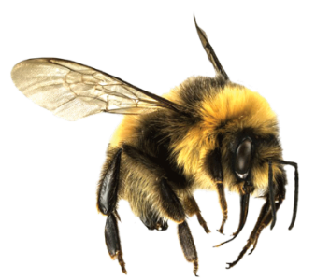
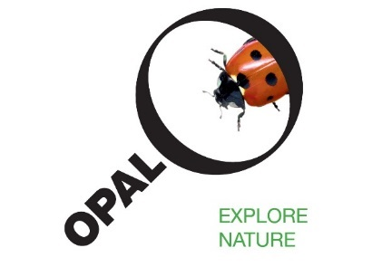
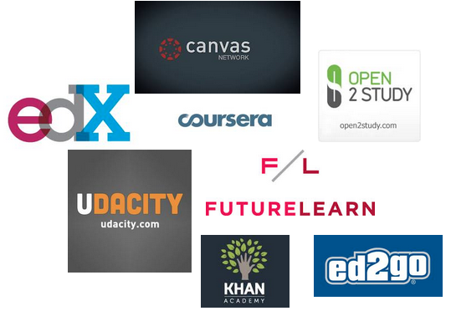
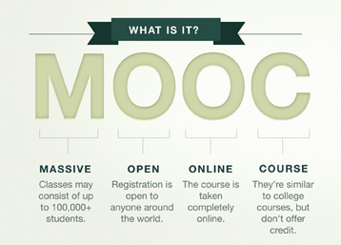
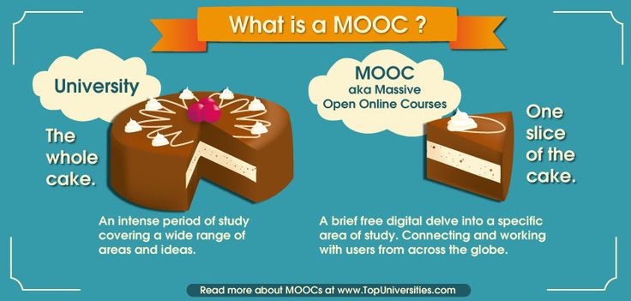
Science: Things to do!
There are loads of citizen science projects you can take part in either from the comfort of your bedroom, out and about, or when on holiday. Wikipedia does a comprehensive list of all the current projects taking place. Google ‘citizen science project’
Want to stand above the rest when it comes to UCAS? Now is the time to act.
MOOCs are online courses run by nearly all Universities. They are short FREE courses that you take part in. They are usually quite specialist, but aimed at the public, not the genius!
There are lots of websites that help you find a course, such as edX and Future learn.
You can take part in any course, but there are usually start and finish dates. They mostly involve taking part in web chats, watching videos and interactives.
Completing a MOOC will look great on your Personal statement and they are dead easy to take part in!

