Slide 1
GCSE Computer Science
Do you like?

Slide 2
GCSE Computer Science
What is Computer Science Anyway?

Slide 3
GCSE Computer Science
What is Computer Science Anyway?
Computer scientists design new software, solve computing problems and develop different ways to use technology.

Slide 4
GCSE Computer Science
What is Computer Science Anyway?
All computer scientists rely on ‘computational thinking’ – this involves looking at a problem and working out a way a computer might be able to help you solve it.

Slide 5
GCSE Computer Science
What will I do?
Learn about computer systems and hardware
Knowledge of network security
Develop computational thinking through coding
Problem solving
Write your own programs

Slide 6
GCSE Computer Science
Why choose Computer Science?
Computers are changing every part of our lives at an ever increasing rate – why not drive the future?
In this GCSE:
Experience programming and making new software
Find out how hackers attack computers
Discover how computers work
Solve logical problems

Slide 7
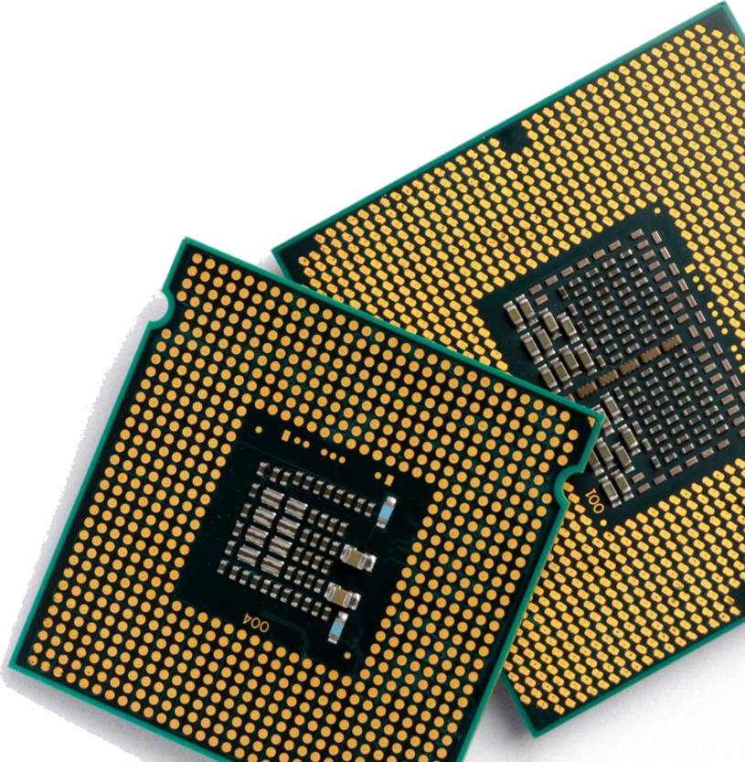
GCSE Computer Science
CPU Design
The brain of any computer is the CPU
The UK is a world leader of CPU design
Made by ARM, who are based in Cambridge
ARM chips are used in almost all mobile phones including iPhones
Are you the person who will design the next generation of devices?

Slide 8
GCSE Computer Science
Drones
Drones are already used for film making, search & rescue and surveying
In the future, deliveries to your house could be made by drone
They will need programmers to tell them where and when to go each day
Would you like to be a part of this future?

Slide 9
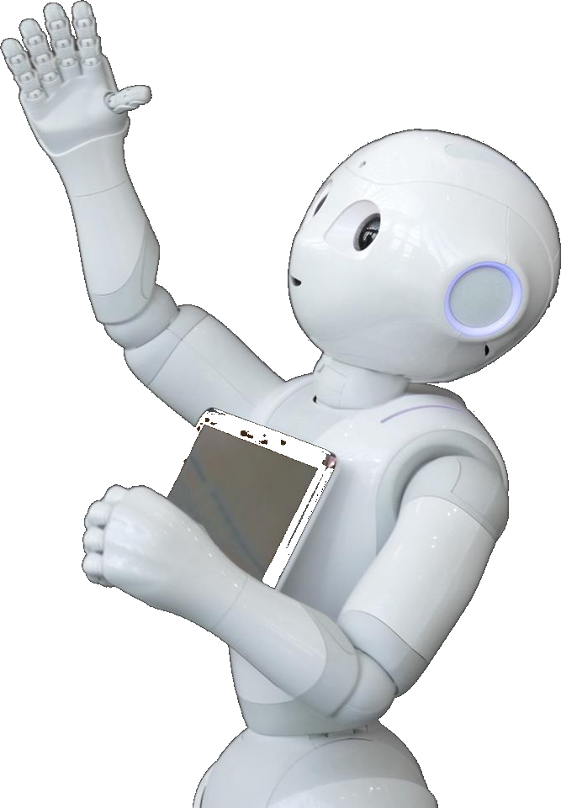
GCSE Computer Science
Robotics
We are finding more and more uses for robots
Robotic vacuums in the home
Car assembly
Clearing mines in a war zone
To make a robot you need to have
a good understanding of how computers
work and how to program them

Slide 10
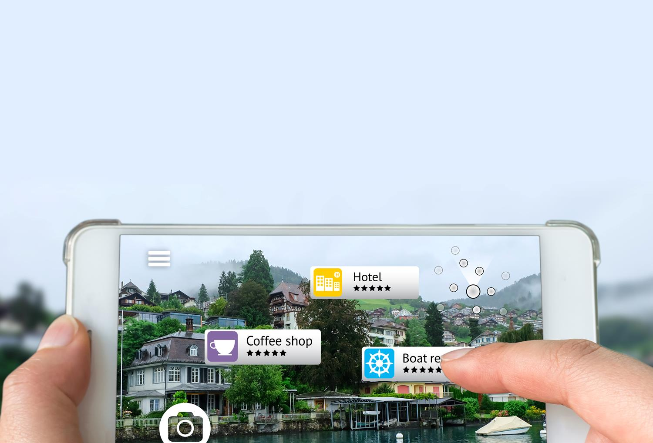
GCSE Computer Science
Augmented reality
By adding information to the world we can:
add reviews on shops and cafés as we see them
utilise a heads-up display when driving
or play Pokémon Go

Slide 11
GCSE Computer Science
Entrepreneurs and Start-Up
It took just three people to create Snapchat
Bobby Murphy was the programmer who coded the app
Within four years the software was sending six billion videos per day
Most entrepreneurs can’t imagine having made it without a knowledge of IT and Computer Science

Slide 12
GCSE Computer Science
A strong games industry
The UK is well known for its games development
The following were all made in the UK:
Grand Theft Auto (Edinburgh)
Elite Dangerous (Cambridge)
Candy Crush (London)
Batman: Arkham (London)
Sonic Forces (Leamington Spa)
Burnout Paradise (Guildford)

Slide 13
GCSE Computer Science
Course Content
The GCSE is assessed through two external exams
Each exam is worth 50%
There will be ample opportunity to program during the course
You will be given a programming task to complete, but the marks won’t count which takes the pressure off you as you code

Slide 14
GCSE Computer Science
Course Content
Unit 1 – Computer Systems (50%)
Unit 2 – Computational thinking, Algorithms & Programming (50%)

Slide 15
GCSE Computer Science
What will I learn?
This GCSE will equip you with a range of transferable practical and theoretical skills:
Programming skills in a modern language
An understanding of how computers and networks work
Knowledge of cyber-security and how hackers attack systems

Slide 16
GCSE Computer Science
Equip yourself for success
IT, programming and computer services have an ever-growing number of jobs in the UK
712,000
674,000
640,000
607,000
558,000
574,000
483,000
2011
2012
2013
2014
2015
2016
2017

Slide 17
GCSE Computer Science
Is this course right for me?
Are you curious about the digital world?
Do you like to find out about computer systems and security?
Do you like to code?
Can you think logically and outside of the box?

Slide 18
GCSE Computer Science
What do our students think of this course?
You get to learn fundamental skills which will benefit you in the future. You will build on your problem solving ability as well as working on computers
In today’s society most things are computer based. They change everyone’s life. You may as well try and understand them!

Slide 19
GCSE Computer Science
Big careers in…

Slide 20
GCSE Computer Science
What’s next?
If you want any more information about the course, or have any questions feel free to speak to any of the teachers in the department
Mr Gordon

