Slide 1

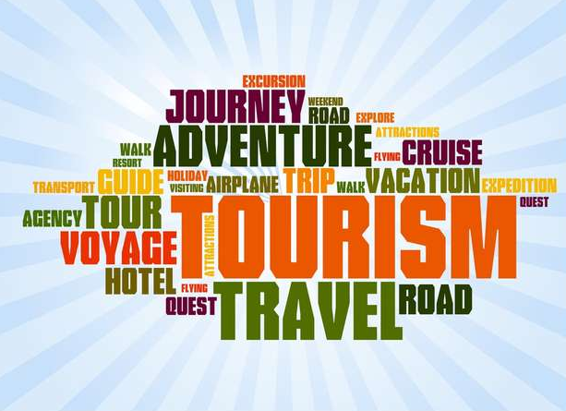
BTEC Travel and Tourism
DD
Do you
Enjoy?

Slide 2
What is it all about ?
DD
What’s not to like about seeing different travel destinations?
Meeting new people and helping them to experience new adventures!
Travel and tourism is one of the largest industries in the world & with more people travelling, It just keeps on growing.
There’s a wide variety of jobs so plenty of choice to find one you’ll love!

Slide 3
What will I do?
DD
Learn about different types of destinations
Knowledge of types of travel
Understand the needs of different visitors
Problem solving
Design your own holiday itineraries
Develop your mapping skills
Visit a travel and tourism organisation

Slide 4
What qualities do I need?
DD
If you enjoy helping others and have a friendly and enthusiastic personality a career in travel and tourism is a great option!
You will need to be good at problem solving, able to work well in a team and have a strong customer focus and excellent organisational skills.

Slide 5
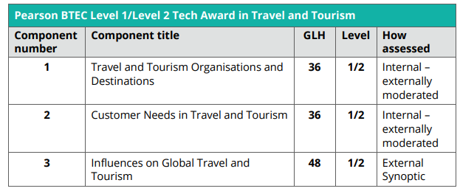
Course content
DD

Slide 6
INVESTIGATING Destinations
DDYou
You will investigate
Cities
Seaside resorts
Countryside areas.

Slide 7
INVESTIGATING Destinations
DDYou
You will consider factors that make the destination appealing;
Visitor attractions
Natural Features
Range of accommodation
Arts and entertainment
Sightseeing
Transport Links

Slide 8
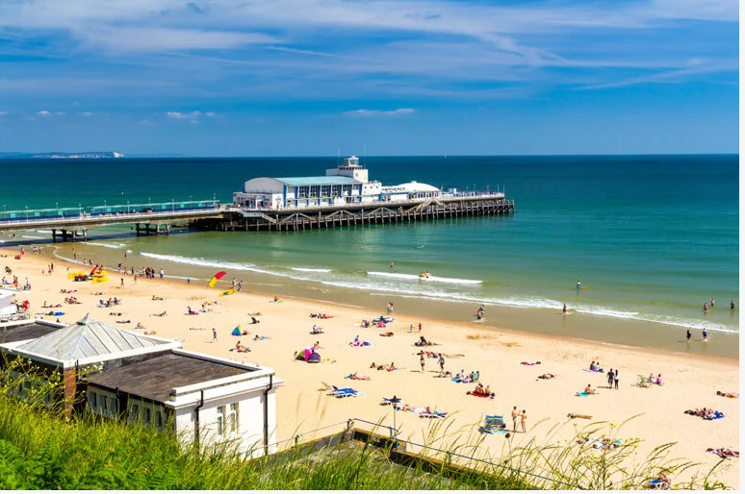
INVESTIGATING UK Destinations
DDYou
BOURNEMOUTH Beach has been voted the number 1 spot in the UK
Could you be responsible for marketing and promoting a destination, or selling holidays to clients to destinations such as Bournemouth?

Slide 9
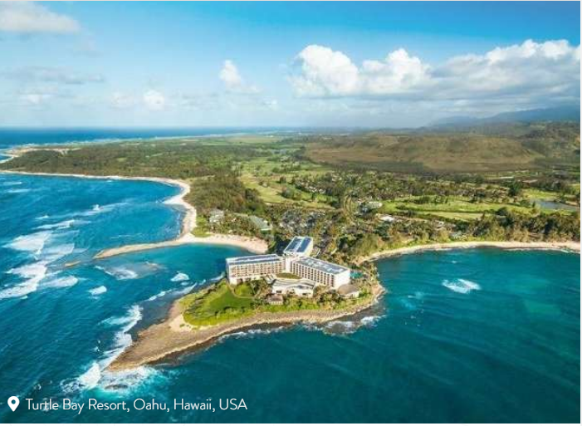
INTERNATIONAL Destinations
DDYou
Hawaii is the number 1 dream destination…………
Could you aspire to work for a major tour operator and design package holidays and itineraries, or tailor made holidays for clients?

Slide 10
Careers in travel and tourism
DD
Watch this video it shows a man who has booked a holiday with First Choice for him and his family.
You will see a range of different people carrying out jobs in the travel industry.
Travel and Tourism

Slide 11
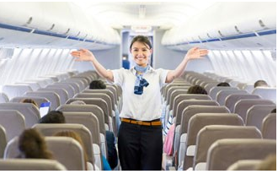

Careers in travel and tourism
DD
C
A
B
I
N
C
R
E
W

Slide 12

Careers in travel and tourism
DD
T
R
A
V
E
L
A
G
E
N
T

Slide 13
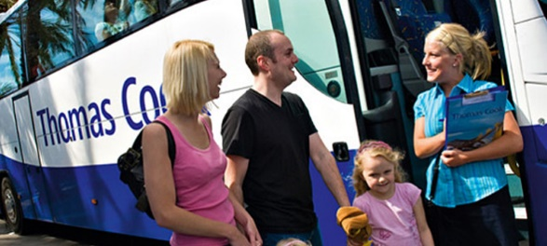
Careers in travel and tourism
DD
H
O
L
I
D
A
Y
R
E
P

Slide 14

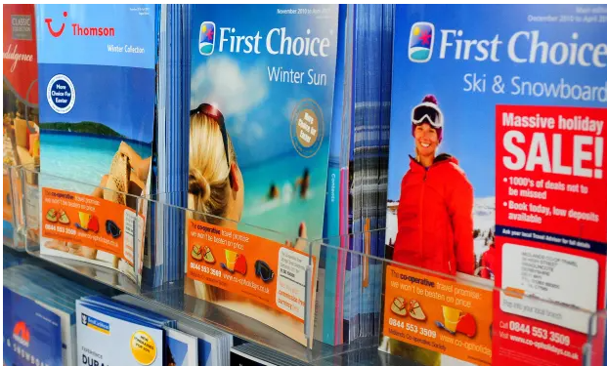
Careers in travel and tourism
DD
O
P
E
R
A
T
O
R
T
O
U
R

Slide 15
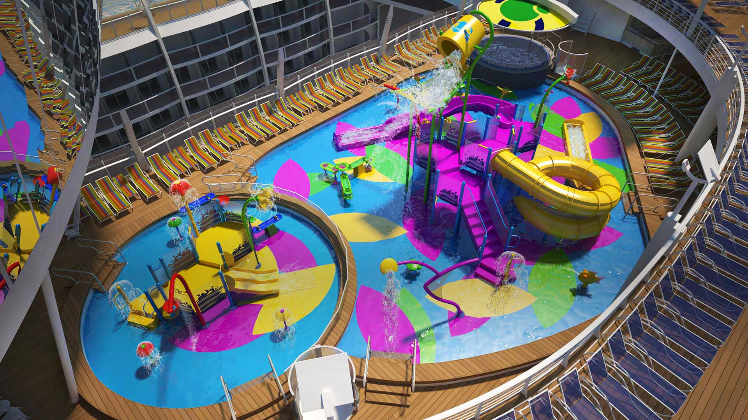
Careers in travel and tourism
DD
C
R
U
I
S
E
S
H
I
P

Slide 16
Is this course right for me?
DD
Are you curious about different places and cultures?
Do you like helping people?
Do you like to solve problems?
Are you good at planning and organising?

Slide 17

What Do Our Students Think?
DD
I really enjoyed this course as it was a new, interesting subject which gave me a good insight into different cultures & landmarks around the world. It also gave me good computer skills using Word & PowerPoint to display work,, which I have found to be useful especially now I am in sixth form.
I have developed the customer service skills that will help me with my ambitions to become a travel agent.

Slide 18
What Do Our Students Think?
DD
“My favourite part of the course was being able to study and research different countries across the world whilst looking into their cultures, seeing what they offer as a holiday destination and explaining how they would suit different types of visitors. I also loved making brochures on these destinations and creating a day to day itinerary for multiple customer types.” Libby Morgan

Slide 19
Next Steps…..
DD
If you would like any more information about the course, or have any questions feel free to speak to
Mrs McKenzie

